Slide 1
TIMS
2019
School Code
Replacement Database
This tool allows TIMS Staff to
Auto-Assign Students to Another School Code

Slide 2
School Code Replacement Database
During the summer, many LEAs will only hold classes at a few school locations, bringing students from multiple schools to a single building for summer classes.
This has historically caused problems in TIMS as students are not assigned to this building and tend to have a different school code during the regular school year.
The School Code Replacement Database allows TIMS Staff to change the student’s normal school code to a Summer School Code. With a list of Summer School Students and the building they are assigned to, TIMS Staff can now instantly change the school code for dozen, hundreds and even thousands of students at a time.
School Replacement Database

Slide 3
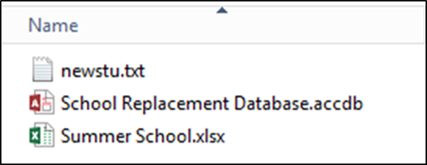
School Code Replacement Database
In order for the database to work correctly, TIMS Staff will need the following:
School Code Replacement Database
(typically located in the D:\School Replacement Database)
TIMS Extract from PowerSchool (newstu.txt)
Excel Spreadsheet of Students and their Summer School Assignments
School Replacement Database

Slide 4
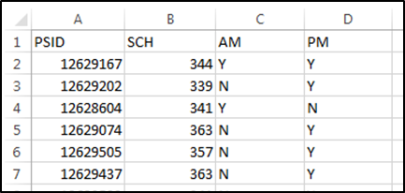
School Code Replacement Database
The Summer School Spreadsheet must contain the following columns:
Student PowerSchool ID (PSID)
Summer School Code (SCH)
The following columns are optional, but preferred for TIMS purposes:
AM Transportation Flag (AM)
PM Transportation Flag (PM)
School Replacement Database

Slide 5
School Code Replacement Database
Summer School Spreadsheet – Ridership Codes for AM and PM
If AM and PM Ridership Codes are collected, then TIMS Staff can quickly identify and easily display the students who have requested a bus ride to or from Summer School. This will help produce a much quicker turnover time when developing Summer School Routes.
Historically, TIMS Staff often receive a list of All Students enrolled in Summer School and have no idea which students need Summer Transportation. Please don’t let this happened in your LEA.
Speak to the Summer School Coordinator. While it is good for TIMS to know which students are in Summer School, it is more important for TIMS Staff to know which Summer Students require School Bus Transportation.
School Replacement Database

Slide 6
School Code Replacement Database
The TIMS Extract from PowerSchool (newstu.txt) contains the Student ID, the regular School Code for the Student and, if being used, the Y’s and N’s for AM and PM Ridership as entered on the Student Transportation Page of PowerSchool.
The School Replacement Database will read the information for each student in the Summer School Spreadsheet and update\replace their regular School Code and regular AM\PM Ridership Codes within the TIMS Extract and produce an updated newstu.txt file.
Staff then use this updated NewStu File during UPSTU into SS Data.
Student ID School Code AM PM
School Replacement Database

Slide 7
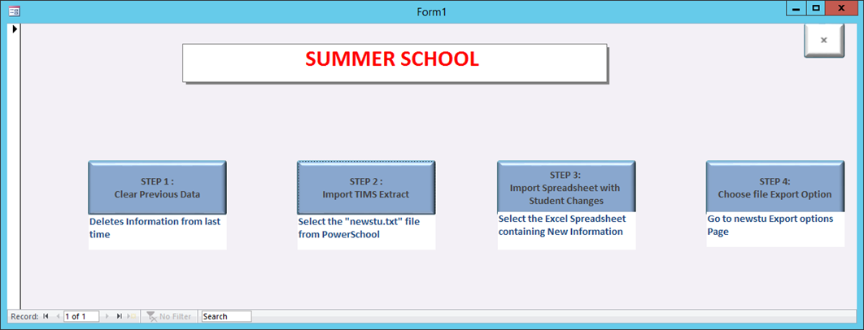
School Code Replacement Database
Instructions for Using the School Replacement Database
After opening the Database (typically located in the D:\School Replacement Database folder
Clear Previous Data
Import TIMS Extract
Import Student Spreadsheet
Choose Export Option
School Replacement Database

Slide 8
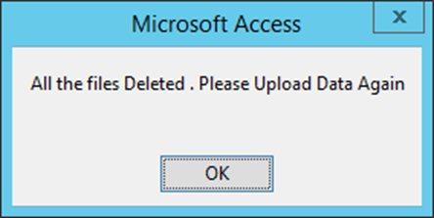
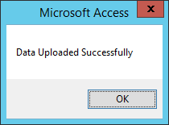
School Code Replacement Database
Instructions for Using the School Replacement Database
Click the Step 1 Button to Clear Previous Data
Click the Step 2 Button.
Then browse to and select the most recent TIMS Extract
Click the Step 3 Button.
Then browse to and select the Excel Spreadsheet
After Importing the NewStu.txt and Excel Spreadsheet;
Click the Step 4 Button to visit the Export Options Page
You may need to view All Files to see
Different versions of Excel Spreadsheets.

Slide 9
School Code Replacement Database
There are two options for Exporting the Updated Student Information into an UpStu File.
Option 1: All Students Export (Recommended)
This option produces a complete TIMS Extract containing all students with and without changes to their School Code and Ridership Codes.
Option 2: Changed Students Export Only
This option produces a TIMS Extract containing only the students that were listed in the Excel Spreadsheet. All other students (non-summer) would not be included in the TIMS Extract.
The All Students Export is recommended as operators may need all students within the TIMS Summer School Dataset in case assignments change and more students are added to the Summer Program at the last minute.

Slide 10
School Code Replacement Database
Export Option 1:
All Students Export will create a file named FullNewStu.txt in the same folder as the School Replacement Database
Export Option 2:
Changed Students Export will create a file name PartialNewStu.txt in the same folder as the School Replacement Database.
TIMS Staff then take this Text File and use it to UPSTU into the TIMS Summer School Dataset.
Rename the file to newstu.dat and place in it TIMS Database used for Summer School
Example: ELT\SS\Server\Export
After then completing an UPSTU, all students will now be assigned to their Summer School Code as listed in the Excel Spreadsheet.

Slide 11
TIMS
2019
School Code
Replacement Database
This tool allows TIMS Staff to
Auto-Assign Students to Another School Code

