Slide 1
TIMS Webinar
2016
Railroad Crossing Update

Slide 2

TIMS Webinar
2016 Railroad Crossing Update
Railroad Crossing Update
  Overview of Railroad Crossings in TIMS
  Driver Directions & Student Safety
  Total Students passing over each Railroad Crossing
  Updated Railroad Crossing IDs from NCDOT
TIMS Tasks
  Verify Railroad Crossings are correctly built in MARIS
  Document Crossing Nodes on LEA Railroad Spreadsheet
  Create/Edit Railroad Crossings as needed
  Update RRCRS File in TIMS

Slide 3
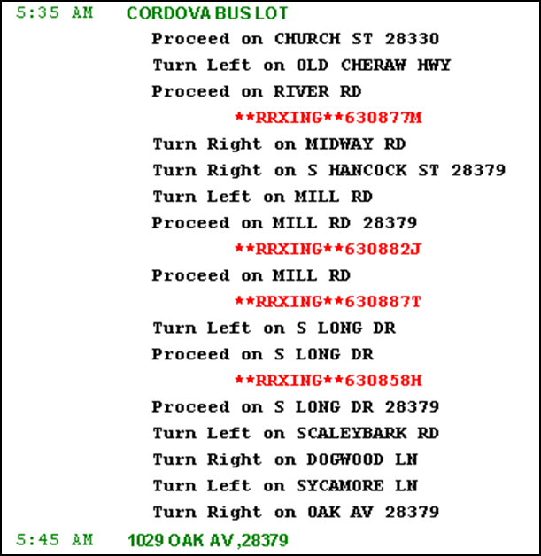
TIMS Webinar
2016 Railroad Crossing Update
Overview of Railroad Crossings in TIMS
TIMS has the capability for LEAs to document various driving hazards, including Railroad Crossings, in the TIMS Geocode. Documenting Hazards in your LEA helps promote student safety by informing Bus Drivers of an upcoming sharp turn, blind curve or Railroad Crossing along the Bus Route.
In addition to documenting hazards in Driver Directions, TIMS Railroad Crossing Data is shared annually with the Rail Division of NCDOT. As part of TDTIMS each year, LEAs submit a summary of each Railroad Crossing in TIMS.
TIMS Support Staff then tally this data each year and inform NCDOT how many students go over each Railroad Crossing per day. The Rail Division of NCDOT uses this data to help prioritize annual Railroad Crossing Inspections, Closures, Paving and Upgrades.

Slide 4
TIMS Webinar
2016 Railroad Crossing Update
Overview of 2016 Railroad Crossing Update
Over the last few years, the Rail Division of NCDOT has noticed irregularities with the TIMS Data they received. After trying to determine the reason for the data errors, it was discovered that some LEAs do not have all of the correct Railroad Crossings IDs in TIMS. Also, many railroad crossings have been closed, paved or privatized over the years and these changes had not been shared with School Transportation Departments.
As a result of our collaboration with NCDOT, the Rail Division has provided updated Railroad Maps and a list of all Public and Private Railroad Crossings in each county. In addition to the opening and closing of Railroad Crossings throughout the state, NCDOT has also renamed a lot of Railroad Crossings IDs within each county.
As a result of the changes by the Rail Division of NCDOT, each LEA must now review, verify and correct all Railroad Crossings present in TIMS.
Updates to TIMS Railroad Crossings must be completed before submitting 2016-2017 TDTIMS.
TDTIMS is due by November 1st, 2016.

Slide 5
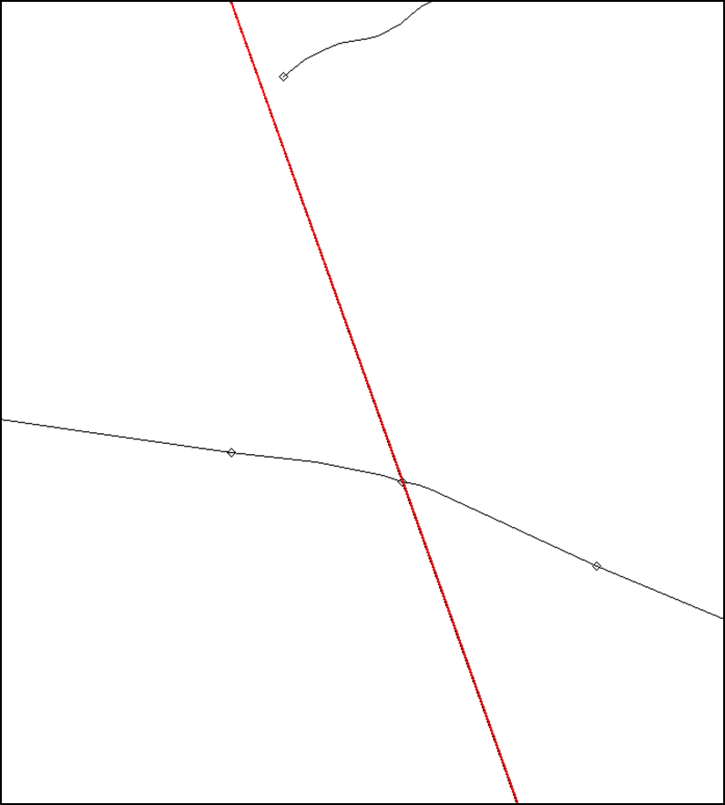
TIMS Webinar
2016 Railroad Crossing Update
How Railroad Crossings Look in MARIS
In order to correctly create Railroad Crossings in TIMS, the street the bus travels must be split into two segments, one that ends at the Railroad Crossing and one that begins at the Railroad Crossing.
We will use the three Nodes that create the beginning and end of two segments to create the rules for the Railroad Crossing in TIMS.
In MARIS, you will need to split the street at three places…
Before the Crossing (Node 1)
At the Crossing (Node 2)
After the Crossing (Node 3)
Node 1
Node 2
Node 3

Slide 6
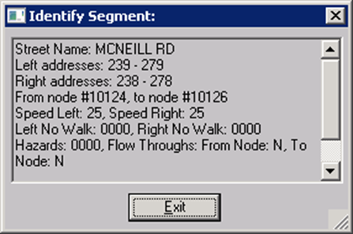
TIMS Webinar
2016 Railroad Crossing Update
How TIMS uses Railroad Crossings created in MARIS
Like most things in TIMS, Railroad Crossing information is connected to the Node Parings for a specific segment. So between Node 1 and Node 2, the system knows there is a Street Name, Addressing and Speed for this segment. Same thing for the segment from Node 2 to Node 3.
The Railroad Crossings in TIMS are based on Run Directions and the Bus traveling a certain segment. So if the bus is driving from left to right on the map below, the system sees the Bus as travelling from Node 1 to Node 2 and then from Node 2 to Node 3, and so forth on down the street.
Railroad Crossing commands are also based on traveling a certain segment.
Rules need to be created saying that as the Bus travels from Node 1 to Node 2, insert “RAILROAD WARNING”.
Or as the Bus travels from Node 3 to Node 2, insert “RAILROAD WARNING”
Node 1
Node 2
Node 3

Slide 7
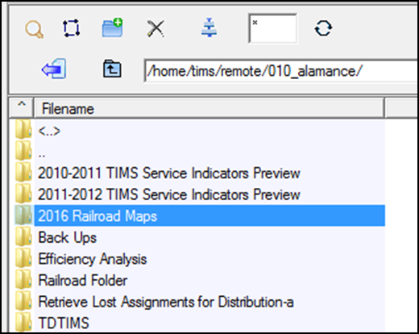
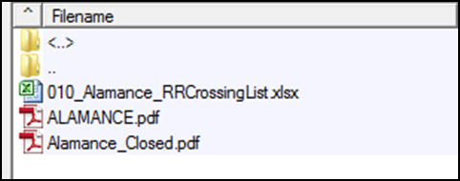
TIMS Webinar
2016 Railroad Crossing Update
TIMS Tasks
Within your LEA Folder on CoreFTP, there are files to assist you in reviewing, verifying, editing and creating Railroad Crossings in TIMS.
Inside the 2016 Railroad Maps folder are the following documents.
  RR Crossing List Excel Spreadsheet
  County Open Railroad Crossing PDF
  County Closed Railroad Crossing PDF

Slide 8
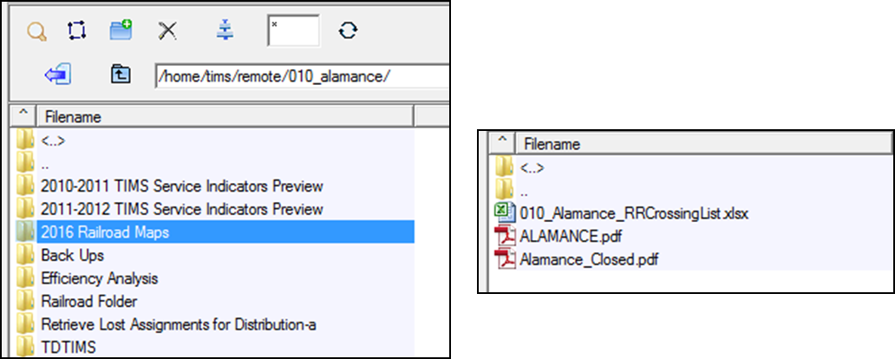
TIMS Webinar
2016 Railroad Crossing Update
Reviewing, Verifying and Creating Railroad Crossings in MARIS
The first step in checking that your Railroad Crossings are correct is to download the files inside the 2016 Railroad Maps folder from your LEA CoreFTP Site.
You can move these files to the TIMS Server or to your Office Computer so they can be easily accessed.
If you have two monitors, moving the files to your Office Computer will allow you to open the maps and spreadsheet on one screen while keeping TIMS open on the other screen.

Slide 9
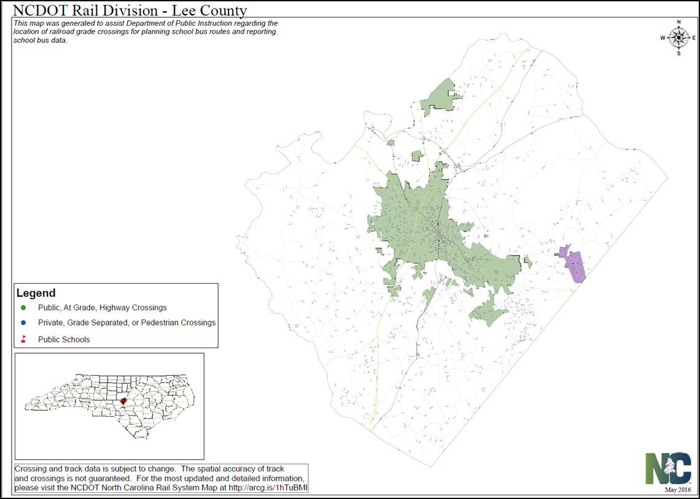
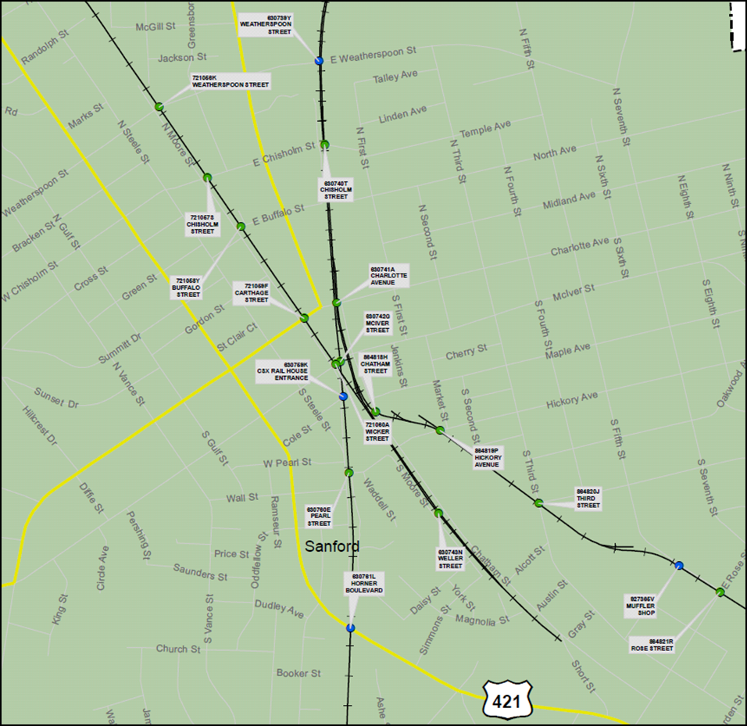
TIMS Webinar
2016 Railroad Crossing Update
Overview of Railroad Maps from NCDOT Rail Division
The Rail Division of NCDOT has created County Maps displaying the Crossing Location and the Crossing ID for each open Railroad Crossing in your county.
This map displays Public Crossings (in green) and Private Crossings (in blue).

Slide 10
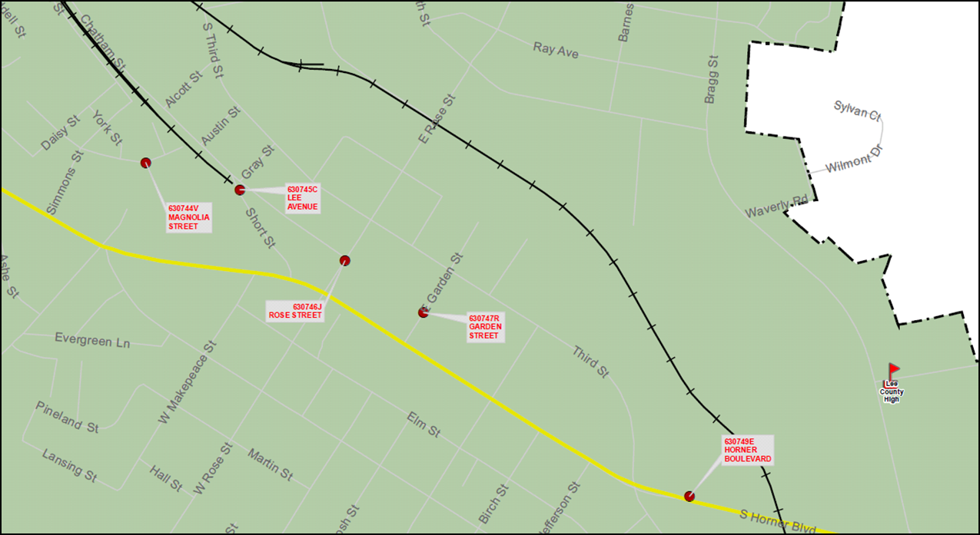
TIMS Webinar
2016 Railroad Crossing Update
Overview of Railroad Maps from NCDOT Rail Division
The Rail Division of NCDOT has also provided a map of Closed Railroad Crossings. These crossings have been paved over and/or the tracks removed completely. Since these crossing no longer exist, LEAs should review each of these to ensure they are no longer present in TIMS.
This map displays the Closed Crossings in Red.

Slide 11
TIMS Webinar
2016 Railroad Crossing Update
Overview of RR Crossing List Spreadsheet
The Rail Division of NCDOT has provided a spreadsheet listing of each Open Railroad Crossing in your county that needs to be documented. The spreadsheet contains the following information.
Crossing Number (some may have been changed)
Street (where crossing is located)
City (where crossing is located)
Crossing Type (Public or Private)
School Bus Node (most recently reported by TIMS Data)
Each Public Railroad Crossing Number in the spreadsheet needs to be reviewed, verified, corrected or created in TIMS and coded with the correct NCDOT Crossing Number - RRX 721050U
As for the Private Crossings, some of your Buses may be traveling over these (for special needs students or to transport students to a place of business). You will want to review each of these to determine if they need to be created in TIMS. If so, you do not need to use the NCDOT Private Crossing Number for these, but rather code them as RRX PRIVATE.

Slide 12
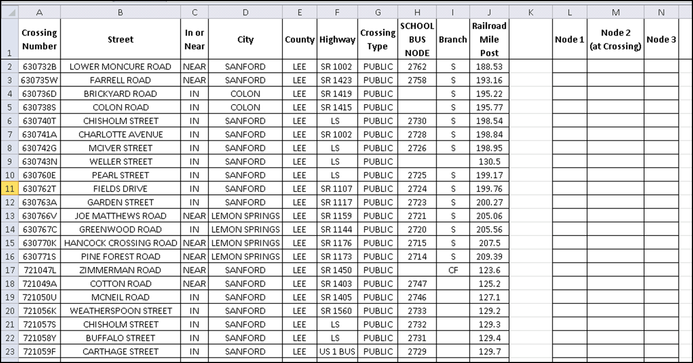
TIMS Webinar
2016 Railroad Crossing Update
Overview of RR Crossing List Spreadsheet
To help with verifying each of the Railroad Crossings, we have added three columns to the end of spreadsheet so you can quickly document the 3 Node Numbers at each Railroad Crossing.

Slide 13


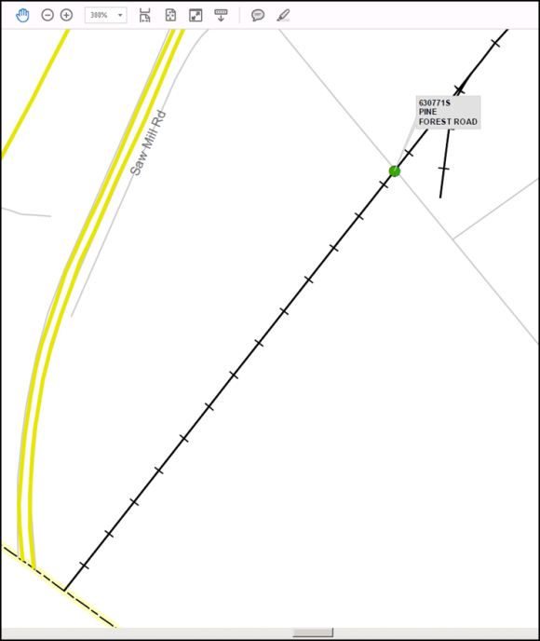
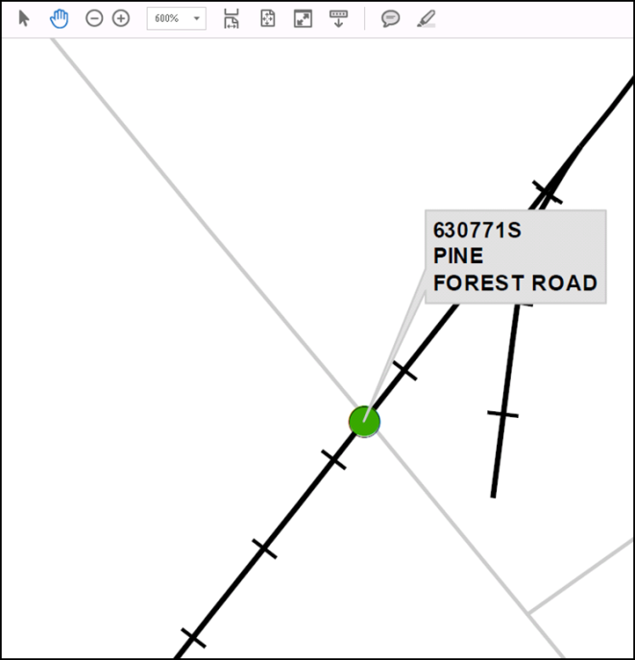
TIMS Webinar
2016 Railroad Crossing Update
Reviewing, Verifying and Creating Railroad Crossings in MARIS
After downloading the Railroad Maps and Spreadsheet from CoreFTP, open the Railroad Crossing Map and take a look.
Start by finding where a Railroad begins at the edge of your county, Zoom In on the map as needed and then follow the track using the Pan Tool , looking for Railroad Crossings.

Slide 14
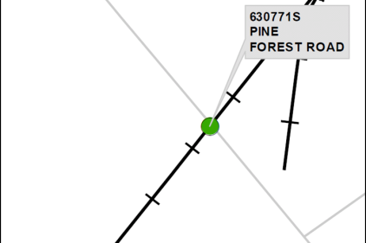
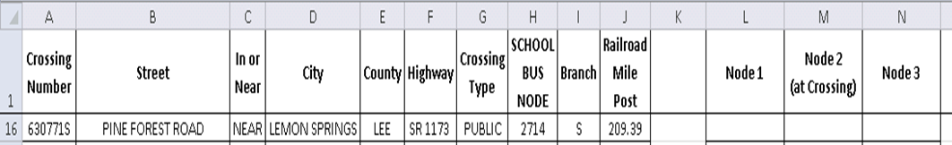
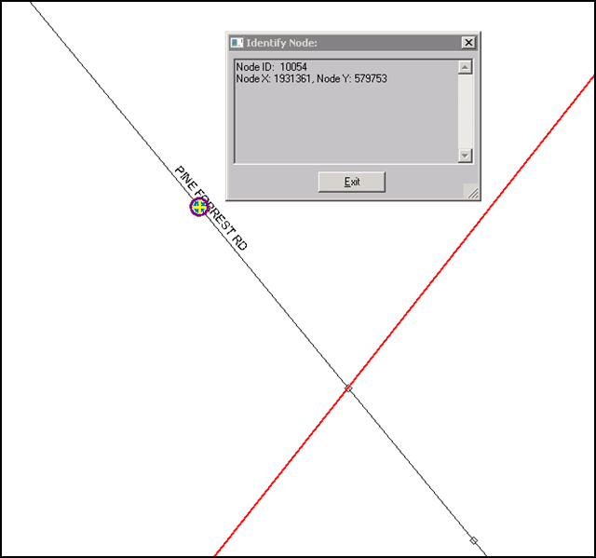
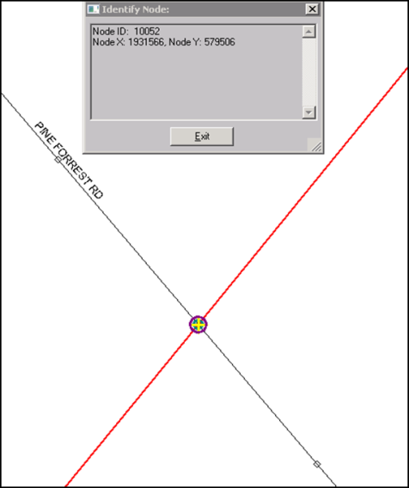
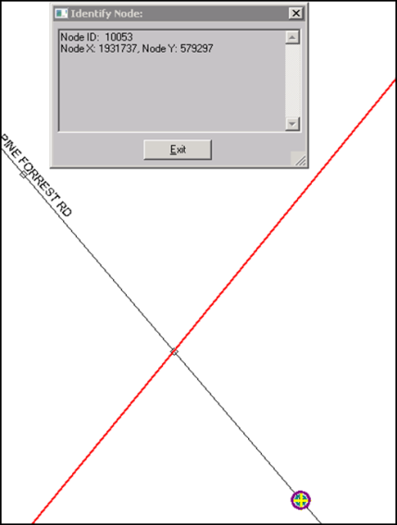
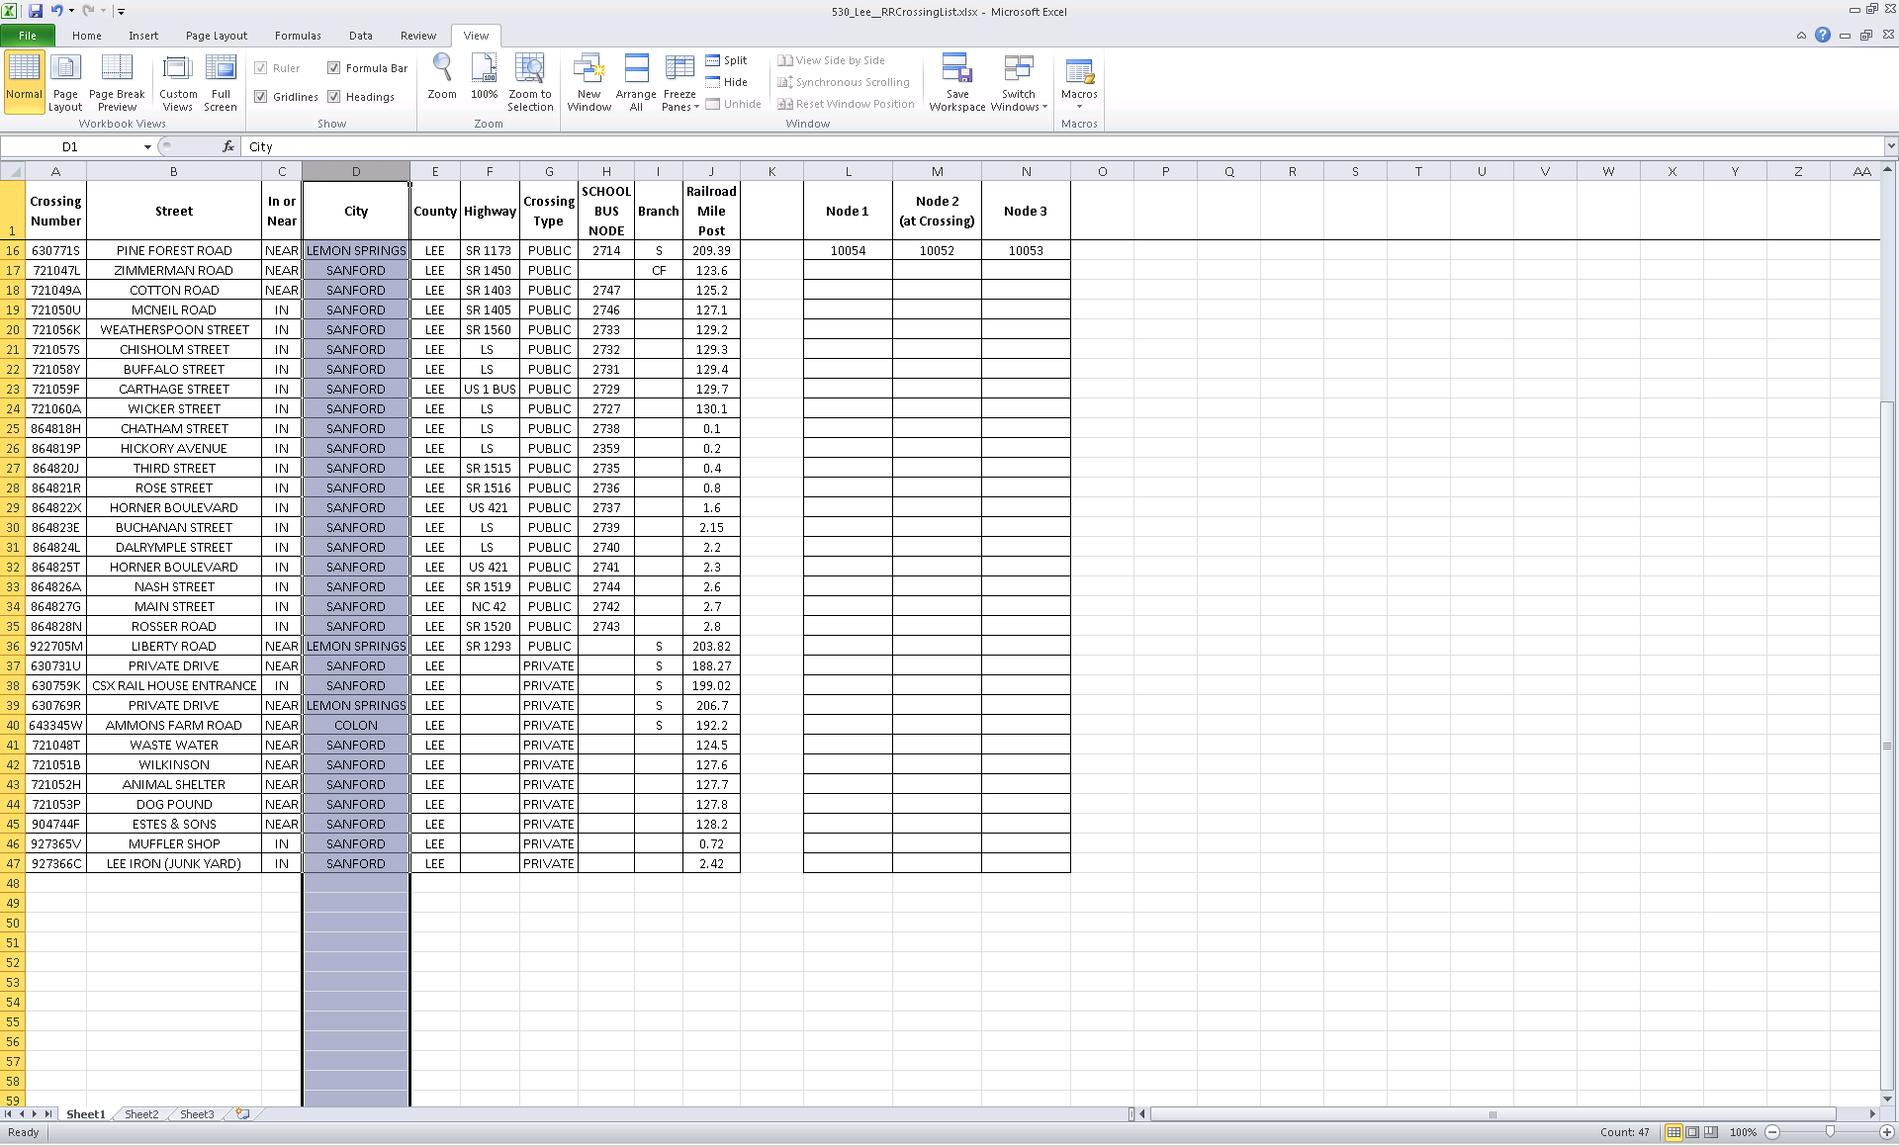
TIMS Webinar
2016 Railroad Crossing Update
Reviewing, Verifying and Creating Railroad Crossings in MARIS
When you come to a Railroad Crossing, find the corresponding Crossing ID on the Spreadsheet.
Then, in MARIS, find the location of the Railroad Crossing and identify the Node Numbers before the crossing, at the crossing and after the crossing. Document the 3 Nodes in the Spreadsheet.

Slide 15
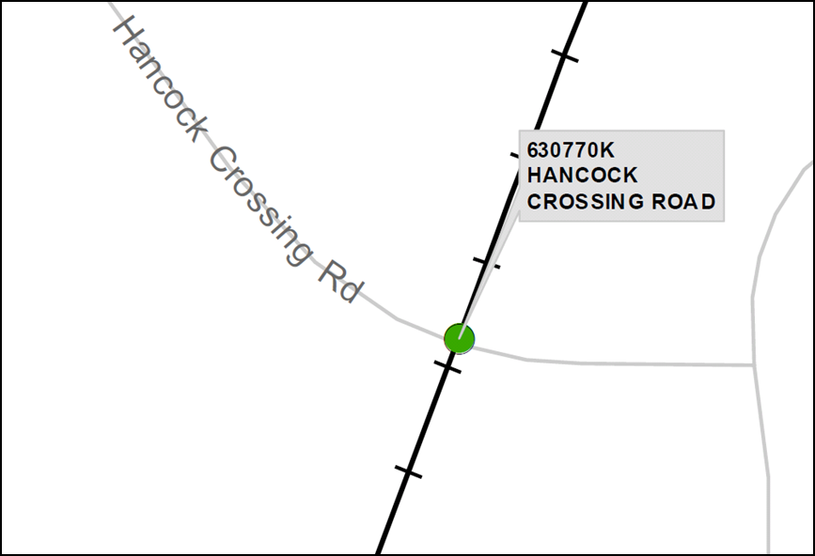
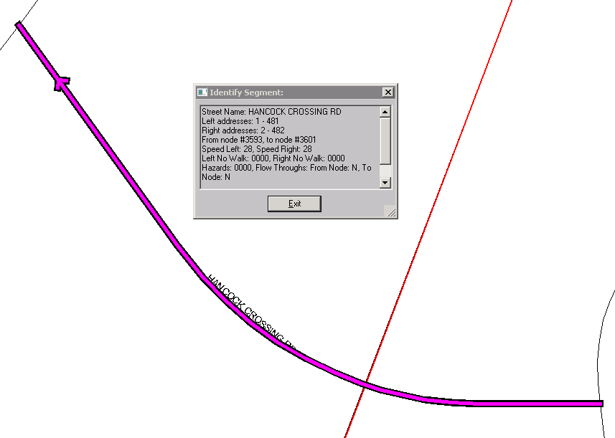
TIMS Webinar
2016 Railroad Crossing Update
Reviewing, Verifying and Creating Railroad Crossings in MARIS
If the Street in MARIS is not already split, or is not split correctly (Before, At, and After the Crossing), then you will need to split the street correctly in MARIS.
NOTE: Do Not Split the Railroad in MARIS or Connect the Railroad to the Street Network. You only need to split the street the bus travels.
This crossing is not in MARIS and needs to be created.

Slide 16
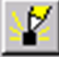
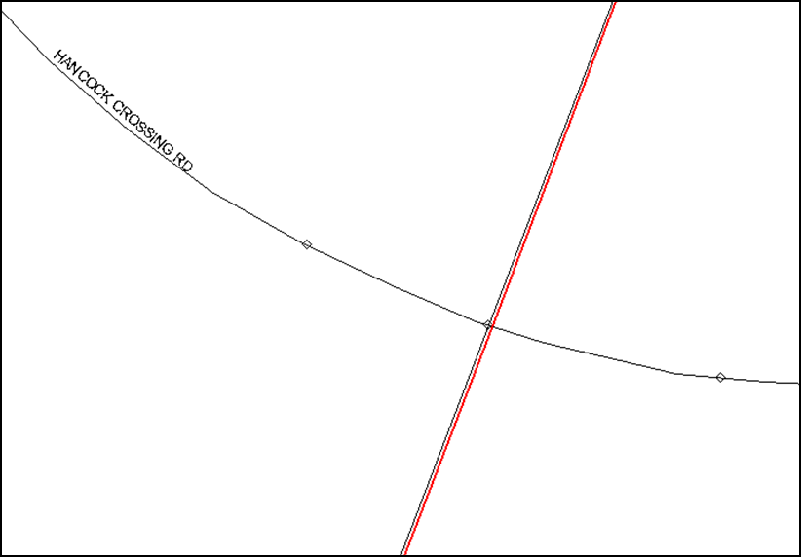

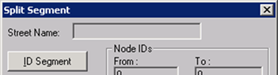

TIMS Webinar
2016 Railroad Crossing Update
Reviewing, Verifying and Creating Railroad Crossings in MARIS
To Create a New Railroad Crossing in MARIS, Add the 3 Nodes needed at the crossing location.
1 Node Before the Crossing - 1 Node At The Crossing - 1 Node After the Crossing
Add Node
Split Segment
Then, using the Split Segment Tool, Identify the Segment and Split the Segment at each of the
3 Nodes you just added.
Hint: Since you added the nodes first, choose “Old Node” when identifying where you want to split the segment.

Slide 17
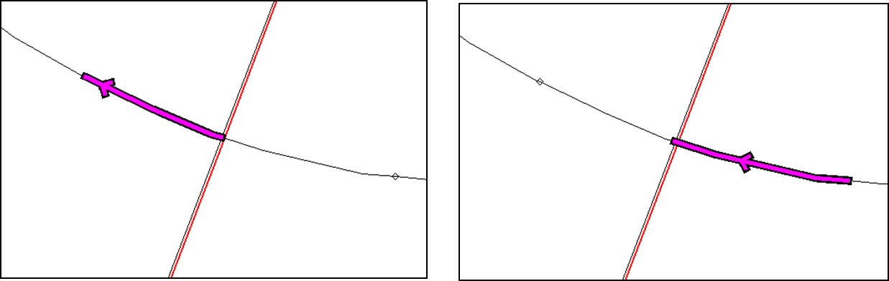
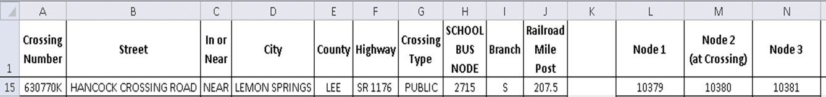
TIMS Webinar
2016 Railroad Crossing Update
Reviewing, Verifying and Creating Railroad Crossings in MARIS
When you are finished splitting the segment at the crossing, check your work by identifying each of the new segments and the 3 Node Numbers that create the Railroad Crossing.
Add the 3 Node Numbers the Crossing Spreadsheet.
Continue following the Railroad until you Verify, Correct or Create each
Railroad Crossing in MARIS. Be sure to enter the Node Numbers for each
Public Crossing ID in the Spreadsheet.

Slide 18
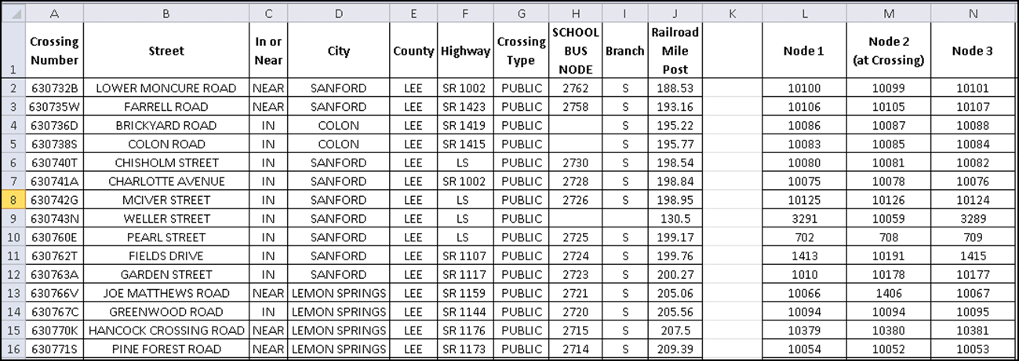
TIMS Webinar
2016 Railroad Crossing Update
Reviewing, Verifying and Creating Railroad Crossings in MARIS
When you are finished Verifying, Correcting or Creating each of the Railroad Crossings, you should have Node Numbers for each of the Public Crossings listed in the Spreadsheet.
Remember to review the Private Crossings and Verify, Correct or Create any of the
Private Crossings your Buses may be travelling over.

Slide 19
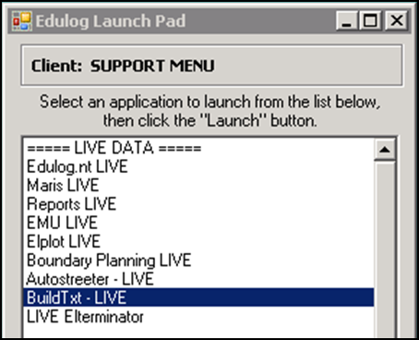
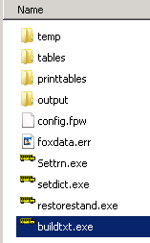
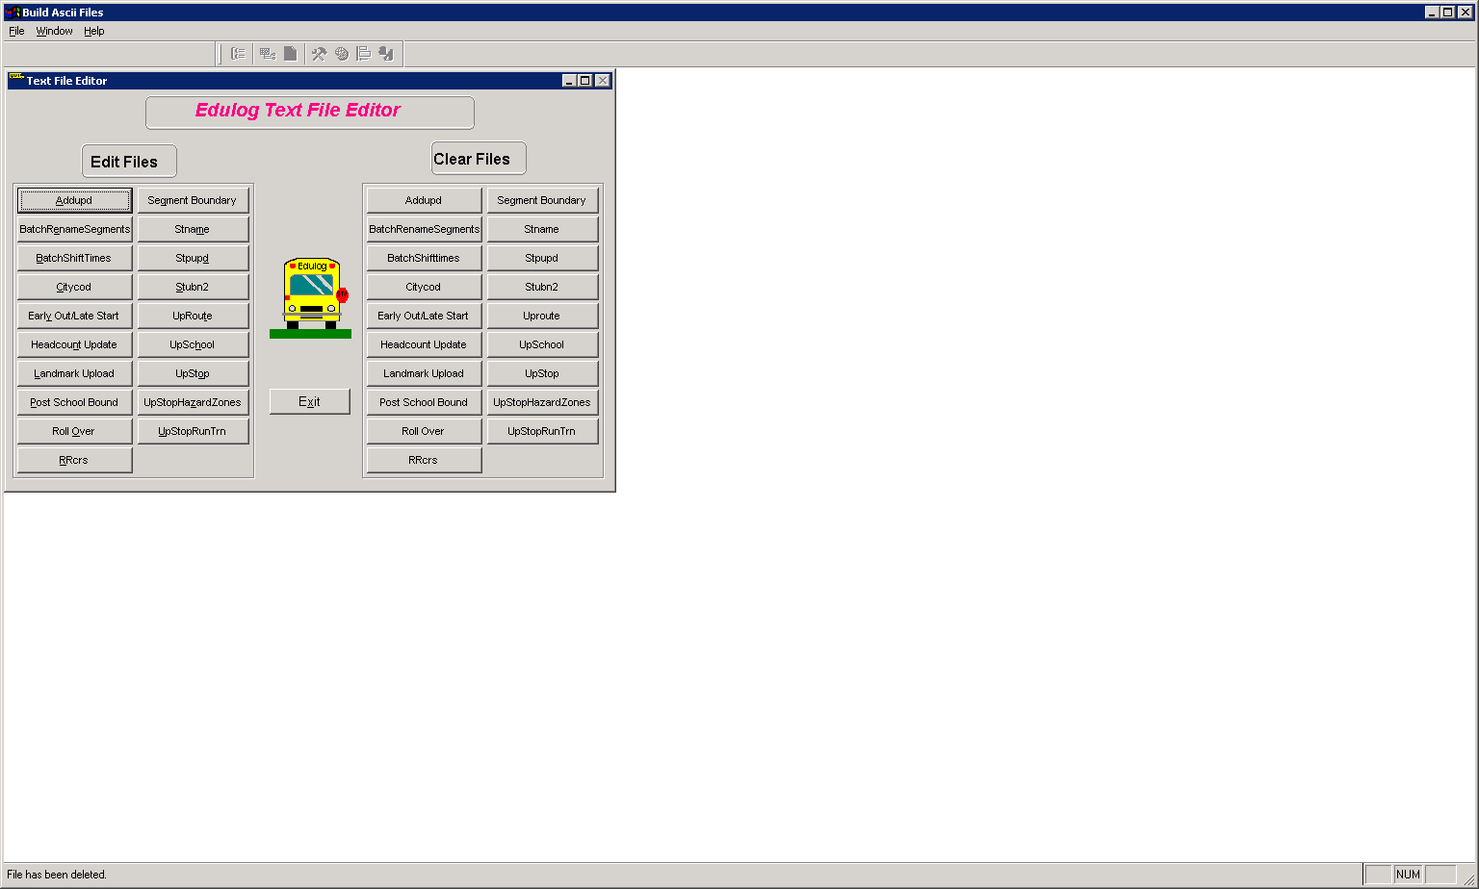
TIMS Webinar
2016 Railroad Crossing Update
TIMS Tasks – Updating the RRCRS File in TIMS
Now that you have Reviewed, Verified, Corrected or Created each of your Railroad Crossings in MARIS, you are now ready to Review, Verify, Correct or Create the rules for each Railroad Crossing in the BUILD TEXT Module of TIMS.
Depending on your Server Setup, there may be a link to BuildTxt –LIVE on your LaunchPad.
If it is not on your LaunchPad, you can browse to the ELT>Database>Report folder
on the TIMS Server and look for the buildtxt.exe link. Double-Click the link to open Build Text

Slide 20
TIMS Webinar
2016 Railroad Crossing Update
Updating the RRCRS File in TIMS
TIMS-NT vs TIMS- SQL
The Build Text Module for SQL looks slightly different than the following screenshots, although the same methods for creating, editing or deleting a records are the same. Also, the procedures for Importing and Exporting in Build Text SQL are slightly different.
For SQL, the RRCRS commands are automatically stored in the SQL Database, so you will not need to Clear the File and Import before beginning. As you add, edit and remove records, these changes will automatically be saved in TIMS.
For SQL Sites who have reviewed all of their Crossings in MARIS and are ready to begin reviewing the Build Text commands, please contact your TIMS Project Leader to get you started on this process.
Checking the Crossings in MARIS and documenting the correct Node Numbers will be the most time consuming task for the Railroad Update, so please reach back out to us when you are ready to update the data in Build Text.

Slide 21
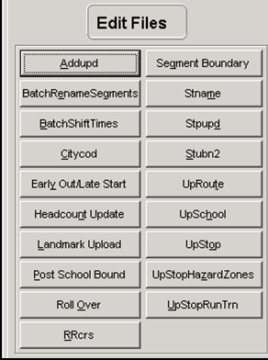
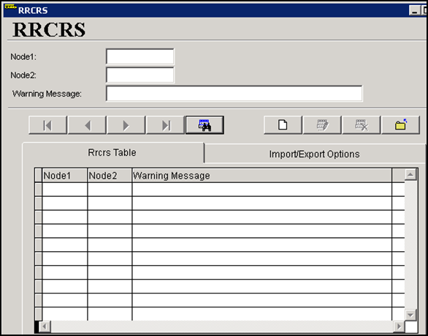
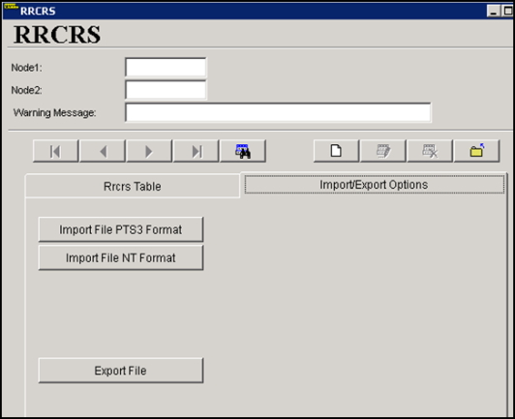
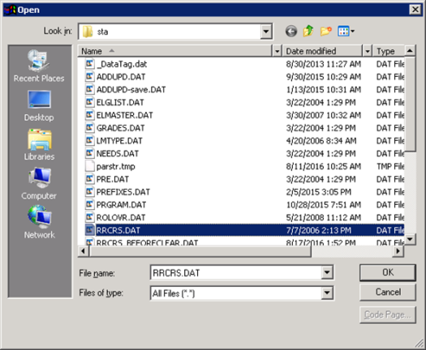
TIMS Webinar
2016 Railroad Crossing Update
Updating the RRCRS File in TIMS
After opening Build Text, the first Step is to Clear the RRCRS File. On the right, under Clear Files, select RRCRS and choose OK that you want to clear the RRCRS File.
Then on the left, select RRCRS.
Click on the Import\Export Options Tab
Choose Import NT File
Browse to ELT\Database\Server\STA and select the RRCRS.DAT File
This will populate Build Text with your current
Railroad Crossing Rules and Commands

Slide 22
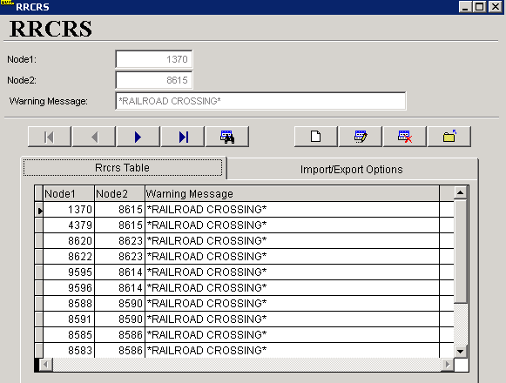
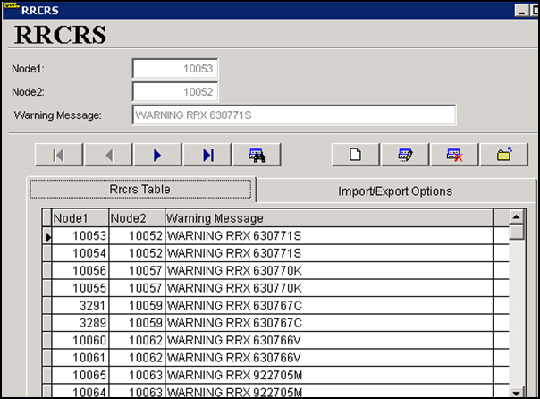
TIMS Webinar
2016 Railroad Crossing Update
Updating the RRCRS File in TIMS
After importing the RRCRS.DAT File into Build Text, select the RRCRS Table Tab and view your current Railroad Crossing commands. Below are two example files.
This LEA does not have any of the NCDOT Crossing IDs listed in the file. Their warnings only say “Railroad Crossing”
This LEA does have the NCDOT Crossing IDs listed in the file. Their warnings include the ID
“Warning RRX 630771S”

Slide 23
TIMS Webinar
2016 Railroad Crossing Update
Updating the RRCRS File in TIMS
The naming method for entering Railroad Crossing Warnings in Build Text varies by LEA. Below are a few examples of how LEAs identify a Railroad Crossing.
  RRX 621050R
  RR XING 621050R
  RR CRSG 621050R
  WARNING RRX 621050R
  **RRX** 621050R
  **RAILROAD ** 621050R
LEAs are free to use whatever abbreviation or warning message they prefer. However, for all Public Railroad Crossings, the last thing in the warning message must be the NCDOT Public Crossing ID.
For Private Railroad Crossings you decided should be included in TIMS, please replace the NCDOT Crossing ID with the word PRIVATE. Below are a few examples for Private Crossings.
  RRX PRIVATE
  RR XING PRIVATE
  **RRX** PRIVATE

Slide 24
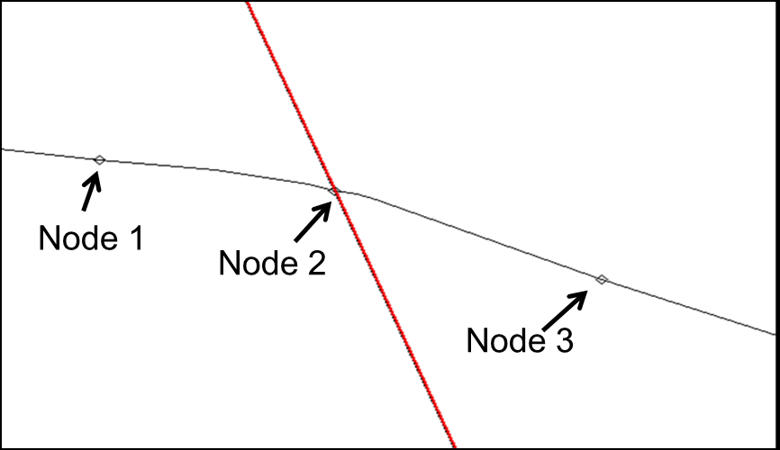
TIMS Webinar
2016 Railroad Crossing Update
Updating the RRCRS File in TIMS
Depending on the accuracy of your current RRCRS File, some of your Railroad Crossings may be correct, while others may need to be Edited, some new Crossings Created and Closed Crossings removed.
Most Crossing IDs will have two listings in the RRCRS File.
The first for when you are traveling one direction on the street (Node 1 to Node 2).
And the second for when you are traveling the other direction on the street (Node 3 to Node 2).
If there is a Railroad Crossing at a 3-Way or 4-Way Intersection, you may have
6 to 8 or even more such listings for a single Crossing ID. Be sure to think
through all of the possible ways a bus could cross a track in these areas.

Slide 25
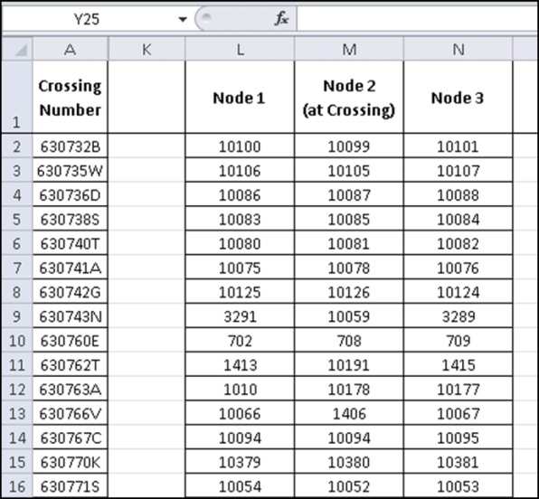
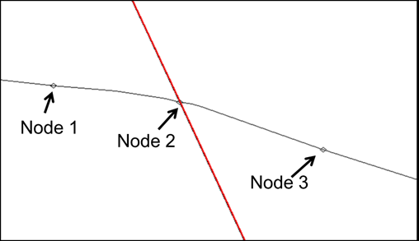
TIMS Webinar
2016 Railroad Crossing Update
Updating the RRCRS File in TIMS
The commands for Railroad Crossings are based on the direction of travel from the first Node the Bus reaches to the second Node the Bus reaches. Below are both examples for each Crossing.
Node 1 Node 2 Warning Message
10099 RRX 630732B (From Node 1 to Node 2)
10101 10099 RRX 630732B (From Node 3 to Node 2)
Node 1 Node 2 Warning Message
10106 10105 RRX 630735W (From Node 1 to Node 2)
10107 10105 RRX 630735W (From Node 3 to Node 2)
Please note how there are two listings for each Crossing ID.
One for each direction the Bus could cross the tracks.

Slide 26
TIMS Webinar
2016 Railroad Crossing Update
Updating the RRCRS File in TIMS
After opening the RRCRS.DAT File into Build Text, select the RRCRS Table Tab and view your current Railroad Crossing commands.
Now you need to review each listing in Build Text and Verify, Correct or Create each of the
Railroad Crossing commands. Use the completed spreadsheet to make sure the commands contain the correct MARIS Nodes and the correct NCDOT Crossing ID.
Remember, some of Crossing IDs have been changed by NCDOT.
So pay close attention as you review and edit this file.

Slide 27

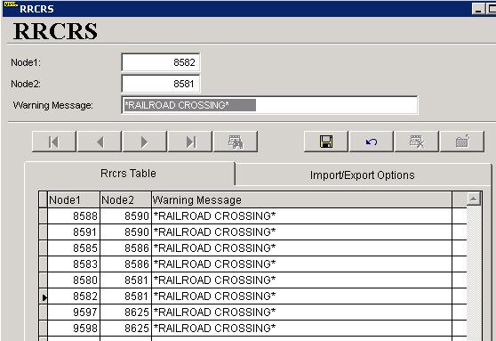

TIMS Webinar
2016 Railroad Crossing Update
Updating the RRCRS File in TIMS
If Node 1 and Node 2 are listed correctly and the Crossing ID has not been changed by NCDOT, then move on to the next crossing in the list.
I suggest highlighting the Crossing ID in the spreadsheet as you verify, correct or create each listing in Build Text so you can keep track of which ones have been completed.
If the Nodes or Crossing ID are incorrect, then you will need to Edit the current command rules.
Use the Edit Record Button to enable editing of the command.
After selecting Edit Record, you can now Edit data in
the Node 1, Node 2 and the Warning Message section at
the top of Build Text.
When finished, select the Add\Save Record Button
to save your changes to this listing.

Slide 28

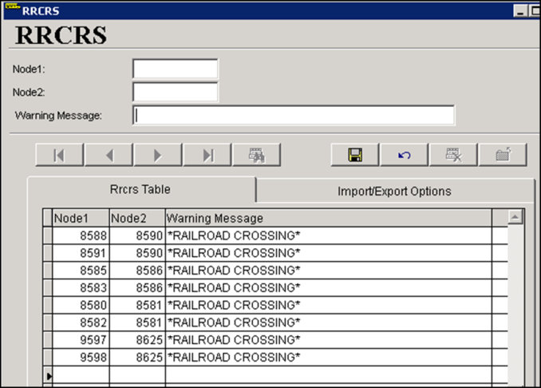

TIMS Webinar
2016 Railroad Crossing Update
Updating the RRCRS File in TIMS
If there is a new or missing Railroad Crossing you need to add to the file.
Use the Add Record Button to add a new Warning Command.
After selecting Add Record, you can now Add data in
the Node 1, Node 2 and the Warning Message section at
the top of Build Text.
When finished, select the Add\Save Record Button
to save your new command.
There may also be closed or incorrect Railroad Crossings you need to remove from the file.
To remove a command line, select the record you want to remove and use the
Delete Record Button to remove this listing.

Slide 29

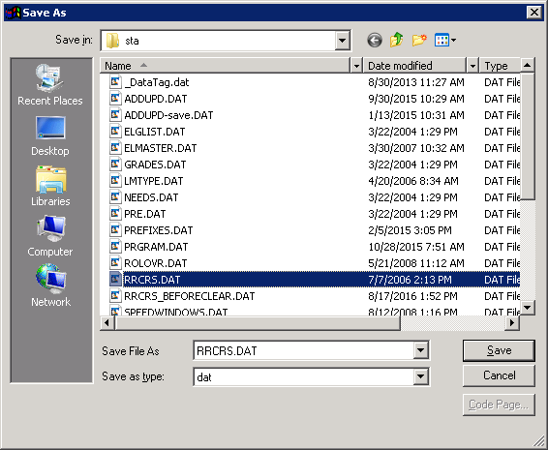
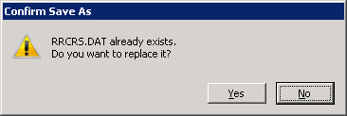
TIMS Webinar
2016 Railroad Crossing Update
Completing Updates to the RRCRS File and Exporting Back into TIMS
After completing updates to the RRCRS File in Build Text, the last step is to Export the newly updated file back into TIMS.
Exporting the Updated File is only necessary for LEAs using TIMS-NT
Once again, select the Import/Export Options Tab
Choose Export File
Browse to the ELT\Dataset\Server\STA folder
Highlight the RRCRS.DAT File and Choose Save.
Say YES when it asks if you want to replace this file.

Slide 30
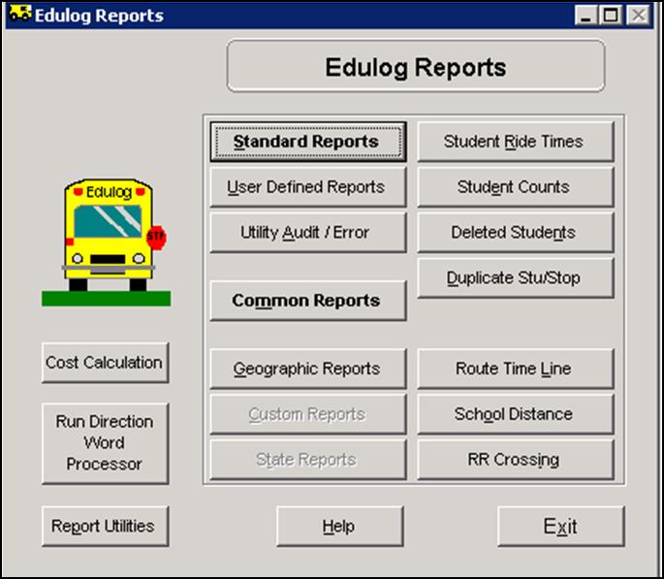
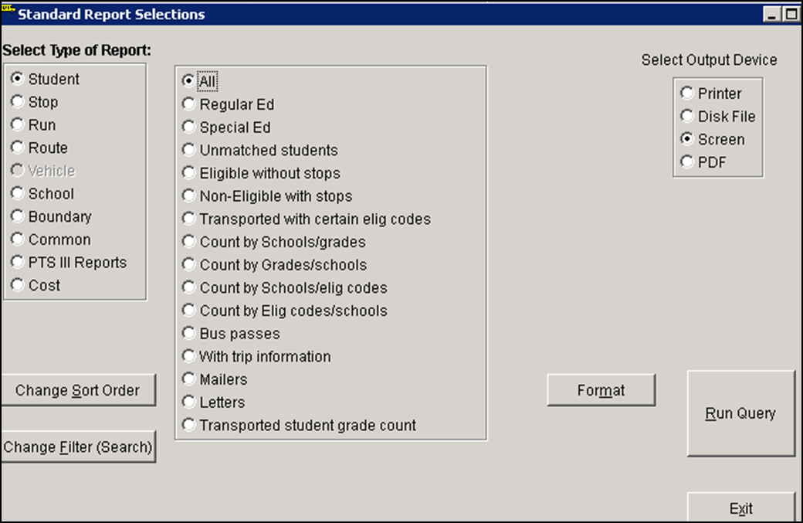
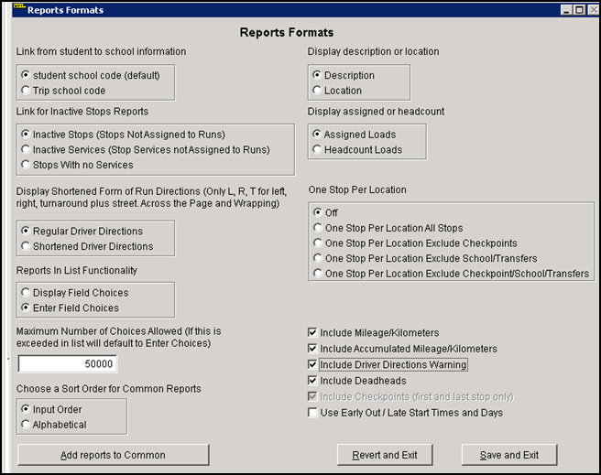
TIMS Webinar
2016 Railroad Crossing Update
Enabling Driver Direction Warnings
If you or your drivers have never seen Railroad Warnings in a Driving Directions Reports, you may not have them selected for inclusion. To check if Driver Directions Warning are included in Reports
Open Edulog Reports
Go to Standard Reports
Choose Format
Make sure the Include Driver Directions Warning box is checked

Slide 31
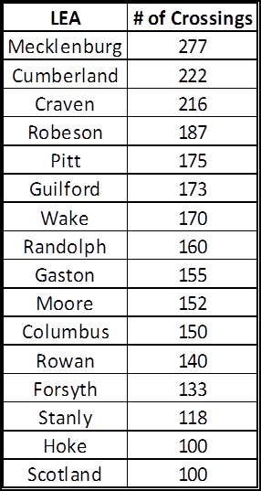
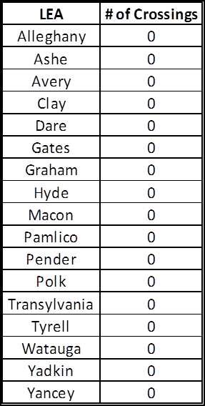
TIMS Webinar
2016 Railroad Crossing Update
Number of Railroad Crossings by LEA
16 LEAS with 100+ Crossings 17 LEAs with Zero Crossings

Slide 32
TIMS Webinar
2016 Railroad Crossing Update
Tips & Tricks for Completing the Railroad Crossing Update
  Make Backups Before You Begin
  If you make edits in MARIS (adding and removing nodes, splitting streets, etc.) you will be creating new node parings for Students and Stops. As a result, stops and students on these segments will become Unmatched. Map Maintenance will relocate the stops and the students for you, however the Students may lose their Bus Assignments because of the MARIS changes.
  Hint: Use the Lost Assignments Report
    Before EMU Map Maintenance - run the “Riders IDs Before UPSTU” Report used to create the list of Lost Assignments. Then after Map Maintenance completes, run the “Rider IDs After UPSTU” Report.
    Then use the Lost Assignments Program to create a list of Lost Assignments due to the MARIS Changes.
    Each student should be easily Quick Assigned back to their previous stop.

Slide 33

TIMS Webinar
2016
Railroad Crossing Update
Any Questions?

