Slide 1
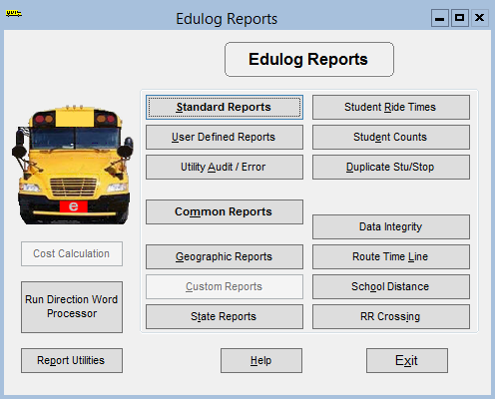

Welcome to TIMS Reports

Slide 2
Class Overview
Geographic Reports
  Street Listings
  Traffic Listings
Overview of Report Features
  Student Counts
    School Grade number of students registered at each school broken down by grade
    Eligibility Report totals per school based off of eligibility codes – default = 0
  Riders Report
    Total number of riders AM & PM
    Longest ride times
Structure of TIMS Data
Understanding Queries and Worklists
Standard Reporting (Reprocess your runs)
User Defined Reports
Practice Reporting options
  Edit queries, Edit sort order, Edit forms
  Creating and modifying Excel files
    Blackboard
    Powerschool extract
Boundary Listings (Inside and Outside boundaries)
Worklists

Slide 3
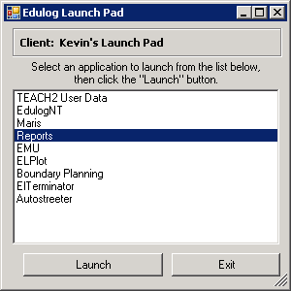
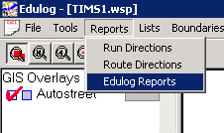
Overview of Report features:
The Reporting Module used for TIMS is Accessed via the Launch Pad or through the Edulog-Advanced program.

Slide 4
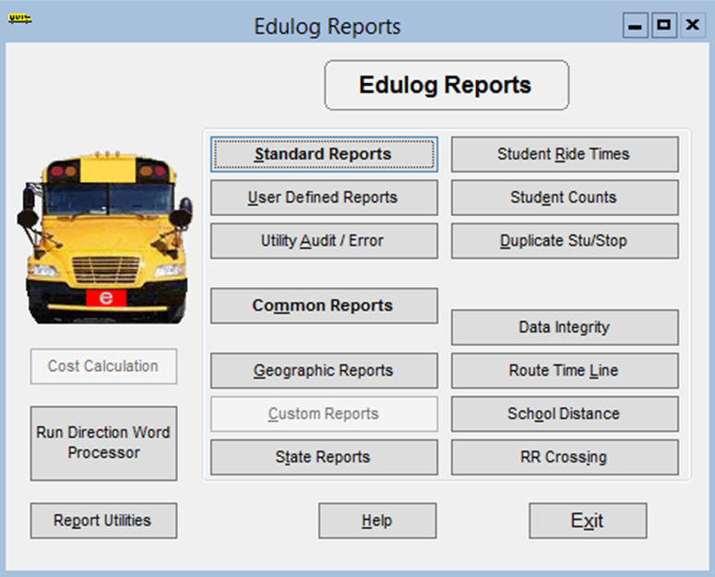

Geographic Reports:
Some Geographic Report options are: Street Name Listing, Overlapping Segments, Traffic Listing, Boundary Listing. They are informational reports pulled from Maris
Today I would like to cover the Eligibility Listing and Stop Range Reports because I feel that they can helpful to your data managers and office staff.

Slide 5
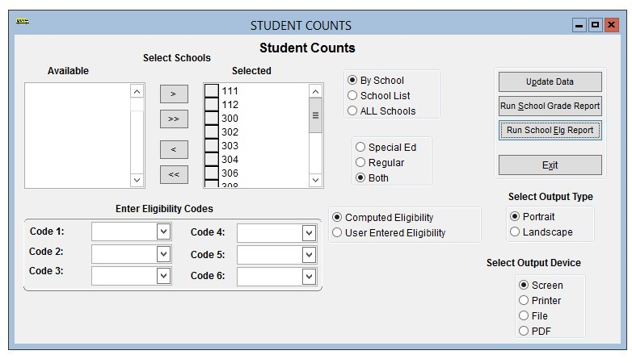
School Grade Report/Elg Report
ALWAYS update your data when you change your report options.

Slide 6
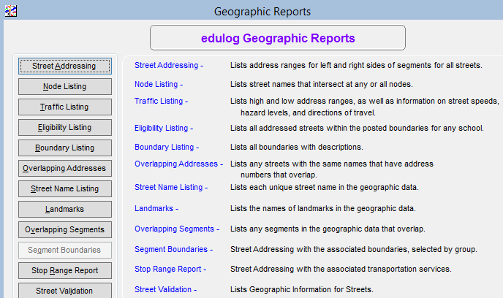
Geographic Reports

Slide 7
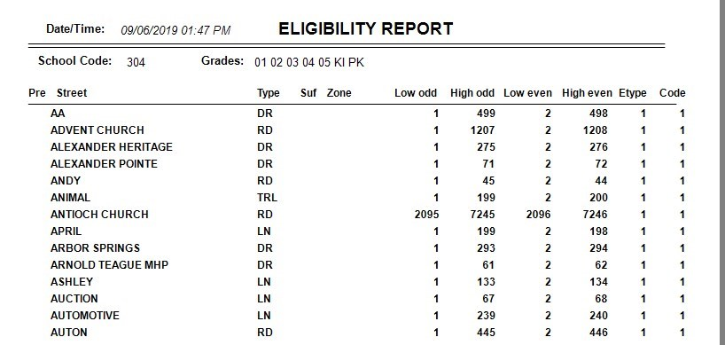
Geographic Reports
Eligibility Listing:
Great for Data Managers to see
streets posted in their school
boundary.

Slide 8
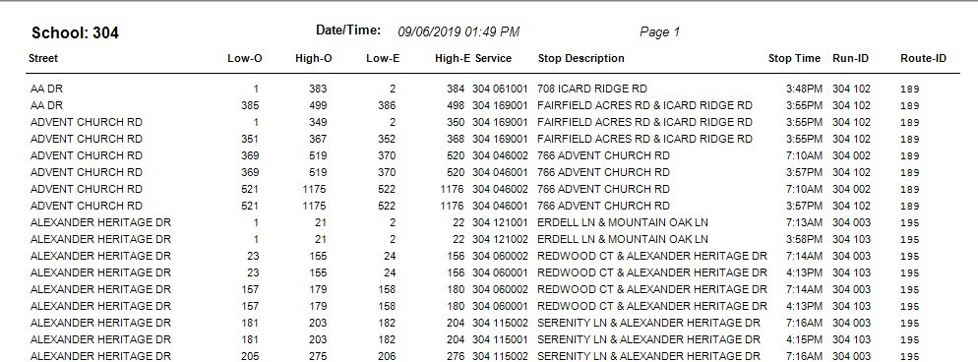
Geographic Reports
Stop Range Reports – Great tool for office staff to use for a quick reference for stop location and time.

Slide 9
Overview of Report features:
Student Counts
Produces a report listing the numbers of students at each of the schools in your system. You can produce student counts broken down by grade or by transportation eligibility code.

Slide 10
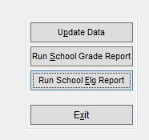
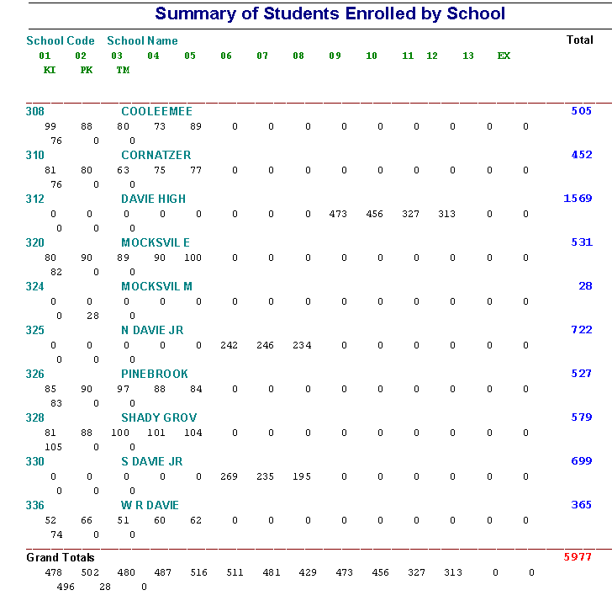
Students Enrolled by School
Grade
Note at the bottom you will see a total of all grades levels. Example on this report you have a grand total of 478 1st graders. This is an excellent report to compare your before and after upstu totals.

Slide 11
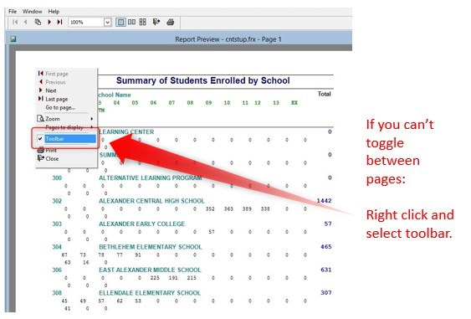
Students Enrolled by School
Reporting Toolbar

Slide 12
Eligibility Data by School
Student Counts
Can also produce a transportation eligibility code report.

Slide 13
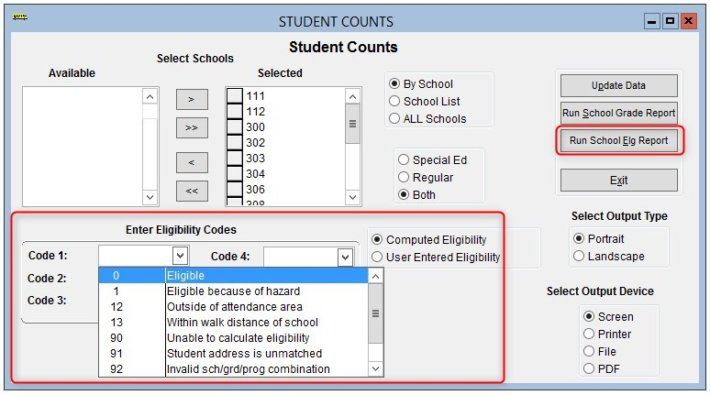
Eligibility Data by School

Slide 14
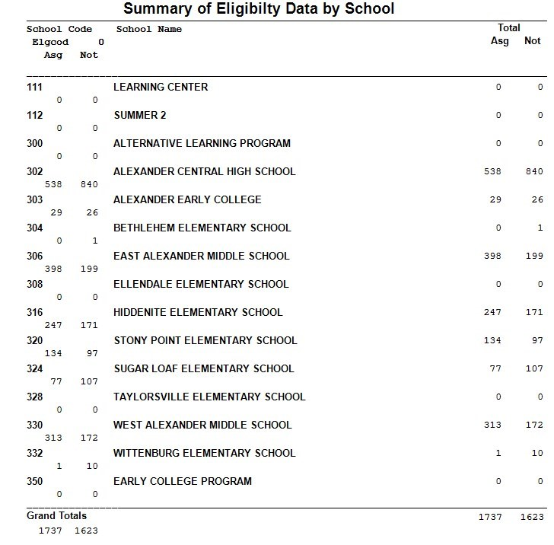
Eligibility Data by School
Student Eligibility Codes
You can produce student counts broken down by transportation eligibility code. If you don’t select a code it will default to 0. 0 = within eligible school boundary.
On the report it is broken down by Assigned and Not Assigned to a stop.
This information is populated by your school boundaries.

Slide 15
Overview of Report features:
Student Ride Times
Produces a report showing the number of assigned bus riders in TIMS for each School, by AM and PM Assignments.
Also tallies ride times for students – AM, PM or Total Ride Time

Slide 16
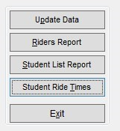
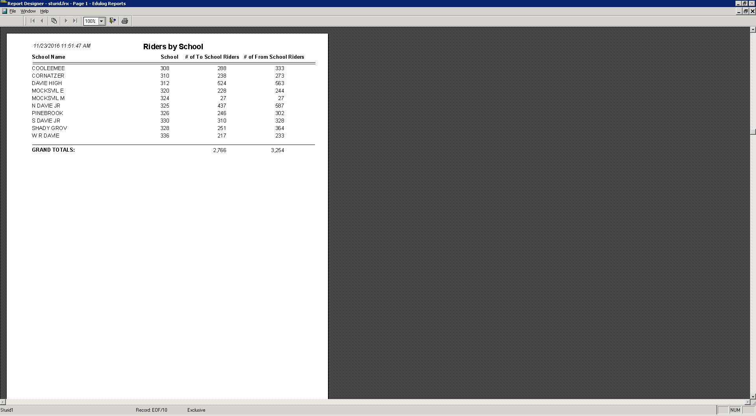
Overview of Report features:
Always update the report first
Student Riders
Produces a report showing the number of assigned bus riders in TIMS for each School, by AM and PM Assignments.

Slide 17
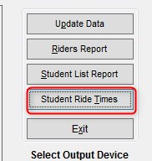
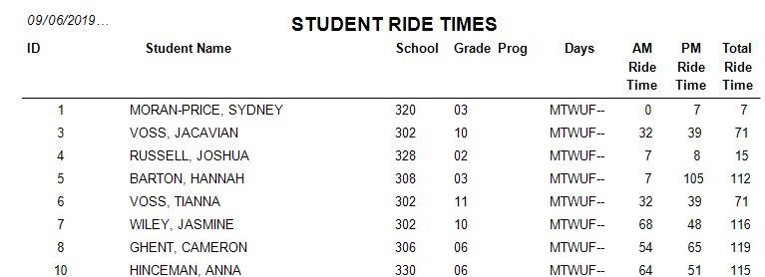
Overview of Report features:
Student Ride Times

Slide 18
Understanding Reports
Understanding the Structure of the TIMS Data

Slide 19
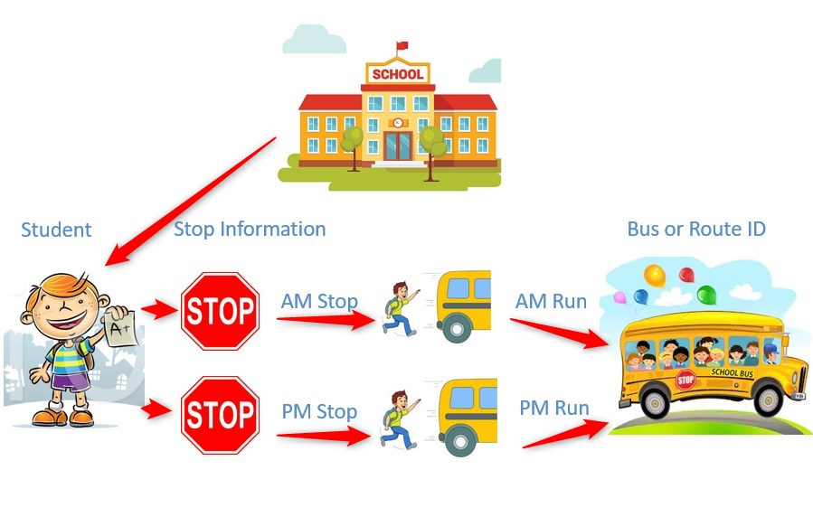
Structure of the TIMS Data

Slide 20
Structure of the TIMS Data
When creating reports you are pulling information from “tables”
Each table is unique and has unique ID numbers
See below
In this table the unique ID number is the Edulog number that stores Student Information. There is also tables for stops, runs, routes, schools, etc.

Slide 21

Structure of the TIMS Data
STUDENTS
SCHOOL
STOPS
RUNS
ROUTES

Slide 22
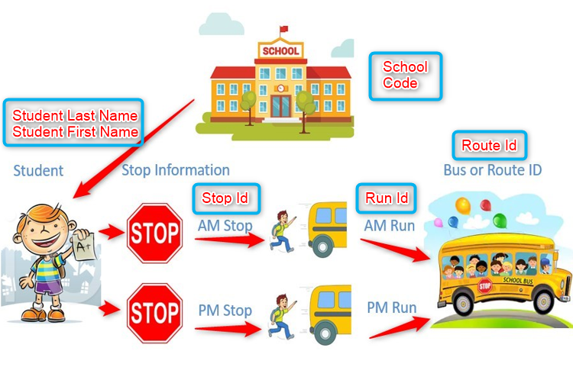
Structure of the TIMS Data
Structure of the TIMS Data

Slide 23
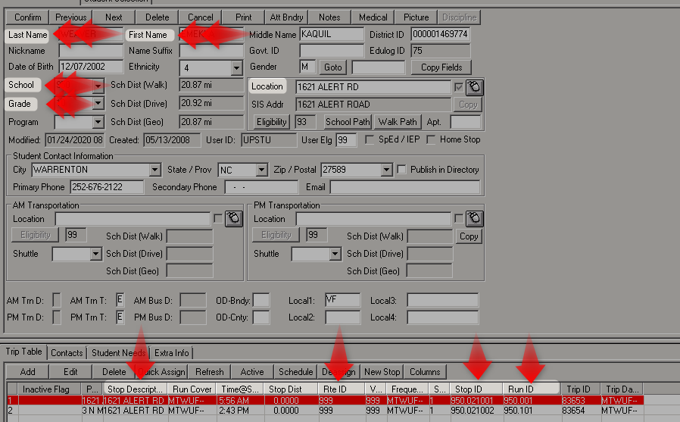
Structure of the TIMS Data
Structure of the TIMS Data/Launchpad View

Slide 24
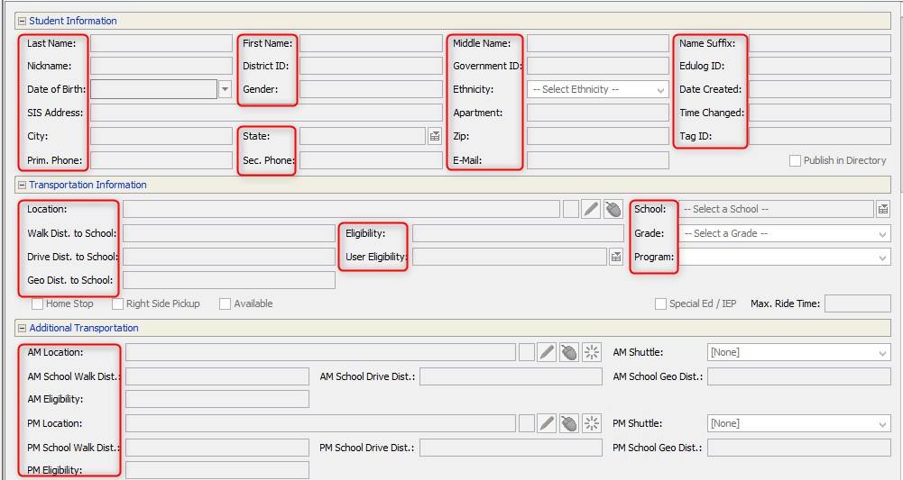
Structure of the TIMS Data/eSQL View

Slide 25
Reporting Data
Reports give us the ability to pull information off of the TIMS data. This
information is very useful for students, miles, stop info, rider info, pickup and drop off time, bus numbers, name a few.

Slide 26
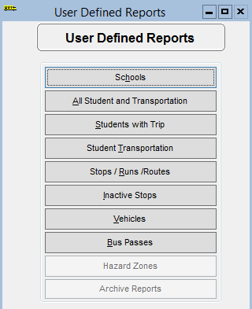
Structure of the TIMS Data
For example:
The School tab would have a unique ID of the School ID. (332)
When creating our report most of them will pull from Run Id & Route ID.

Slide 27
Reporting
Understanding Queries and Worklists

Slide 28
Understanding Queries and Worklists
A query or worklist is a statement or a group of statements that return a value.

Slide 29

Understanding Queries and Worklists
Select all apples = “RED”
How many apples would you have?
Writing queries for riders,
stops and runs is similar to the above
statement. The difference would be the
Variables or field names, instead of apples you would select stopid, runid, school code, etc.

Slide 30
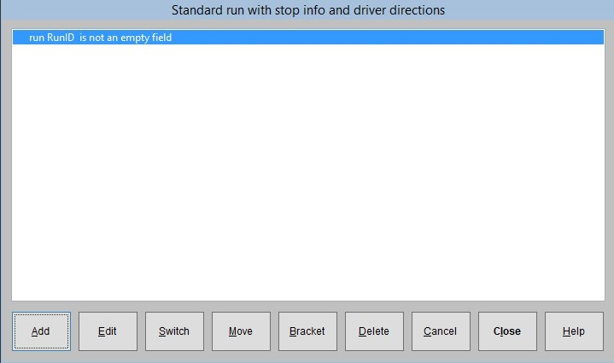
Understanding Queries and Worklists
Queries are statements or conditions

Slide 31
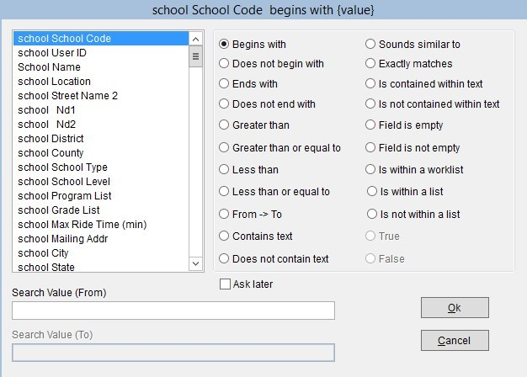
Understanding Queries and Worklists
Operators

Slide 32
Understanding Queries and Worklists
Connectors of AND/OR – be careful how you position the connectors. The outcome can be very different depending on how you use them.

Slide 33
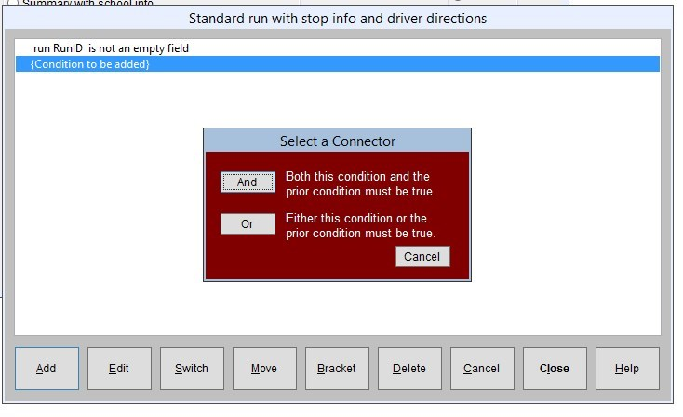
Understanding Queries and Worklists
Connectors of AND/OR
At this time you can NOT use the OR connector in eSQL. Most of
my queries are done in the reporting module off of launchpad.

Slide 34
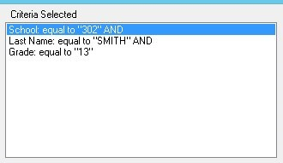
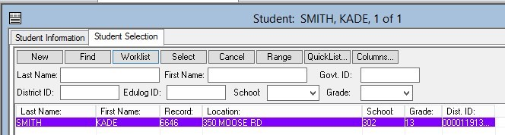
Connectors of AND/OR
In this case all conditions must be true.

Slide 35
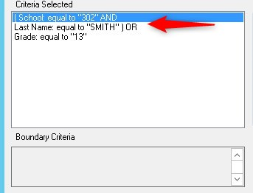
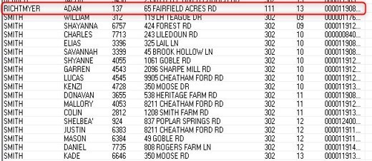
Connectors of AND/OR
School = 302 AND
Your last name = Smith (Any grade)
OR
Your in Grade 13
Note: School code of 111
(OR GRADE = 13)

Slide 36
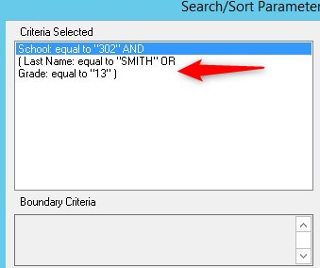
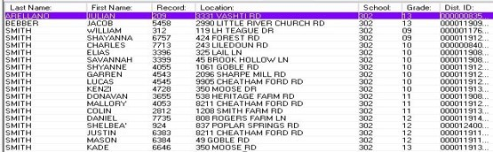
Connectors of AND/OR
Changed the parentheses but kept the connectors the same. NOTE – No school 111

Slide 37
Understanding Queries and Worklists
Values can be asked now or later when running the query. You can also use an existing worklist.

Slide 38
Reporting
Standard Reports vs. User Defined Reports

Slide 39
Standard Reports vs. User Defined Reports
Standard: Structured menu system that lets you select some parameters for reports. Select subject (stops, runs, etc.), filter, and sort order. No control over field selection, grouping, or report layout.
User Defined: Prepared reports, ready to run as they are or be customized. Nearly total user control over all aspects of report design: subject (stops, runs, etc.), filter, sort, field selection, grouping, and report layout.

Slide 40
Reporting Tip
Standard Reports provide a variety of pre-made reports and options you can select from. Please look through each Standard Report as there may be a few that are very close to what you would like.
Many of the reports contain additional information you may not be interested in (ex: PowerSchool ID) or would not like to display in the report. But each Standard Report can be customized within the User-Defined Reports section to add/remove any pieces of data to better meet the needs of your district.
Also, if you would like data from a report imported into a spreadsheet, you can accomplish this within User-Defined Reports as well. Find/Copy the Standard Report and then Modify it for export into Excel.

Slide 41
REPROCESS RUNS
Remember to REPROCESS ALL RUNS before running reports

Slide 42
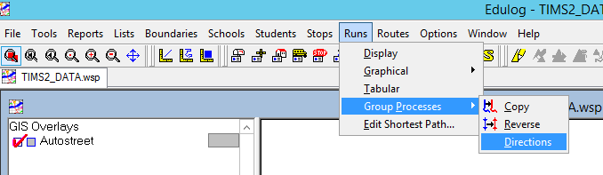
REPROCESS RUNS
The easiest and fastest way is to go to your
Runs – Group Processes - Directions

Slide 43
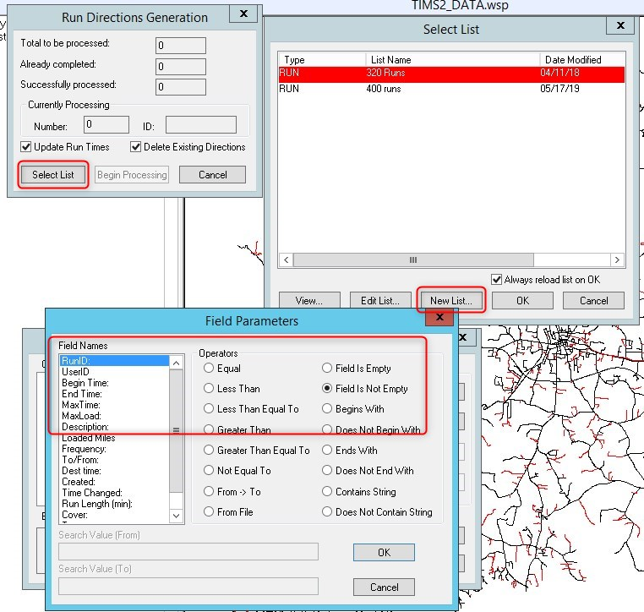
REPROCESS RUNS WITH A WORKLIST

Slide 44


Standard Reporting

Slide 45
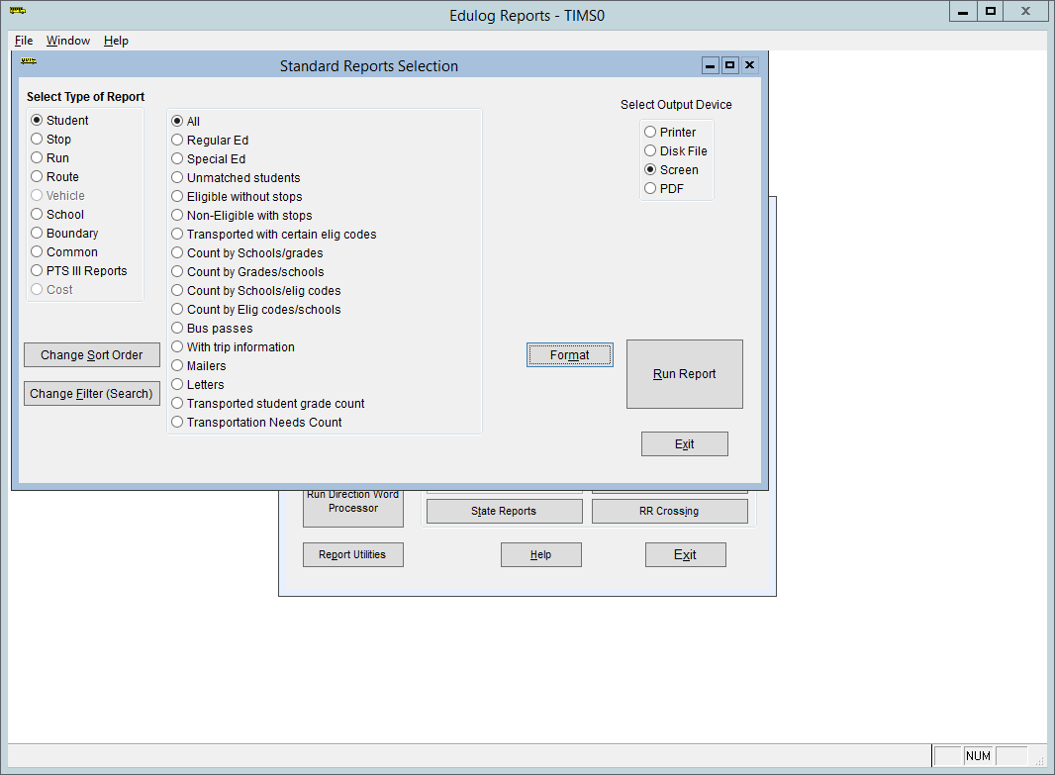
Standard Reporting
Selecting a report type will bring up sub menus for those reports
The Menu on the left lets you filter the reports by type or topic
Students
Stops
Runs
Routes
Schools
Boundaries

Slide 46
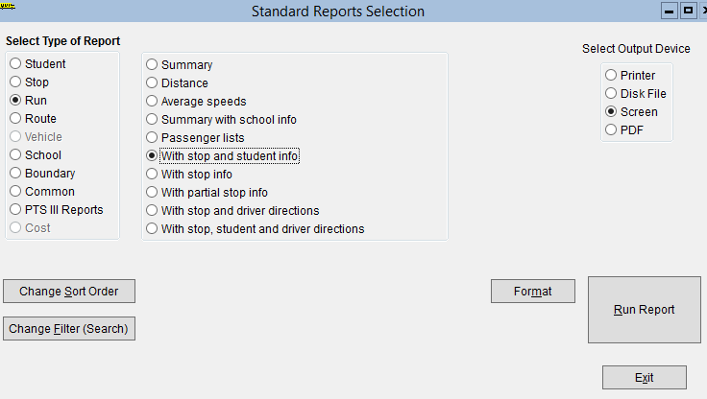
Standard Reporting
Lets start by looking at the
Standard Run Report named
With Stop and Student Info
Choose the selected report and click Edit Filter

Slide 47
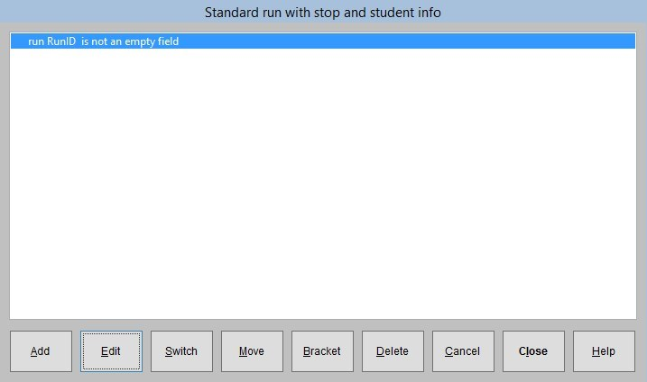
Reporting Tip
As you can see this query will select all the runs in your database. We want to change that to reflect RUNID = 308.001

Slide 48
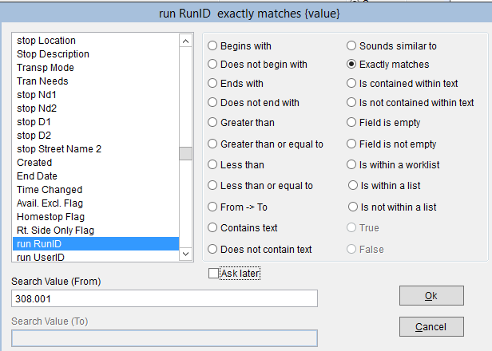
Reporting Tip
Filtering a Report is a 3 Step Process:
Pick the Field you want to filter by (Run ID)
Pick an Operator (begins with, exactly matches, or is within a list, etc.)
Enter the Value for your filter (typically a school code, a Run ID or a Route ID)

Slide 49
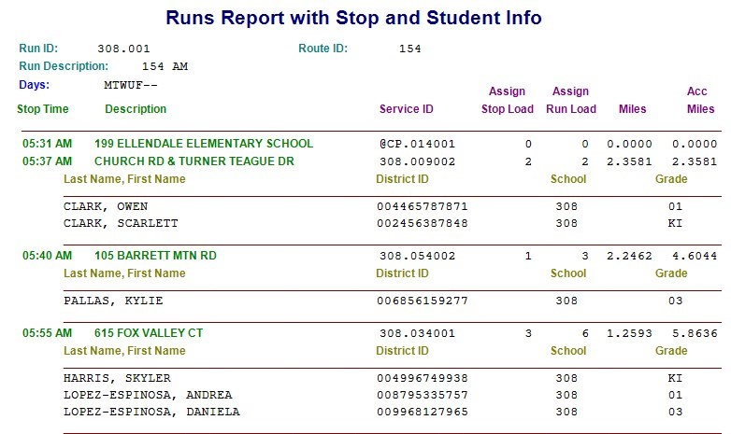
Standard Reporting
This is the Standard Run Report with Stop and Student Info
It shows the Stop Description, Stop Time, Passengers at each stop as well as the accumulated miles and accumulated student counts.

Slide 50
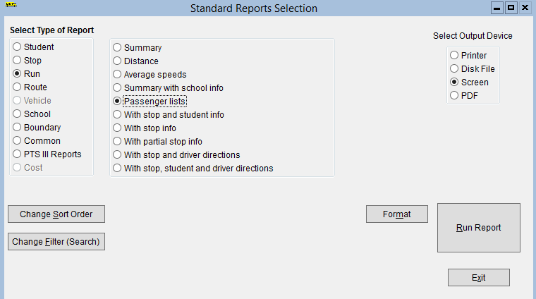
Standard Reporting
Next we will look at a different report and then modify the way the data is sorted within the report itself.
Under Standard Run Reports, select the Passenger Lists report and Run Query
Be Sure to Change the Filter Again for only Run 308.001

Slide 51
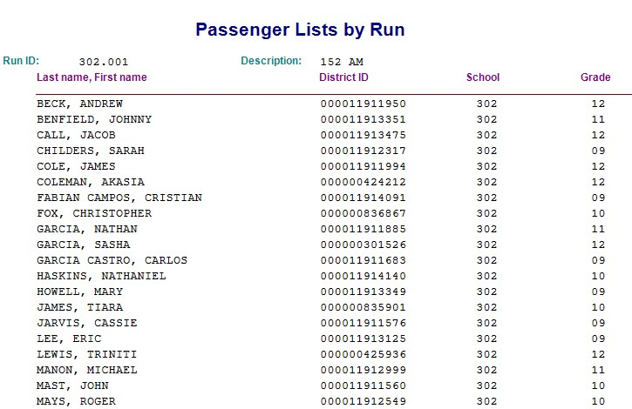
Standard Reporting
The report is defaulted to sort by Last, First. We want to change it to sort by Grade, Last, First.

Slide 52
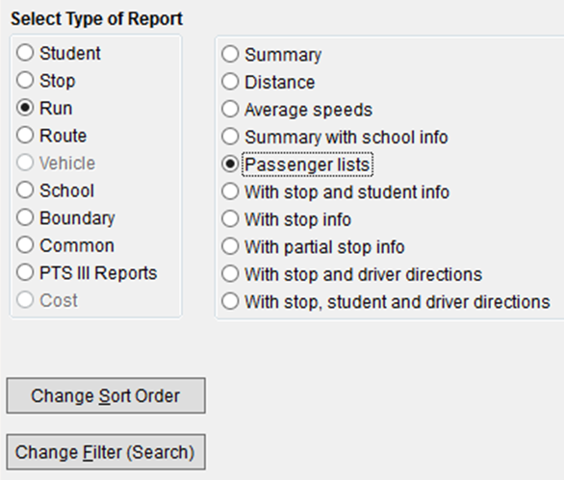
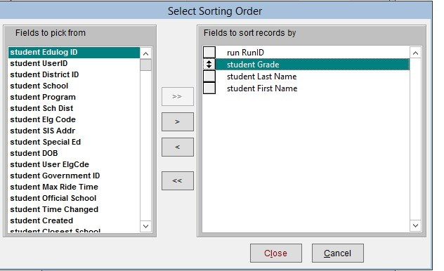
Standard Reporting
To change the sort order click on the option below.
The default sort order is Run Id, Last Name, First Name

Slide 53
Standard Reporting
Modify the Sort Order so the Passenger List is sorted by the Student’s RunID, Grade, Last, First.
Double click to add this variable to the Fields to Sort by list
Using the gray box with the arrows to the left of the variable name to drag
Stop Sequence so it is the second variable to sort by, then click Done.
Now run the query and notice how the report is sorted differently. Students are now listed by Run Id, Grade, Last, First.

Slide 54
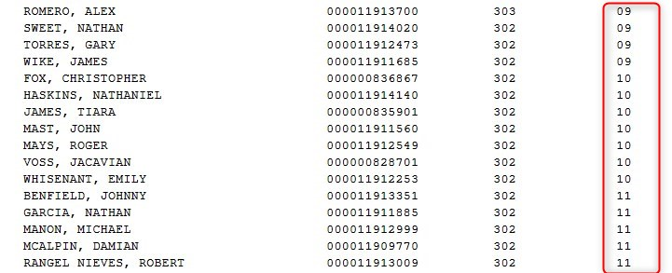
Standard Reporting
Sorted by RunID, Grade, Last, First

Slide 55
Standard Reports
Questions about Report Filters?
    Choose Field
    Choose Operator
    Enter Value to Filter By
Questions about Report Sort Order?
    Add/Remove Fields from Sort Order
    Drag Fields Up and Down Sort Order List

Slide 56
Standard Reporting – end notes
The Standard Reports option is great for generating reports that require typical or general information.
More complex data outputs or modifying a Standard Report to add/remove information will require the use of User Defined Reports

Slide 57
User Defined Reports
How to Copy and Modify Existing Reports
Add/Remove Fields

Slide 58
User Defined Reporting
A couple of things about the Standard Reports that are listed under USER DEFINED * reports:
  The list of reports starting with the word ‘Standard’ are the very same reports you access through the Standard Reports Module
  They are templates that cannot be run or modified, only copied, renamed and then edited.
  The name of your copied report cannot begin with the word ‘Standard’
  Once copied, the report can be run as-is, or modified and saved to a new form or excel file
  You can go back to the original ‘Standard’ report and copy it again as often as you like.

Slide 59
User Defined Reporting
User Defined Reports are categorized into different sections.
It can be tricky to find the Standard Report you like and want to begin editing. It takes regular use and experience to know which section contains the report you seek.
Just look around the different sections and you’ll find it.

Slide 60
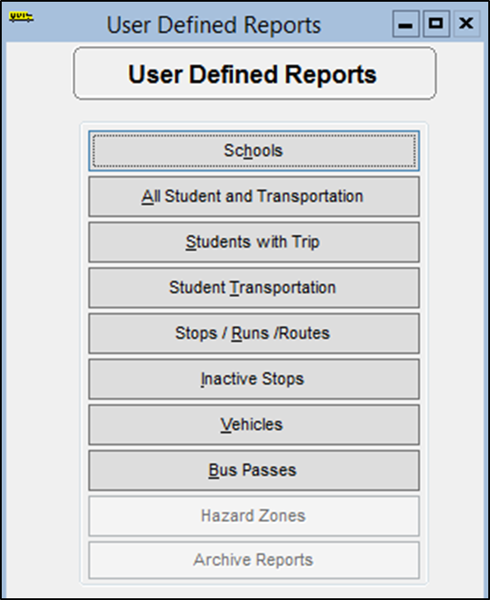
User Defined Reporting
Schools
Produces reports that contain information on the schools in your system. With these queries, you can examine bell times, grades and programs for schools, as well as school boundary and eligibility information.

Slide 61
User Defined Reporting
All Student and Transportation
Produces reports on students with transportation assignments. You can produce a list of students, or you can generate bus passes with these queries.

Slide 62
User Defined Reporting
Students with Trips
Produces reports on students in your system. If you select only student fields for this report, you can obtain a listing of all the students in the database. If you select any trip fields, you will get only those students who have trips assigned. You can examine regular education students, special education students, and unmatched students (students whose addresses do not match the geocode) with these queries. You can also produce reports on the numbers of students at schools in your system.

Slide 63
User Defined Reporting
Student Transportation
Produces reports with various combinations of student and transportation information (on stops, runs, and routes). You can produce passenger lists and student eligibility reports with these queries.

Slide 64
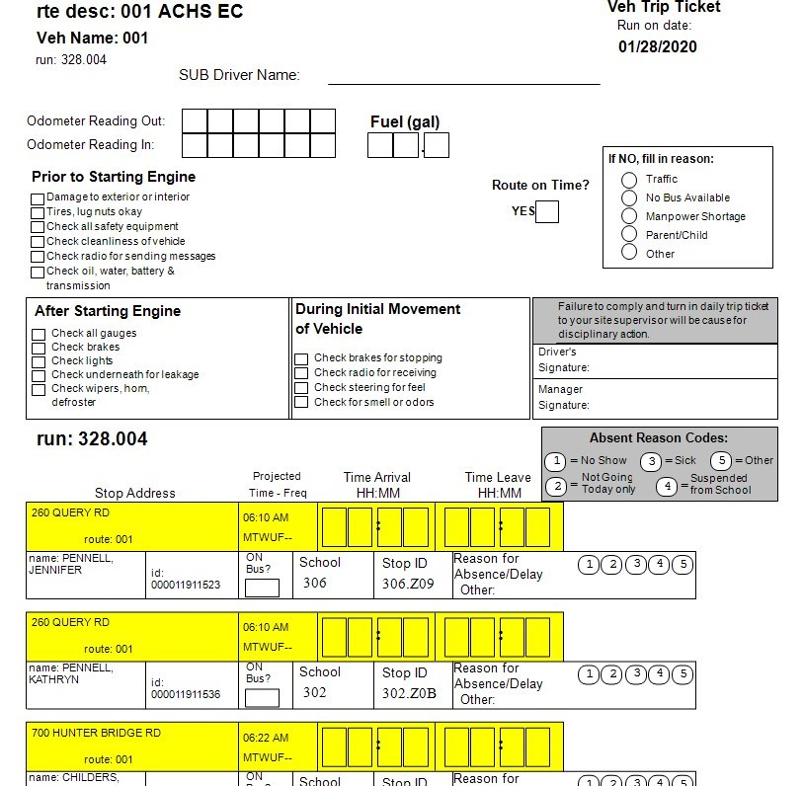
User Defined Reporting/Student Transportation
Standard Trip Ticket (portrait print)

Slide 65
User Defined Reporting
Stops / Runs / Routes
Produces reports with various combinations of information on stops, runs, and routes in your system. You can produce reports on run and route mileage and average speeds with these queries.

Slide 66
User Defined Reporting
Inactive Stops
Produces reports on stops that are not assigned to runs. You can also examine information on students assigned to such stops with these queries. Stops that are inactive.
Vehicles
Produces reports on the vehicles in your district’s transportation fleet.

Slide 67
User Defined Reporting
Bus Passes
Produces bus pass reports which list various types of transportation information for bus riders. While you can create your own bus pass reports, you may find it easier to make a copy of one of the existing Bus Pass queries and modify the copy as desired. Also produces a report for students stop not on a route.
***Use Bus Passes when you want a students transportation information to show up on one line in excel or report.***

Slide 68
TDTIMS Reports
Use your Diagnostic Reports to help you find issues with your data. A good tool to use during the year to help clean your data up.

Slide 69

Diagnostic Reports
User Defined Reports/All Student and Transportation Reports

Slide 70
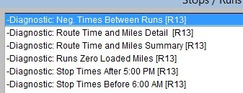
Diagnostic Reports
User Defined -Reports/Stops/Runs/Routes Reports
Neg Time between Runs
Time and Mile Summary – great tool to use to compare with Synovia to check real time to TIMS
Before 6:00 and 5:00. Use to clean runs up and make sure not zig-zagging.

Slide 71

Diagnostic Reports
User Defined -Reports/Stops/Runs/Routes Reports
Quick look at number of buses assigned in TIMS. Compare to actual buses on the road. Do you have buses in TIMS that do not have runs attached. If they are not being used please take them out to avoid reporting errors.

Slide 72
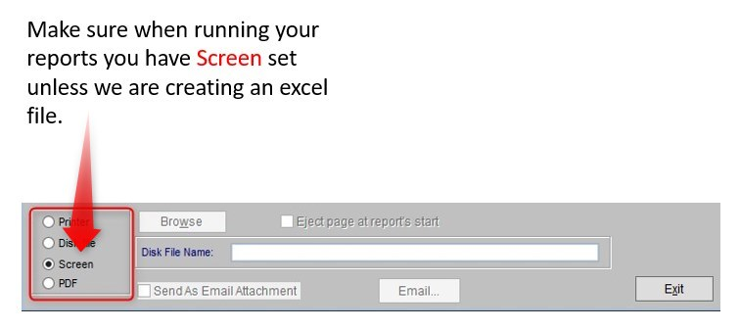
Let get started
User Defined Reporting
Practice Time

Slide 73
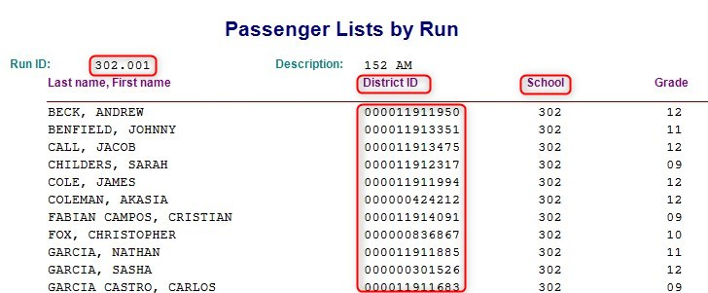
User Defined Reporting/Practice
Go to User-Defined>Student Transportation
“Standard Passenger Lists for Runs” report
As you can see the report is sorted by last, first. We want to change the sort option by pickup time.

Slide 74
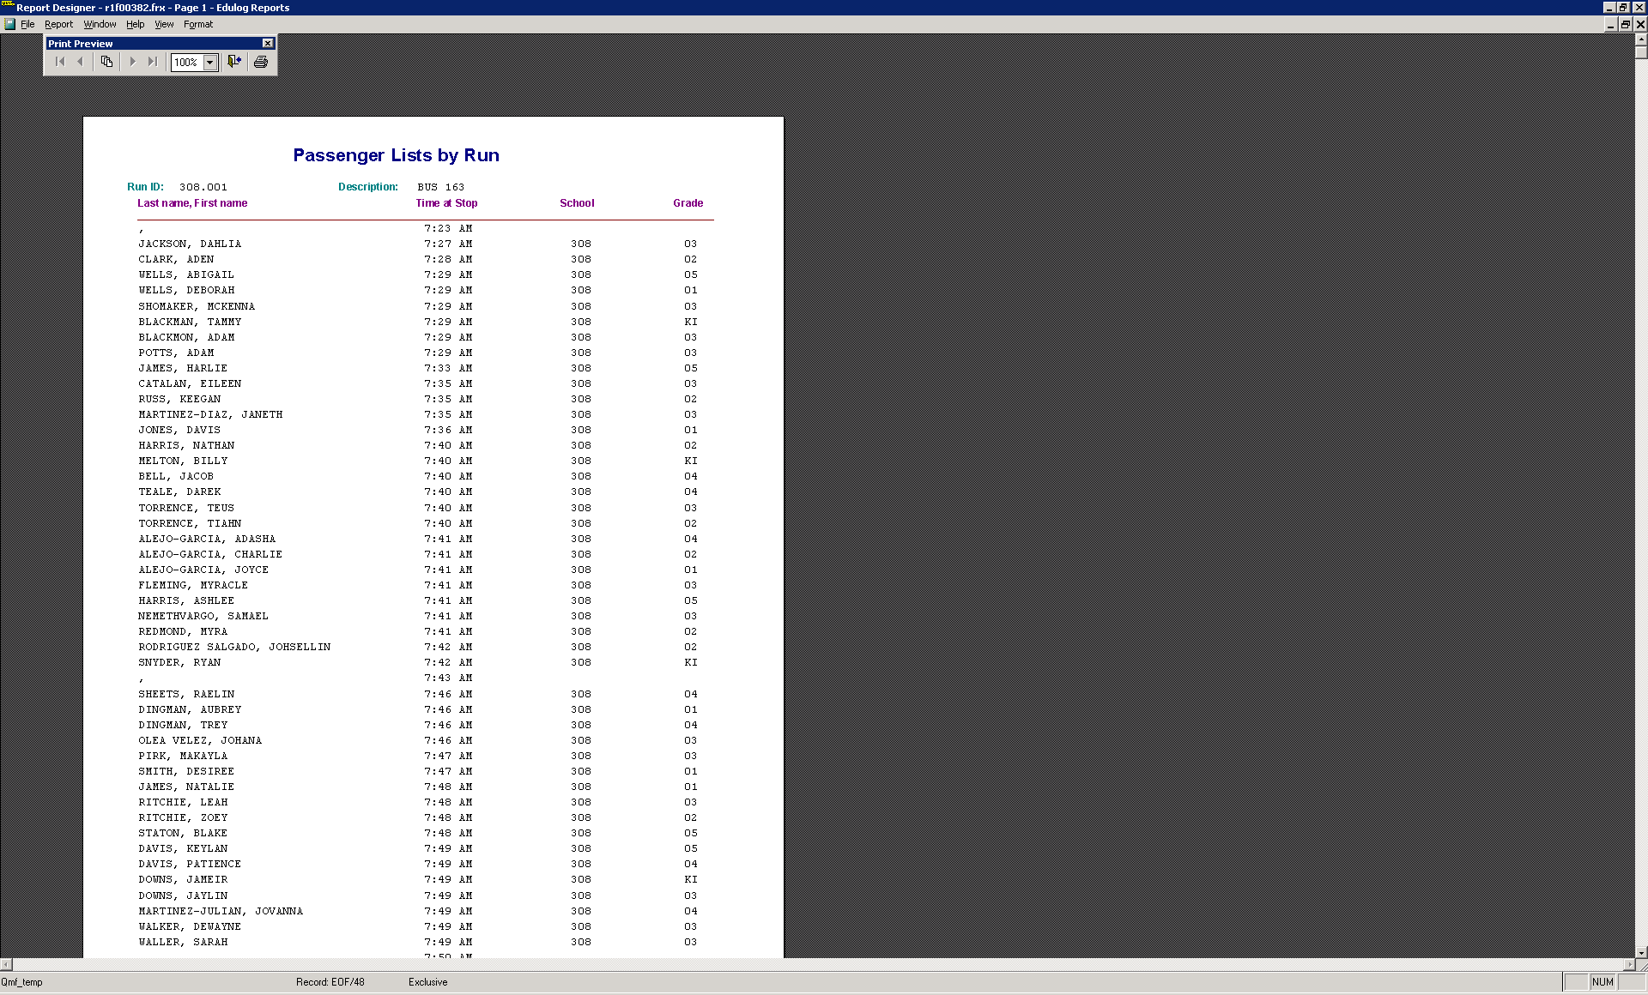
Practice
This is what the report should look like.

Slide 75
User Defined Reporting/Passenger List
Go to User-Defined>Student Transportation
Find and Highlight the “Standard Passenger Lists for Runs” report
Choose Copy
Rename the report “YourName Passenger List”
Now highlight the Passenger List and choose “Edit” to open the report.

Slide 76
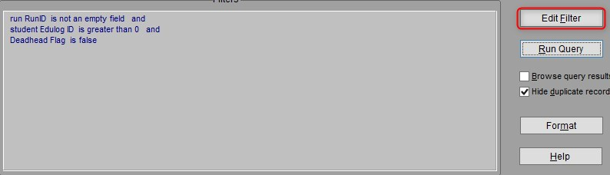

Practice – Change School to 308
Change run RunID to begins with 308
This will pull any run that starts with school 308

Slide 77

User Defined Reporting
The default Output Fields include all of the information visible in the Standard Report we copied.
For this example, we want to add two additional variables that could be included in this report.
Stop Sequence
Time at Stop

Slide 78


User Defined Reporting
The default Sort Order for this Passenger List: by Run ID, Last, First. We want to include Stop Sequence here so the Passenger List is Sorted by the Order students get on/off the bus.
Add STOP SEQUENCE - Drag Stop Sequence up in the sort order so it is second on the list of variables.

Slide 79



User Defined Reporting
If you run the query now, the passenger list displays students in the order the they get on/off the bus. However, the Student PowerSchool ID is still being displayed in the report. Our next step is to replace the District ID with Time at Stop

Slide 80

User Defined Reporting
When you choose Run Query, the Setup for Form Layout Report window appears. Under Output Direction, the report is defaulted to Run to the Screen so you can view the report before you print it.
If you want to modify the report (to include/exclude any data) or to add/replace any data within the report, choose Edit Form from this window. To open the Report Designer interface.

Slide 81

User Defined Reporting
User Defined Reporting
The Report Designer interface shows you the default layout of the report and how each section of the formatted report will be displayed.
Title Section, Page Headers, Grouped Data, Group Footers and Page Footers, etc. Depending on the Standard Report you originally copied, you may have multiple sections you can redesign.

Slide 82



User Defined Reporting
Under the View menu, choose Table Designer. The Table Designer lists the name of all of the fields included under Edit Output Fields.
Please note how each field included is coded/named a certain way. If you want to add a field to the report, you will need to know the exact field name as it is listed under Table Designer.

Slide 83



User Defined Reporting
Under Page Header, locate the purple label “District ID” and double click it.
This will display the Label Properties window where you can edit the default label. Change it from District ID to Time at Stop.

Slide 84



User Defined Reporting
User Defined Reporting
Under Group Header 1, find the black box “RIGHT(stu_districtid, 12)” and double click it. This will display the Field Properties window where you can edit the field or variable that you want displayed.
Change it from PowerSchool ID to Time at Stop
Delete “RIGHT(stu_districtid, 12)” and replace this with
“TTOC(runsrv_timeatsrv,2)”

Slide 85
User Defined Reporting
Stop Times in TIMS-SQL include a generic date of 01/01/1900. So to remove the dates from being displayed, you must include some programming language to exclude the date. TTOC stands for Time To Character and “,2” tells the system to only display the time part of the full Stop Time Field

Slide 86


User Defined Reporting
Before you save the modifications to the report, you should view a preview of the report to make sure you made the edits correctly.
Under View, Choose Preview to preview the modified report.
The report should now show Time at Stop instead of District ID

Slide 87


User Defined Reporting
Use the “Under X” to close out the Print Preview and return to the main page of the Report Designer.
Continue to Make Edits to the Report and Preview as Needed to verify your edits were made correctly. When you are finished, use the “Under X” to close the report designer. The system will ask you if you want to save changes to the Report Designer – if so, choose Yes

Slide 88

User Defined Reporting
All of the edits we just completed are now saved within the YourName Passenger List Report. However the filter is set for Runs that start with 308
If you wanted to produce this report for other Bus Runs in TIMS, you would need to edit the filter every time. Let’s make some edits to the Report filter to make it easier when needing to run this report for other Bus Runs in the future.
Choose Edit Record Filter and let make some modifications.

Slide 89

User Defined Reporting
Change the Operator to “Is within a list”
This will allow you to choose which
Run(s) you want to print.
Save and Exit when finished.

Slide 90

User Defined Reporting
Now the report asks you to select the Run(s) each time you wish to produce this report.

Slide 91

User Defined Reporting
Most LEAs would like for each Passenger List to start on a new page, so let’s learn how to add a page break with each new Run ID

Slide 92

User Defined Reporting
Choose Run Query from the Report Main Menu and then Edit Form from the Setup for Form Layout box.
Report - Data Grouping - Page Break editor

Slide 93

User Defined Reporting Adding Page Breaks
Modifying Data Groupings for Page Breaks
When editing a Report, you can add page breaks so the next run or school or student will start at the top of the next page.
Under Report>Data Grouping , you can tell the system when you want the page break to begin.
The default list of variables are on the left and each has their own command to start on a new page or on a new line within the report.
You may need to add other variables here if they are not included in the default options.
Make sure you select the Screen option.

Slide 94

User Defined Reporting
To set Page Breaks in a report, reopen the Report Designer
The default page break is for the next Run ID to start on a New Line.
Simply choose “New Page” to tell the report to add a page break and start the next Run ID on a New Page.
Click Ok to update the page break command.
View>Preview to check you edits before you Save and Close the Modifications.

Slide 95


User Defined Reporting
The Passenger List for each Run ID should now start on it’s own page

Slide 96

Practice Session
  Copy the Passenger List we created and Rename it to “Passenger List with Phone”
  Then Edit the report and add Home Phone (aka Student Primary Phone)
      Add “Primary Phone” to the Output Fields
      Edit the Report and add Phone # after name
      Add the Displayed Variable and the Label too

Slide 97
Creating an excel file
How do I get the same information off the report and into an excel?

Slide 98


Creating an excel file
Take note of the file path.
D:\REPORTS\QMF_BONNIE
Run your report and check
The D:\Reports
to find your report.

Slide 99
Practice
Lets create a blackboard excel file.
Many counties use this information to pull student transportation information to send out messages for late buses or accidents.

Slide 100
Practice creating a blackboard excel file
User Defined Reports => Bus Passes
Make a copy of
  Standard student with trip information
  This will select all your students in TIMS and put all their information on one line.
  Make sure you select excel for output.

Slide 101
Creating an Excel file
Modify the file to display the fields below:
Fields Listed:
StudentDistrict ID
Student School
Student HR
Student Grade
Student Last Name
Student First Name
Trn AM Stop Description
Trn Am Time at Stop
Trn AM Route ID
Trn PM Stop Description
Trn PM Time at Stop
Trn PM Route ID
Sort By:
Student School
Student Grade
Student HR
Student Last Name
Student First Name

Slide 102

Creating an excel file
As you can see it is listing a lot of students who do
not have bus assignments.
We can edit the filter to take them out

Slide 103


Creating an Excel file
Once you add Trn AM Run ID is not empty or Trn PM Run ID is not empty it will remove all the students who do not have a bus assignment.

Slide 104
Powerschool Extract
How do I create a Powerschool Extract?
This file can be uploaded into Powerschool with the TIMS transportation data?
Most counties already have this option in All Student and Transportation

Slide 105


Powerschool Extract
Reports
  User Defined Reports
    All Student and Transportation Reports
      PowerSchool Extract
Fields needed in the file
      Path D:\Powerschool\PowerSchool Extract Excel File

Slide 106

Powerschool Extract
The Powerschool excel file will have to be modified before you can import it into Powerschool.
Column 1 and 2 need to be adjusted.

Slide 107

Powerschool Extract
Highlight the 1st line of the ID numbers
Go to the bottom and shift click
Go back to the top and click on the ! and convert to a number
This will remove any leading zeros

Slide 108


Powerschool Extract
We must convert 1 – To and 2 – From
Find all 1 replace with To
Find all 2 replace with From

Slide 109

Powerschool Extract
Convert the column names to the following:
Save file in a CSV format
Save file in a CSV format
Now your ready to import it into Powerschool

Slide 110
Boundary Listings
Sometimes Administration will need a list of students who live in or outside a boundary.

Slide 111

Inside School Boundary
You may be asked to pull information used for teacher allotments. Example HR may need to know how many rising 5th graders are scheduled to move up to the middle school. If you have more than one middle school you will need to know the numbers for each.
You can do this by creating a worklist in Student Tabular.

Slide 112


Inside West Middle Boundary

Slide 113


Inside West Middle Boundary
You can see below the 5th graders are currently registered at many different elementary schools.

Slide 114



Outside a school boundary
Student registered at school 304 but
live outside 304 school boundary.

Slide 115

Worklists
Outside a school boundary
In some cases you may need to create a worklist and create an excel file for it.

Slide 116

Outside a school boundary
Lets go back to your excel file in Bus Passes - Edit

Slide 117

Worklists
Edit filter to ask for a worklist later.

Slide 118


Worklists
Worklists
Run Query and you will see it ask you for the worklist name

Slide 119

Worklists
You can then modify the file as needed.

Slide 120
Questions?

