Slide 1

Batch User Field/Excel
Batch User Field/Local Fields
Time saving techniques for routing students
Example – Lost Assignments, New School Assignments and more!

Slide 2
Batch User Field Scenario
You just finished doing an UpStu and it looks like your PowerSchool Data Admin hasn’t been making all of the address corrections you were telling them to because you have an unusually large number of lost assignments. Using the Lost Assignments Database we can identify which students lost their assignment and using the BatchUserFill trick we can mark them in TIMS so we can easily find them and work with them to reassign them.

Slide 3
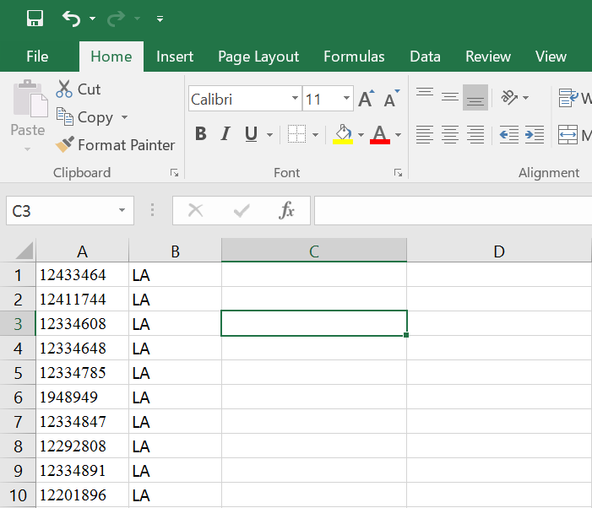
Excel Prep
Once you have your file from the Lost Assignments Database create a new spreadsheet with just the PSIDs in Column A and make sure you have a value in Column B to insert into the LOCAL field. Today I will be showing you how to input the value “LA” into Local 1.
You will need to save the excel file in your export folder as a CSV file.

Slide 4


Correct File Types
Once you have all of your PSIDs and the values you want to fill into the Local 1 field you will save your file as a CSV file. This file can be saved on your desktop.
Once you have the csv file saved you will need to copy it to your export folder and change the extension to .dat
D:\ELT\[DATASET]\server\export

Slide 5
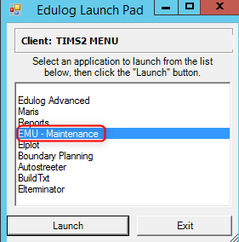
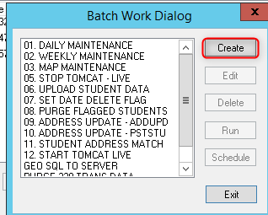
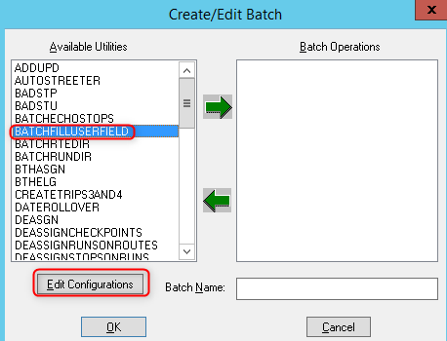
Creating the Batch
1
2
3

Slide 6
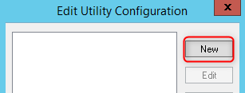
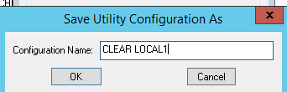
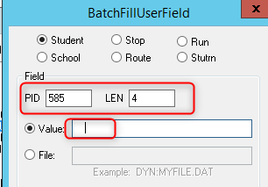
First Clear Local 1
Save and then add it to the batches.
If you want to clear Local 1 enter 4 spaces with your spacebar. This will replace Local 1 with blanks starting in position 585.

Slide 7
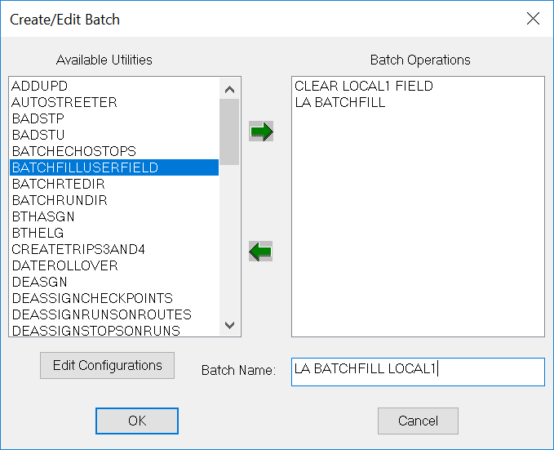
Add a Batch to Fill Local1
Batches are created and ran in the order you see under Batch Operations.
Now you need to create the Batch that will write the value into Local 1.

Slide 8
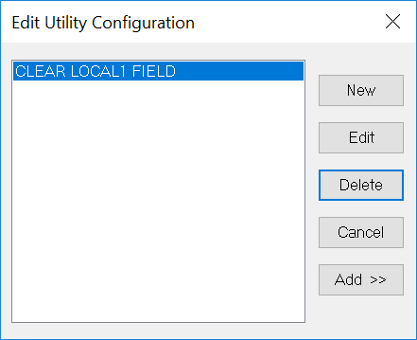
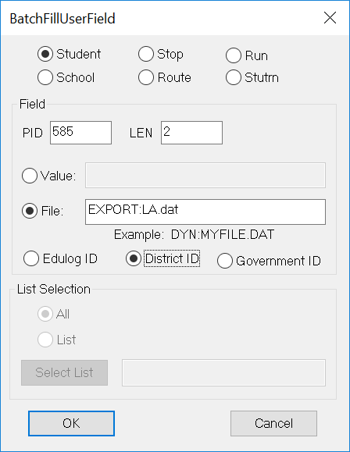
Fill Local 1 Field
I am adding “LA” which is 2 characters.
I am using the District ID which is also the PSID to find the records I am writing LA to.
My file is in my export folder and it is named LA.dat

Slide 9
Name Your Batch

Slide 10
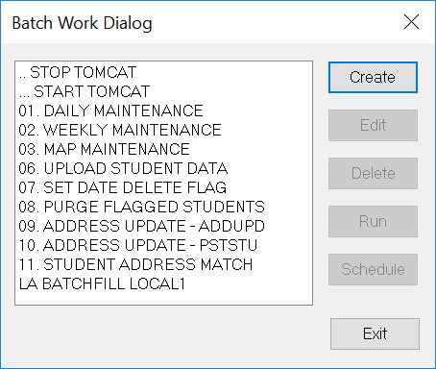
Run Your Batch
Once the batch is created you must:
Stop Tomcat
“Run” LA BATCHFILL LOCAL1
Start Tomcat

Slide 11
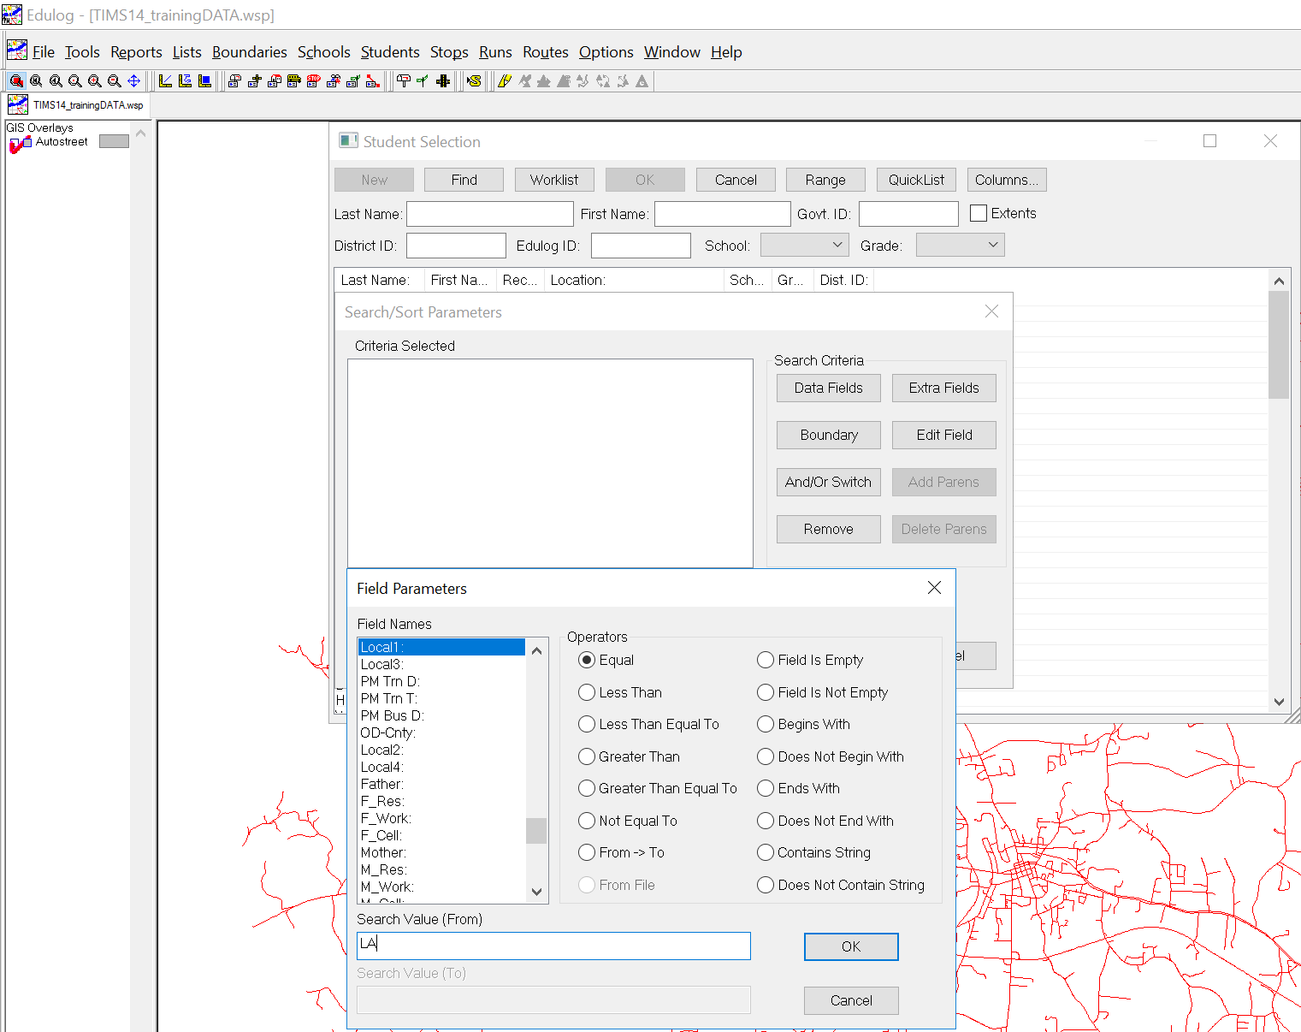
Display Your Students
Click Students >
Display >
QuickList >
Data Fields >
School = 304 &
Local1: =LA

Slide 12
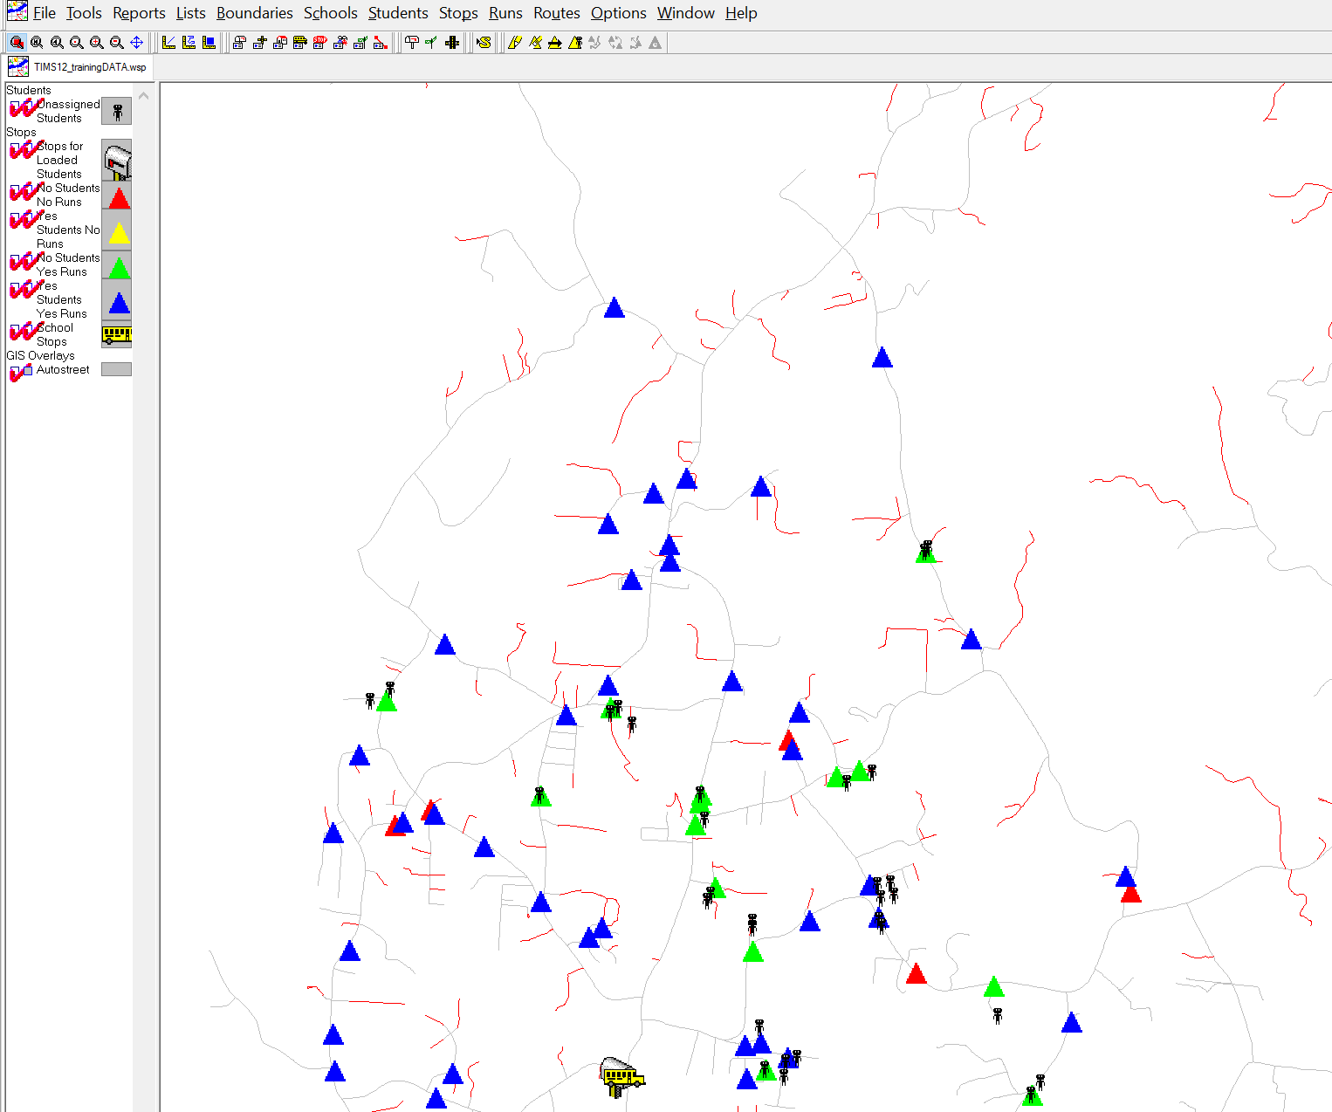
Display the Stops
Now we have all of the stops shown for this school as well as all of the students at this school who lost assignments.

Slide 13
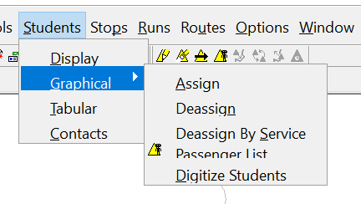
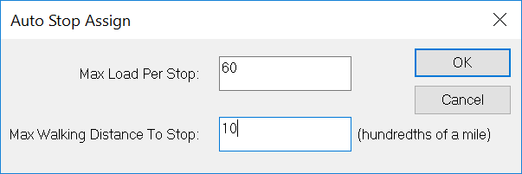
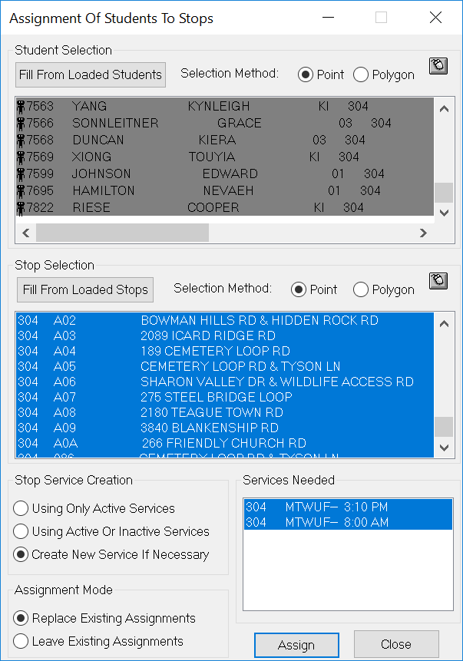
Auto Stop Assign
Max walking distance to stop.
10 = .10 of a mile.

Slide 14
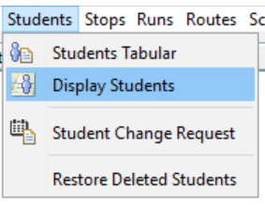
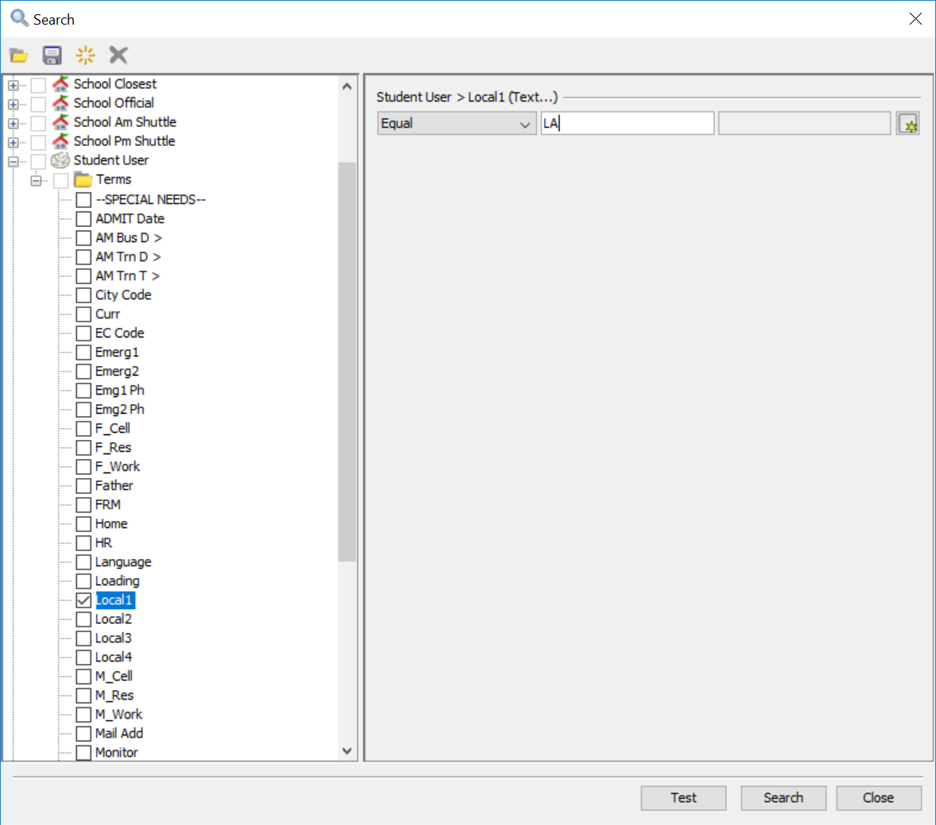
Using eSQL
Open eSQL and display your students.
Advanced Search

Slide 15
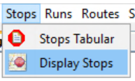
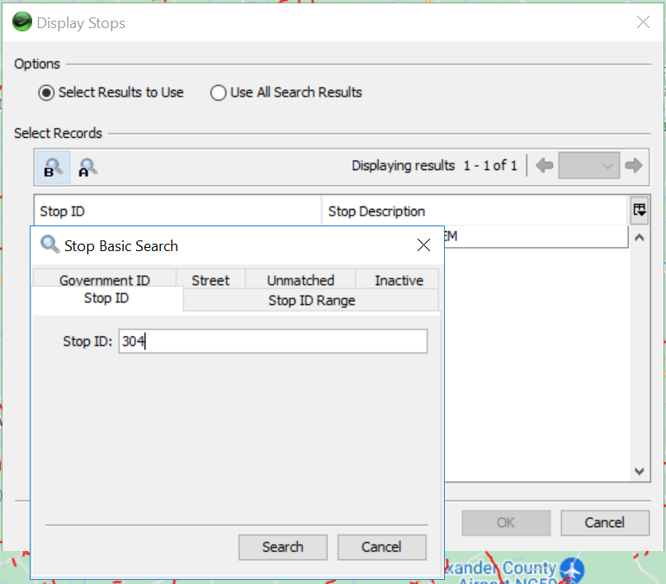
Display Your Stops
Basic Search

Slide 16
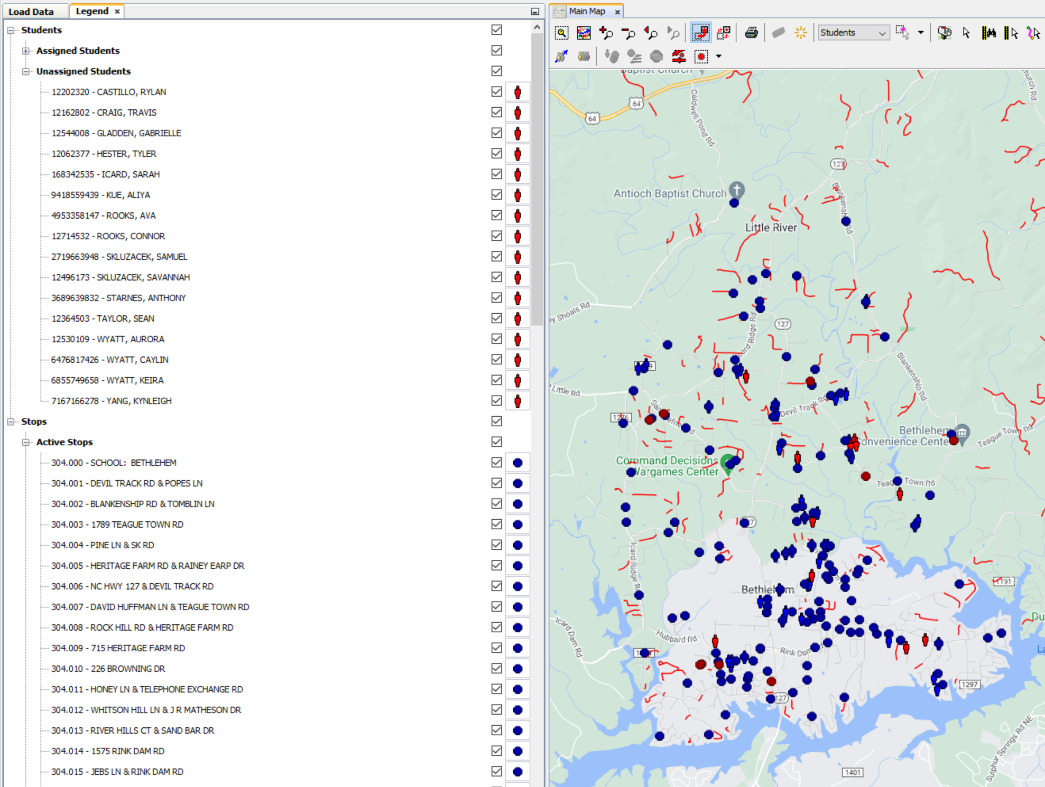
Finish Assigning Students to Stops
Assign students to a stop who were not assigned during the batch assignment.

Slide 17
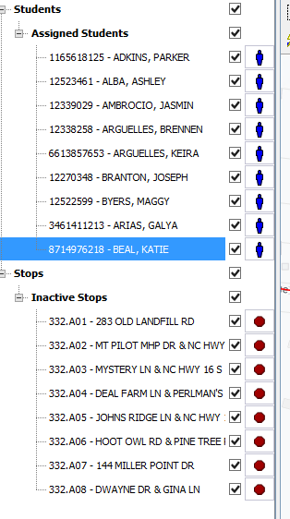
Resume Clean Up
Once your students are assigned to their stops again you are ready to clean up your runs.

Slide 18
Please reach out to your Project Leader if you need assistance with any of the Reports or Batches we covered today!

