Slide 1
TIMS
2019 Update
to
Lost Assignments
Report
Lost Assignments Data Outputs
Now Include Old Address, New Address
and New School Code

Slide 2
2019 Lost Assignments Report
Current Lost Assignments Output
The current Lost Assignments Report provides TIMS Operators with a list of all students who were deassigned from their Bus Stop in TIMS as a result of completing an UPSTU.
Students will lose their TIMS Stop Assignment when they Change Addresses or Change School Codes during UPSTU.
Students can also lose TIMS Stop Assignments due to Geocode Changes in MARIS. These students would not show a School Change or Residence Change as the Reason for the Lost Assignment
HINT: After making edits in MARIS, you can Run the Before Report before EMU Map Maintenance and then the After Report upon completion to identify students who lost assignments due to a Geocode Edit.
Current Lost Assignments Report

Slide 3
2019 Lost Assignments Report
The current Lost Assignments Report identifies each student who was deassigned from their TIMS Stop Assignment due to one of three primary reasons.
Address Change
School Change
Geocode Change
The current report, however, does not provide TIMS Operators the New Address or New School Code for each student with a Lost Assignment.
Current Lost Assignments Report

Slide 4
2019 Lost Assignments Report
2019 Lost Assignments Output
The 2019 Lost Assignments Report, just as before, provides TIMS Operators with a list of all students who were deassigned from their Bus Stop in TIMS as a result of completing an UPSTU.
The 2019 Lost Assignments Report now also provides TIMS Operators with the Old and New Address for each student with an address change as well as the New School Code for each student with a School Change.
This new output will help TIMS Staff quickly identify if the Address Change was a “True Move” to a brand new address or if the Address Change occurred because of an Address Correction in PowerSchool (fixed misspellings or removed an Apartment number, etc.)
2019 Lost Assignments Report

Slide 5
2019 Lost Assignments Report
2019 Lost Assignments Output – Deleted Bus Riders Report
The 2019 Lost Assignments Database also includes a new Deleted Riders Report.
This new report lists each student who was assigned a Bus Stop in TIMS, but who are no longer enrolled in the LEA and were deleted from TIMS during UPSTU.
TIMS Staff should review the Assigned Runs and Routes for each of these stops and deassign the stop if it is now empty. Stops that are not assigned to a Run should then be deleted from TIMS as part of this deassignment process.
2019 Lost Assignments Report

Slide 6
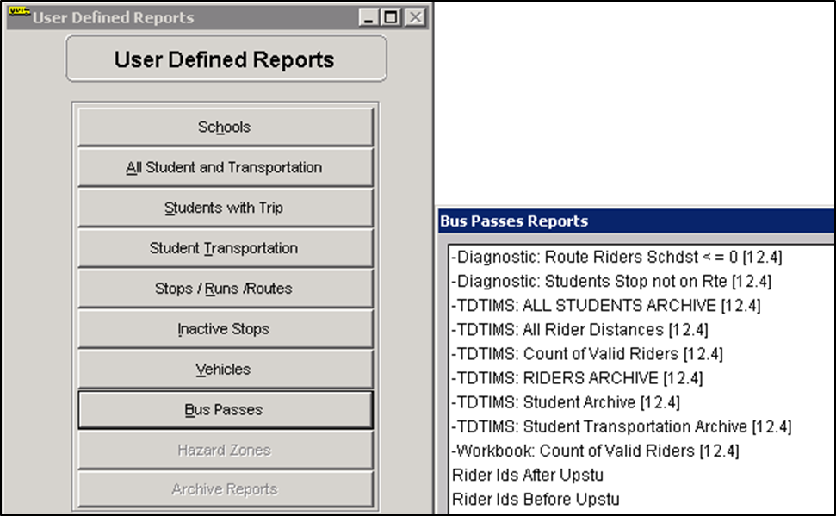
2019 Lost Assignments Report
2019 Lost Assignments Report – Before and After Files
The Updated Lost Assignments Database uses the same TIMS Reports to create the list of Students Who Lost Assignments.
TIMS Staff still need to generate the Rider IDs Before UPSTU and Rider IDs After UPSTU Reports in the proper order as normal.
The Rider IDs Before and Rider IDs After UPSTU Reports are found in the
User Defined> Bus Passes
section of Edulog Reports.
These reports create a file on the TIMS Server named
QMF_Before.TXT
QMF_After.TXT
These files are typically generated in the C:\Lost Assignments folder.
Before and After Files

Slide 7
2019 Lost Assignments Report
2019 Lost Assignments Report – Before and After Files
The 2019 Lost Assignments Database can be found in the Lost Assignments Folder on the LEA TIMS Server, typically located at C:\Lost Assignments
After completing an UPSTU and correctly generating the Before and After Files, Open the 2019_Lost_Assignments.accdb by Double-Clicking on the Database.
The current Lost Assignments Database may also be in this folder and is named
Retrieve Lost Assignments.accbd
Before and After Files

Slide 8
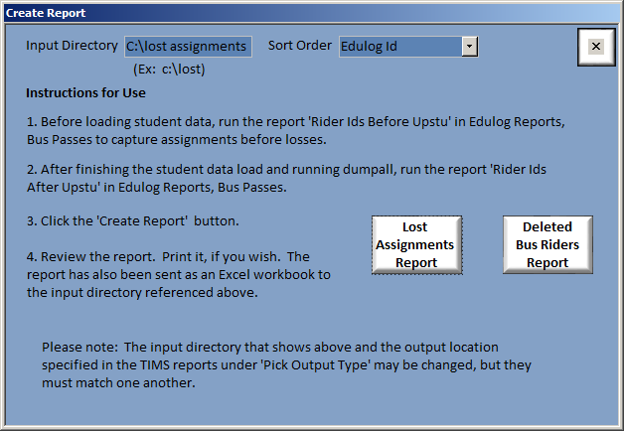
2019 Lost Assignments Report
2019 Lost Assignments Report – Generating the New Outputs
Make Sure the Input Directory matches the location where the Before and After Files are being created by Edulog Reports.
This location is C:\Lost Assignments for most TIMS Servers in North Carolina.
The 2019 Lost Assignments Database looks very similar to the previous version and still allows TIMS Staff to Generate\List\Sort the results of the Lost Assignments Report by Edulog ID, Residence Change or School Change.
After selecting the preferred Sort Order, click on the Lost Assignments Report button to view\print the list of Lost Assignments.
On the Main Menu, there is also a button to view\print the list of Deleted Bus Riders.
2019 Lost Assignments Report

Slide 9
2019 Lost Assignments Report
2019 Lost Assignments Report – Generating the New Outputs
After clicking on the buttons to view\print the Lost Assignments Report or the Deleted Bus Riders Report, the updated Lost Assignments Database will also create an Excel Spreadsheet that matches the data displayed on the printed reports.
Some TIMS Staff prefer Excel Spreadsheets to Paper Printouts, so both options are now available.
2019 Lost Assignments Outputs

Slide 10
2019 Lost Assignments Report
2019 Lost Assignments Report – Finding the Excel Outputs
By default, the Excel Spreadsheet list of Lost Assignments and Deleted Riders can be found in the same folder as the 2019 Lost Assignments Database.
C:\Lost Assignments
2019 Lost Assignments Excel Spreadsheets

Slide 11
2019 Lost Assignments Report
2019 Lost Assignments Report –Excel Outputs vs. Paper Printouts
Please note that both the Paper Printouts and the Excel Spreadsheets contain the exact same information.
Excel Outputs vs. Paper Printouts

Slide 12
2019 Lost Assignments Report
The 2019 Lost Assignments Report now provides TIMS Staff with the following information and outputs…
The old and new address for all Students with an Address Change
The new School Code for all Students with a School Change
A new list of Deleted Bus Riders
Excel Spreadsheet Outputs for the results of the Lost Assignments and Deleted Riders Reports
2019 Lost Assignments Report

Slide 13
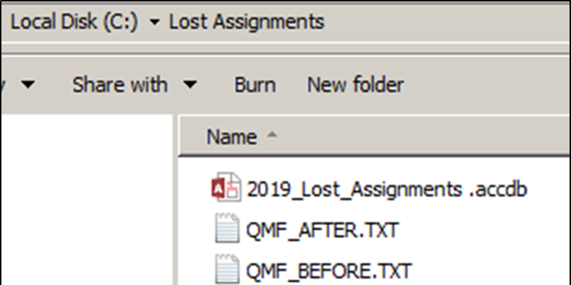
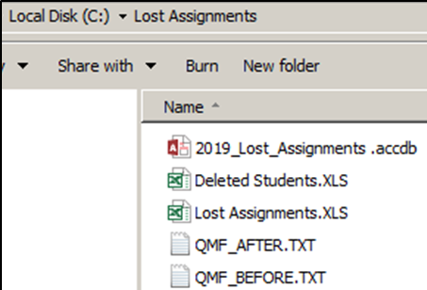
2019 Lost Assignments Report
2019 Lost Assignments Report – Summary
The 2019 Lost Assignments Database can be found in the Lost Assignments folder on the LEA TIMS Server.
(C:\Lost Assignments)
The program requires the same Before and After Files as the current Lost Assignments Report.
Open the database and choose which report you want to view, print and\or generate.
Lost Assignments Report
Deleted Bus Riders Report
In addition to Viewing or Printing the Reports, the new database will also create an Excel Spreadsheet inside the same folder where the database is located.
2019 Lost Assignments Report

Slide 14
TIMS
2019 Update
to
Lost Assignments
Report
Lost Assignments Data Outputs
Now Include Old Address, New Address
and New School Code

