Slide 1
Protecting our students at the bus stop… and in a bus emergency
NC Department of Public Instruction
August, 2015
Notes:
This training is offered to all LEA’s to present to their Teachers prior to the start of the 2015-16 school year. It is recommended that the person that is going to use this look at each video prior to showing the teachers to familiarize themselves with the material.
A projector, internet connection and speakers are needed.

Slide 2
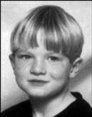





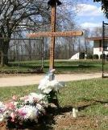

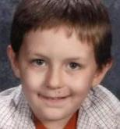




THE NEED FOR SAFE school BUS TRANSPORTATION
Thirteen NC Loading Zone Fatalities since 1998
School Bus Drivers are the only adults in a position to have a direct impact on student safety at every bus stop!
Notes:
School buses are transporting precious cargo. Not only are they transporting the future, they are transporting somebody else’s baby. When parents put their child on the school bus they are entrusting the school bus driver with their child’s safety and well being.
We need to learn from the past to insure the safety of our riders in the future
Since 1998 thirteen students have been killed in the loading zone.
In order to protect children in the future, we must acknowledge that the only adults in a position to have a direct impact on student safety at every bus stop are school bus drivers.

Slide 3
School bus emergencies what students should know
To remain Calm
LISTEN to the Bus Driver
Follow directions from the Driver.
Know What to Do. Learn where all the emergency exits are and how to use them.
Participate in emergency drills.
Tell the driver immediately if you are injured.
Wait to contact parents until told to by the driver, teacher or principal..
Notes:
When transporting almost 800,000 students in over 13, 300 school buses you are bound to have an emergency. Students need to be prepared for this and they are required to receive instruction twice a year about what they are to do in such emergencies.
Remain Calm. In an emergency it is up to you to stay calm.
LISTEN to the bus driver and follow directions carefully the first time they are given.
Know What to Do.
Learn where all the emergency exits are and how to open the door or window.
There is one emergency window on each side of a large school bus, two roof hatches on the top of the bus and one emergency door at the back of the bus, and, of course, the front door.
Participate in emergency drills.
Reporting Injury. Tell the driver immediately if you are injured.
Contacting Parents. Wait to contact parents until told to by the driver, teach or principal..

Slide 4
Bus evacuation procedures what students should know
Leave the bus only when the driver tells you to leave.
Follow the driver’s instructions on which exits to use.
Remain Calm and Remain Seated until your turn to exit. Leave personal items on the bus
Do not crowd the aisle and Do NOT push.
Secure loose clothing so it won’t get caught on the door or any other part of the bus.
Move at a Brisk Pace but Carefully.
Duck your head and bend your knees if you must use the rear emergency door.
Move away from the bus. Be aware of possible dangerous situations.
Go to a safe location as directed by a bus driver, police or emergency workers
Notes:
Know when to Evacuate. Students are usually safer on the bus than outside the bus; however, certain situations – like some accidents or fire - may require that you leave the bus.
Leave the bus only when the driver tells you to leave.
Follow the driver’s instructions on which exits to use.
Remain Calm and Remain Seated until your turn to exit.
Do not crowd the aisle and Do NOT push. Leave personal items on the bus.
Secure loose clothing so it won’t get caught on the door or any other part of the bus.
Move at a Brisk Pace but Carefully.
Duck your head and bend your knees if you must use the rear emergency door.
Move away from the bus. Be aware of possible dangerous situations.
Follow directions of driver and remain calm.
Go to a safe location as directed by a bus driver, police or emergency workers

Slide 5









Thirteen fatalities
Dalton Falwell Priscilla Norton Sheila Hernandez
Terrance Howard Ana Maria Sola Miguel Posada
Nicholas Adkins Adam Kempf Maria Fernandez Jiminez Makinsy Smith
Ashley Ramos Hernandez Hasani Wesley Alyiah McKenzie Morgan
Close call with Log Truck
Notes:
The link on the bottom will bring you to a NCBUSSAFETY page, you have to scroll down to the bottom of that page and click on the “View the Log Truck Video” button
Again mention that there have been thirteen fatalities since 1998. You could add a little information on each child that we lost to personalize the message. Below is basic information on each child
Dalton Folwell – 7 years old – May 17, 1999
Hispanic female motorist driving on an international driver’s license did not know the requirement to stop for the stop arm and red lights. She struck Dalton, traveling in the opposite direction from the school bus
Terrance Howard – 5 years old – February 20, 2002 - Struck and killed by oncoming motorist.
Bus had not come to a complete stop.
Priscilla Norton - 15 years old – April 16, 2003 - Exiting the bus when a motorist (66 year old female) went around the bus on the right side (brake failure)
Ana Maria Sola – 6 years old – November 5, 2003 - Crossing the street to catch the bus. Struck and killed by oncoming motorist. The driver was a student on his way to school.
Sheila Hernandez – 5 years old – January 13, 2004 - Boarding the bus when a truck slammed into the back of the bus. Bus did not have parking brake set, and was literally pushed into another county.
Miguel Posada – 6 years old – October 19, 2004 - Crossing the street to catch the bus. Struck and killed by oncoming
motorist (substitute teacher)
Nicholas Adkins – 16 years old – January 26, 2009 - 63 year old woman reportedly did not see Nick – or the flashing lights - until it was too late.
Ashley Ramos Hernandez – 6 years old - August 19, 2009 - 83 year old woman thought the bus was turning and, when it didn’t, proceeeded through the stop sign, striking and killing Ashley.
Adam Kempf – 12 years old – October 25, 2012 - Adult male driving a van with Mexican driver’s license passed the stopped school bus and swerved in an attempt to avoid hitting Adam. Charged with driving without a license and death by motor vehicle.
Hasani Wesley – 11 years old – December 19, 2012 - 47 year old man was driving in the opposite direction.
Maria Fernandez Jiminez – 14 years old – March 25, 2013 - Crossing before bus was stopped. Amber lights activated. No stop sign or red lights.
Alyiah McKenzie Morgan – 7 years old – April 23, 2013 - Afternoon stop. Log truck passed the bus from the rear on 2-lane US 421.
Motorist Johnny Allen Spell charged with Felony Passing a Stopped School Bus, Felony Hit & Run, Involuntary Manslaughter and DWI While Operating a Commercial Motor Vehicle
Makinsy Jordan Smith – 17 years old – October 17, 2013 - Morning stop, 6:30 AM. Motorist 57 year old Barbara Smith passed the extended stop arm and flashing lights, striking Makinzy. There were no skid marks.

Slide 6
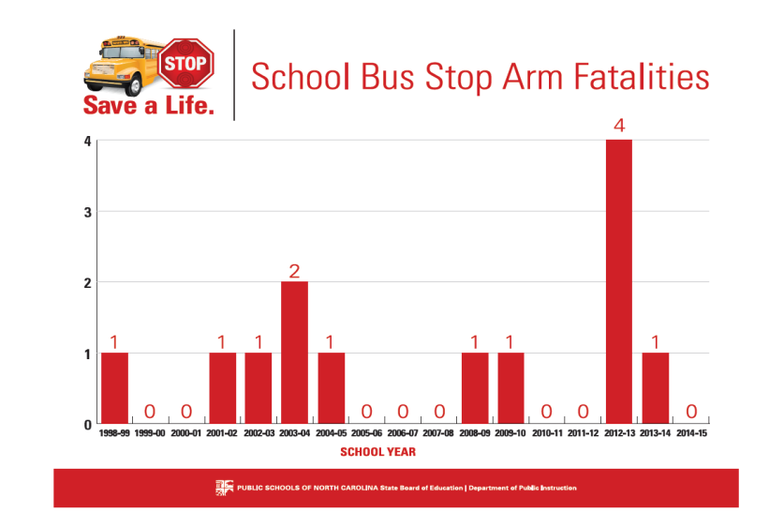
2014-15 zero fatalities – 8 students injured by passing motorists
Notes:
Another example of why we need to do something different. Although we did not have any fatalities in 2014-15 , we had 5 different incidents involving the injury of 8 students due to passing motorists:
9/30/14 One student injured - 11 years old – hit by passing motorist – 16 year old student driver (AM)
10/2/14 Two students injured – 5 and 10 years old – hit by passing motorist – 27 year old unlicensed driver (AM)
12/12/14 One student injured – 17 years old – hit by passing motorist – 72 year old driver (AM)
12/19/14 Three students injured – 9, 10 and 15 years old – hit by passing motorist – 85 year old driver (AM)
3/25/15 One student injured – 14 years old – hit by passing motorist – 33 year old unlicensed driver (AM)

Slide 7
Bus stop safety awareness
There are many resources available to help LEA’s with bus stop safety
    Safety Video
    Public Awareness Resources
Clearly we must do everything possible, as a state, an LEA, a Teacher and/or a Bus Driver to prevent further fatalities
      Safety Lessons for Students
  Teachers Tool Kit - Love the Bus
  Press Release
Notes:
The “Safety Video” is a 30 second Public Service Announcement from 1997. This PSA is still pertinent today. The first link will bring you to another link that you will need to press to get the video.
The “Public Awareness Resources” link brings you to http://www.ncbussafety.org/StopArmViolationAwareness.html that has the resources for the awareness campaigns.
It is not that these campaigns have not been effective, as they do reach people, but they have not been effective enough. We need to do more.
The Safety Lessons link brings you to the NCBUSSAFETY website that has several types of helpful lessons to use with students.
The Teachers Tool Kit is a link the American School Bus Councils (ASBC) website that provides resources to educators to help teach school bus safety in their classroom.
Included as a link is the press release regarding the new crossing signal. You may want to print this out instead of reading it from screen

Slide 8
NORTH CAROLINA CROSSING SIGNAL
Effective January 1, 2016 North Carolina school districts will be using a standard crossing signal to help protect students when they need to cross the street to board the bus or after exiting the bus.
A driver signal is recommended in the National School Transportation Specifications & Procedures Book
The Federal Commercial Driver’s License Manual includes in their procedures a drivers signal
Notes:
At the national level, and in most states, there is a signal that drivers must use, and students must follow, that tells students when it is safe to cross.
Vehicles passing stopped school buses while their red warning lights are on is an epidemic across the United States. In North Carolina alone “We have over 15 years of data to show that more than 3,000 cars per day are not going to stop. If we’ve got that information, then we know public awareness alone can’t be enough to reverse this behavior, especially with more distractions out there on the road” said Derek Graham, section chief of NCDPI School Transportation Services. (for July 9, 2015 news release)
There are success stories, all of which include getting the students attention prior to crossing the street. They include a drivers signal and instructing the students daily about the dangers of even stepping off the bus.

Slide 9
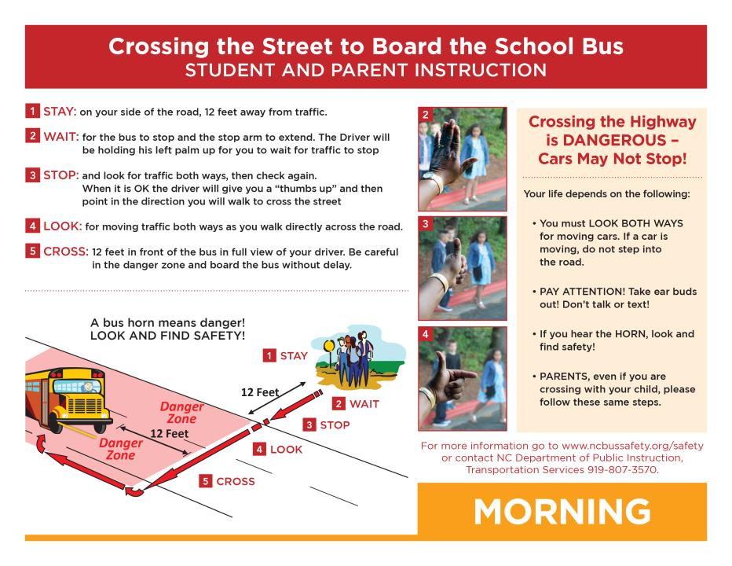
Crossing procedure - am
Notes:
It is important to have the same lessons taught and supported by all of us in the education system.
If the students do not follow the procedure, there needs to be a reporting system in place to insure the safety of the student.
This slide should be discussed step by step

Slide 10
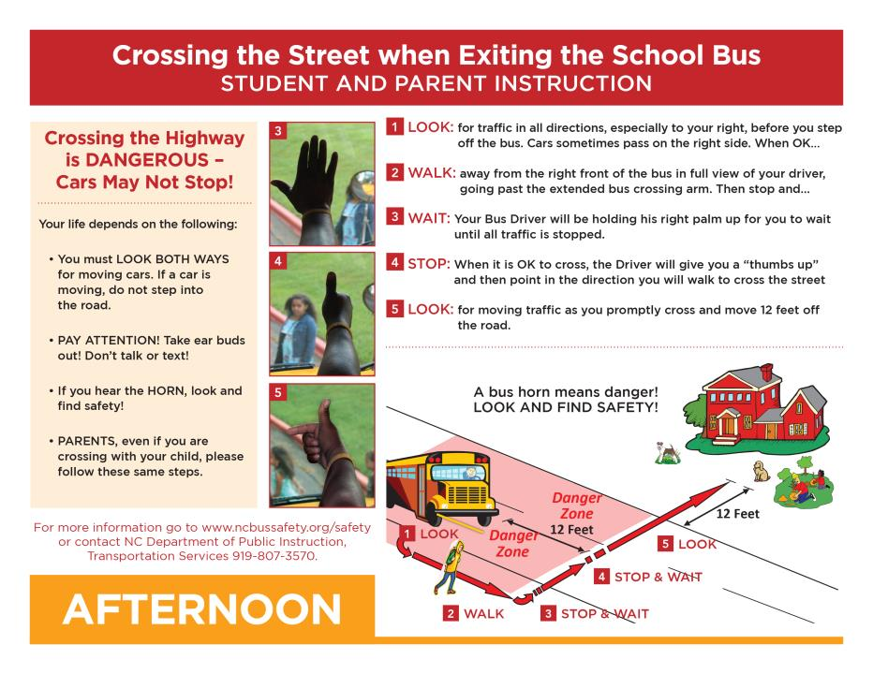
Crossing procedure - PM
Students should be taught to look both ways before they step off the bus
Notes:
It is important to have the same lessons taught and supported by all of us in the education system.
If the students do not follow the procedure, there needs to be a reporting system in place to insure the safety of the student.
Students should be taught to look both ways before they step off the bus, passing motorist also pass the bus on the right. There are also instances where a bicyclist may pass the bus while a student is exiting.
This slide should be discussed step by step

Slide 11
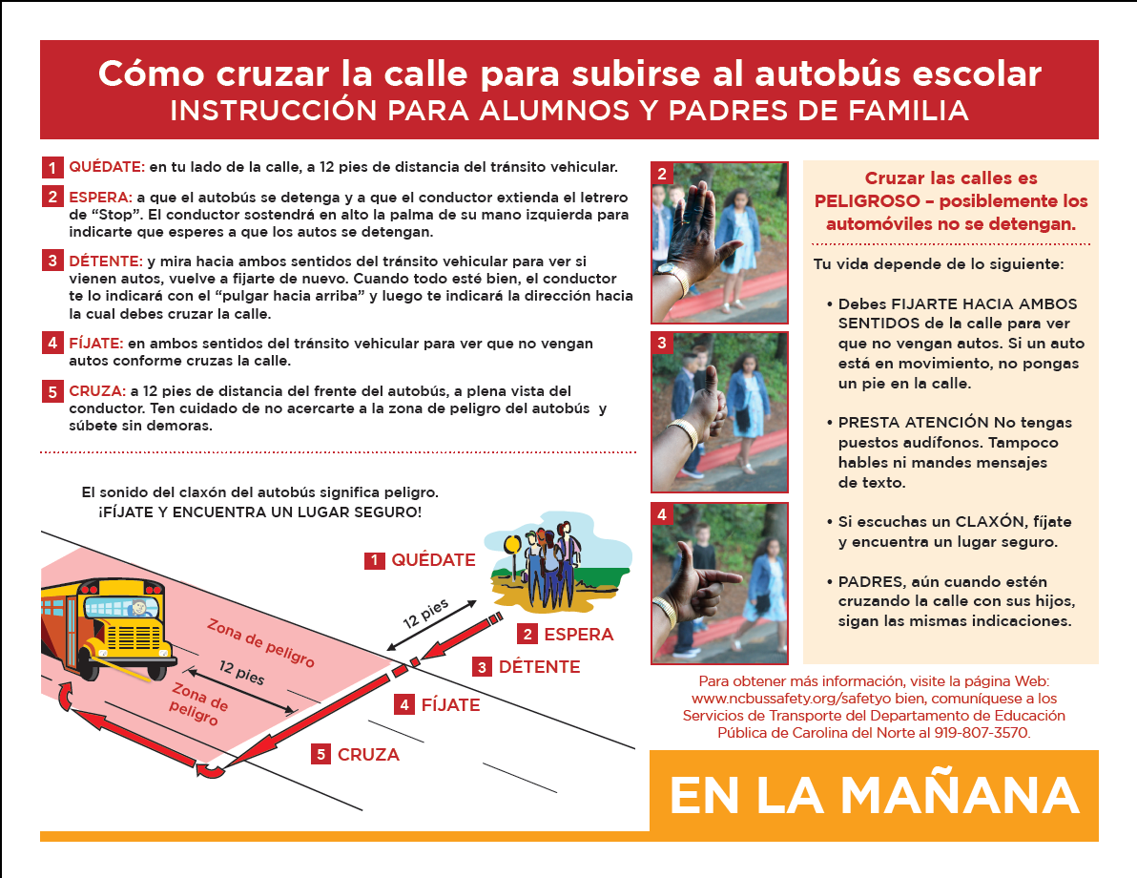
en español

Slide 12
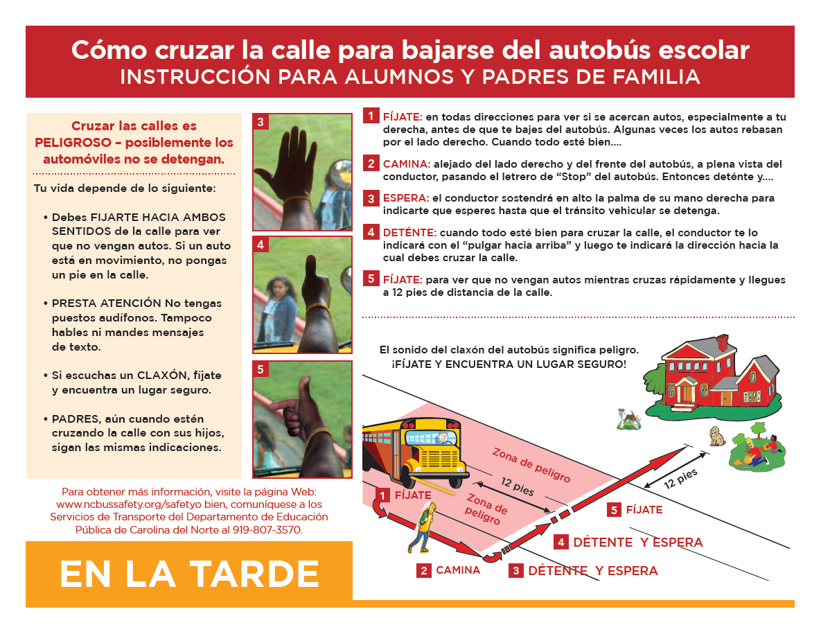
en español

Slide 13
Getting the students attention
A key to the crossing signal is the fact that you are getting the students attention.
If students are wearing earbuds/headphones, or are talking on the phone, or are texting, the Driver does not have their attention.
#BRAKE4BUSES
Notes:
The “#BRAKE4BUSES” video is another 30 second PSA that supports the notion of the student must pay attention, as well as the motorists must stop.

Slide 14
In conclusion
We must take every step to protect the students we transport
We cannot control the other motorists, we can do everything we can to make them aware of the dangers of passing a stopped school bus
We can emphasize, in the classroom as well, the importance of paying attention at the bus stop and following the bus drivers directions
We can emphasize, day after day, at each bus stop that the student must look both ways exiting the bus, then continually when crossing the road and that they look at the driver to get the signal to cross.
WE NEED THEIR ATTENTION
TO MAKE SURE THEY PAY ATTENTION!

