Slide 1
Lessons From
Fox River Grove
North Carolina Department of Public Instruction
Transportation Services
July, 2016

Slide 2
Fox River Grove School Bus / Train Crash
Over 20 years later, the lessons learned still ring true……

Slide 3


Slide 4
The Story – October 25, 1995
Regular school bus driver was not available for the route
The regular substitute bus driver was not available
An assistant transportation director drove the route, but was unfamiliar with that route
Approaches tracks and does a proper stop/look/listen, including turning down the FM radio currently in operation
Turns the radio back up and crosses the track, thinking it is necessary to approach the intersection in order for the red light to turn green
Not enough room for the bus to fit – hanging 3” over the nearest rail, but the train hangs 3 feet outside the rail.

Slide 5
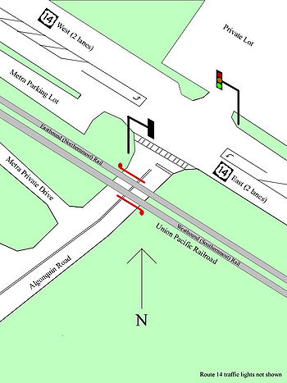
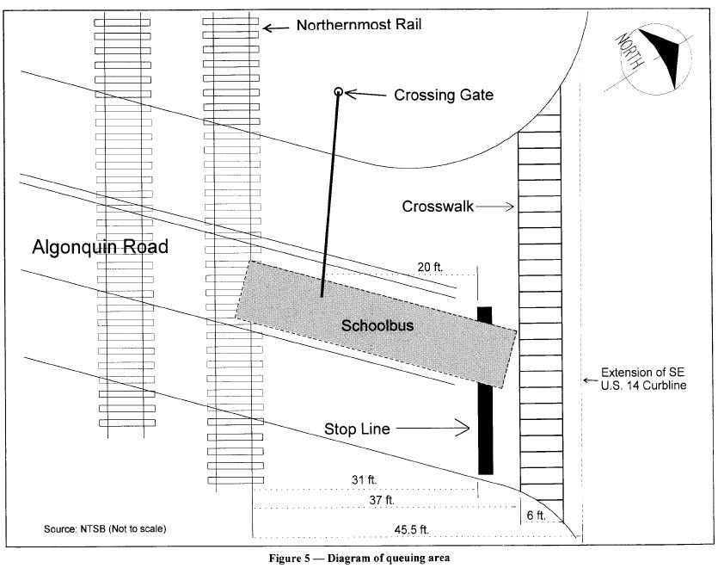

Slide 6


Slide 7
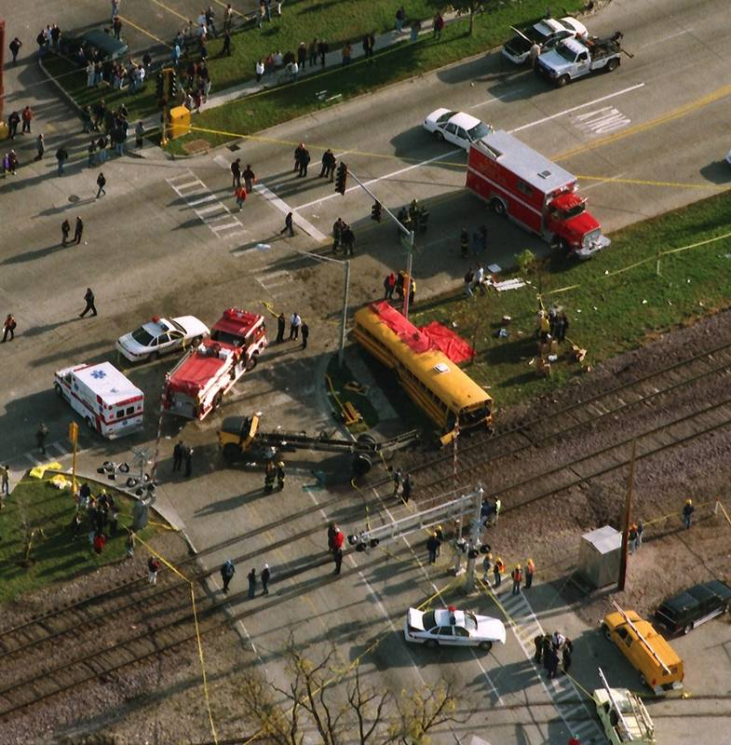
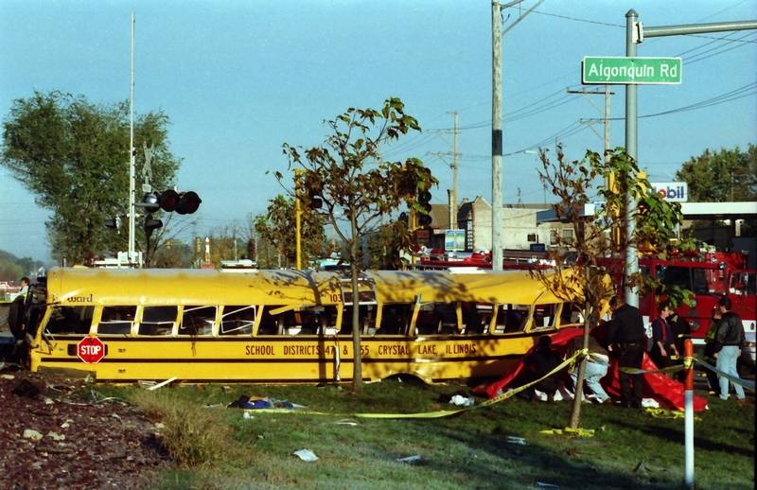
Body/Chassis
Separation
Bus Body
Chassis/
Hood

Slide 8
Contributing Factors
Roadway design, interaction of rail traffic with stop lights to ensure traffic is cleared
School Bus Driver not familiar with the route. She did NOT have to cross the track for the light to turn green. Bus did not fit.
FM radio speaker close to the driver’s head and noise of students made it hard to hear the sounds of the train.

Slide 9

National Transportation Safety Board (NTSB)
Re-creation of the environment prior to the crash
0:00 – 0:41 – Engineer’s Perspective
traveling 69 mph over bridge
0:43 – 1:19 – Gates, Train as scheduled

Slide 10
NTSB Re-enactment Video
Shows the view from the school bus driver’s seat
FM Radio playing the music that was playing at the time of the crash …… the train whistle blends right in with the music
Can you hear the train whistle blow three times at the 5-6 second mark? (make sure volume all the way up – play it over til you hear it)
Complicated by the noise of the students who saw the train coming, virtually impossible for the driver to hear the train

Slide 11
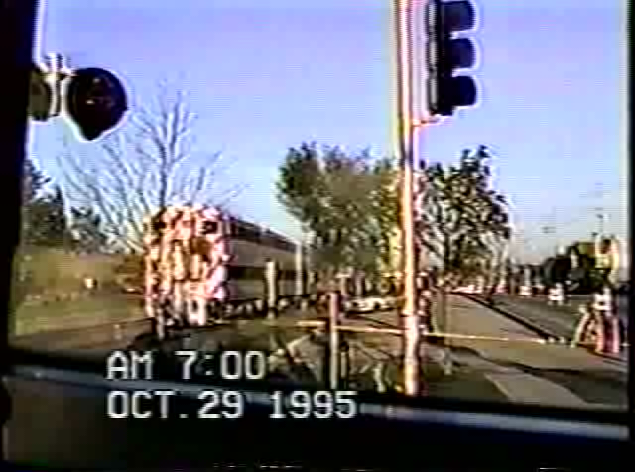
Insert re-enactment video
Insert Radio playing video….replay to hear the train whistle

Slide 12

National Transportation Safety Board Recommendations
To the School District: Develop a program to identify possible hazards on all bus routes. Review the information with both regular and substitute bus drivers regularly.
To the National Association of State Directors of Pupil Transportation Services:
  Advise their members of the accident and its circumstances.
  Develop programs for the identification of hazards on bus routes.
  Develop guidelines for the appropriate placement of radios on school buses.
  When establishing bus routes, consider unusual operating characteristics or grade crossing accident histories.
  Advise members to disable radio speakers located next to drivers' heads.

Slide 13
Resources
NASDPTS Railroad Safety
http://www.nasdpts.org/Operations/Railroad.html
NASDPTS Route Hazard Report
http://www.nasdpts.org/Operations/Routes.html
WWW.NCBUSSAFETY.ORG

