Slide 1
BACKING SAFETY
Excerpt from NC School Bus Driver Training Course
NC DMV School Bus & Traffic Safety Section

Slide 2
BACKING SAFELY
Backing is always dangerous; avoid it whenever you can
When parking, try to park so you will be able to pull forward when leaving
When you have to back, use simple safety rules:
  Start in the proper position
  Look at your path
  Use mirrors on both sides
  Back slowly
  Back and turn toward the driver's side whenever possible
  Use a helper
  Use the hazard lights (four-way flashers) and sound the horn to alert other motorists

Slide 3
BACKING SAFETY RULES
• Turn around only at places designated by the principal.
• Always keep the bus in the proper lane of travel.
• Observe all the precautions for backing.
• If you must turn the bus around by backing at a passenger
stop;
  make sure all the passengers are on the bus when you back.
  If you are loading passengers at the turn around point, load them onto the bus before turning around.
  If you are unloading passengers at the turn around point, unload after turning around.

Slide 4
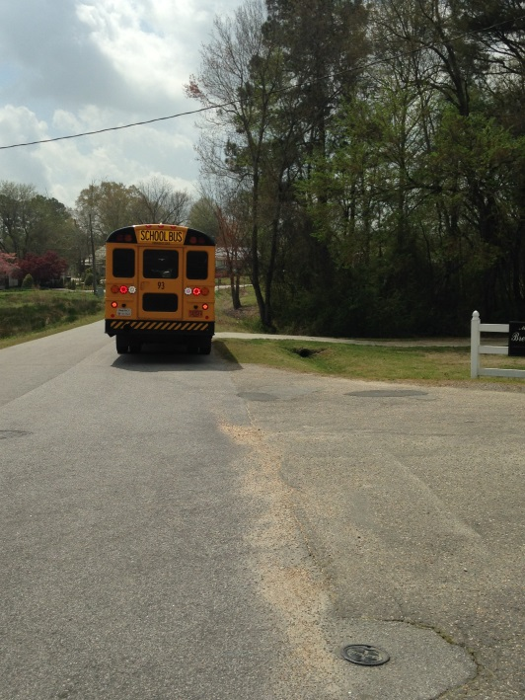
START IN PROPER POSITION
Put the vehicle in the best position to allow you to back safely.
This position will depend on the type of backing to be done.
Right side road turn around

Slide 5
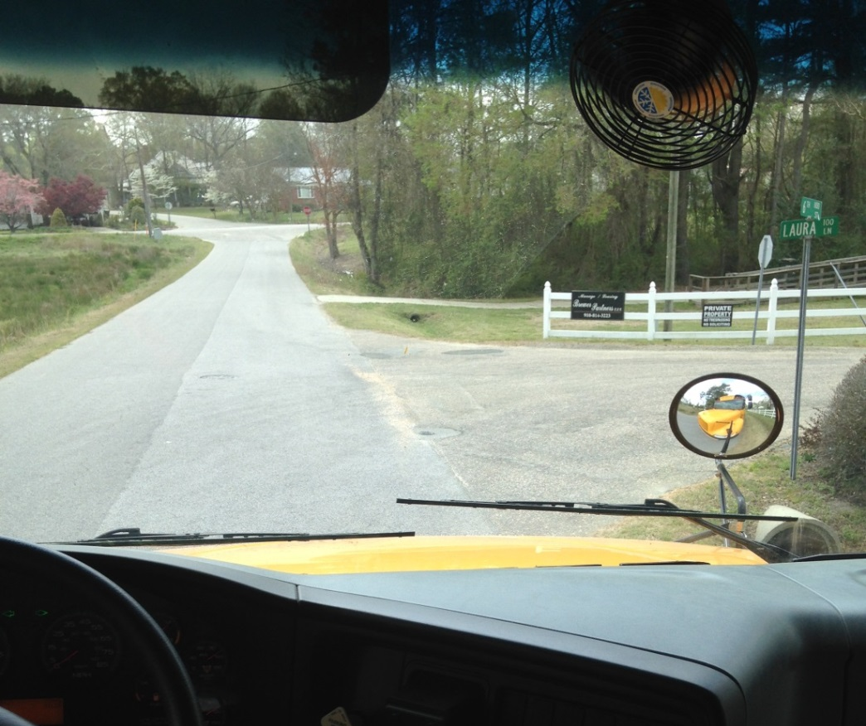
LOOK AT YOUR PATH
Look at your line of travel before you begin
Check your clearance to the sides and overhead, in and near the path your vehicle will take
Street Sign
Stop Sign
Ditch
Fence
Bush

Slide 6
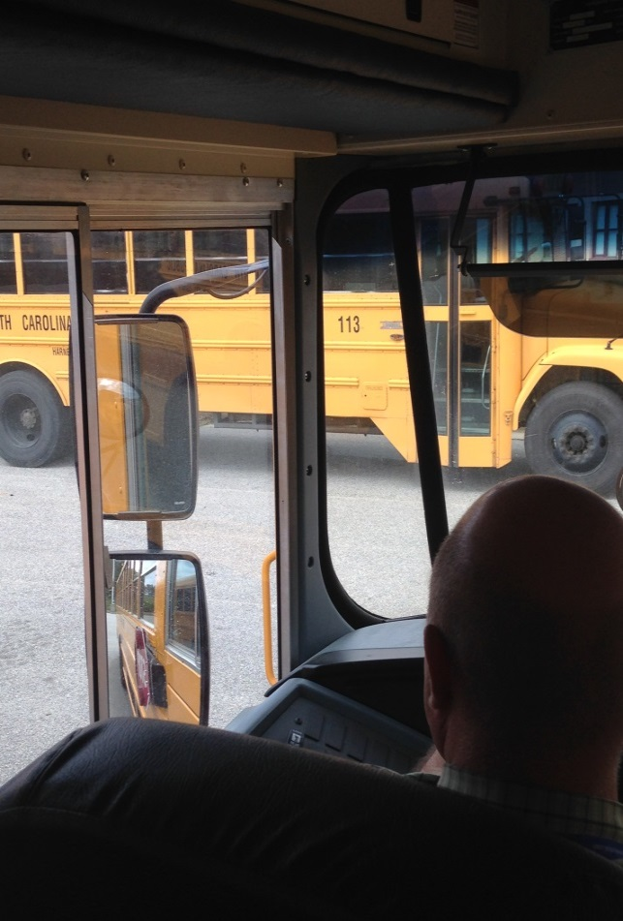
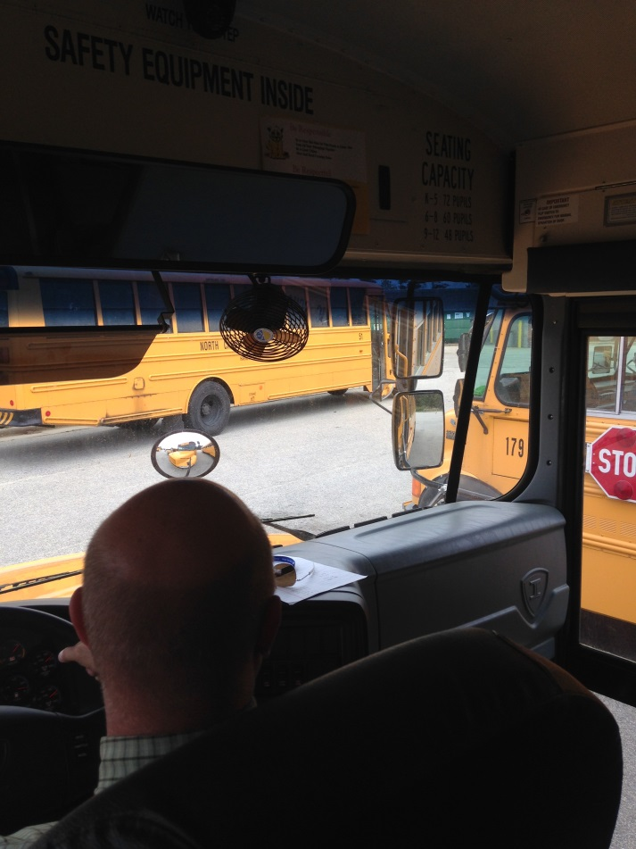
USE MIRRORS ON BOTH SIDES
Frequently check the outside mirrors on both sides

Slide 7
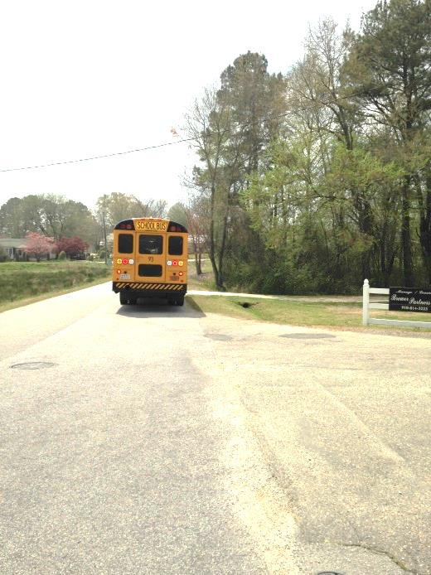
BACK SLOWLY
Always back as slowly as possible
  Allows you to easily correct any steering errors
  Allows you to stop quickly if necessary

Slide 8
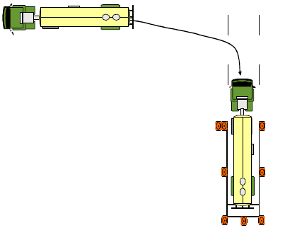
BACK AND TURN TOWARD THE DRIVER’S SIDE
Back and turn toward the driver’s side
  Allows you to watch the rear of the vehicle by looking out the side window

Slide 9
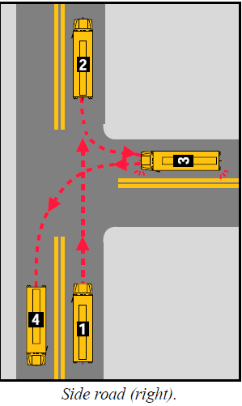
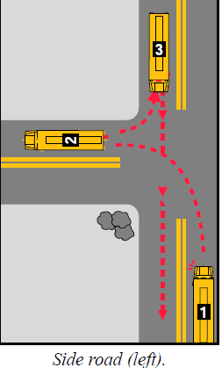
TURNING AROUND
Note: If backing on the roadway with a school bus, use either side road right or side road left

Slide 10
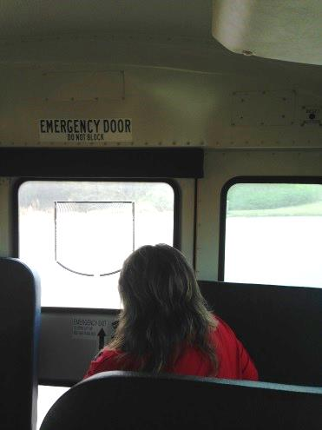
USE A HELPER
Use a helper since there are blind spots you can't see
Before you begin backing, work out a set of signals that you both understand
Agree on a signal for "stop"

