Slide 1
TRANSPORTATION FINANCE

Slide 2
Reimbursement (TD19)
Transportation Services
NC Dept. of Public Instruction

Slide 3
NC Public School Laws
Insurance
Reimbursement
  Liability
Buses
Contract Transportation
  Laws
DPI
Drivers
Funding
HELP!!!!!!

Slide 4
Reimbursement Law / Policy
115C-242 Use and Operation of School Buses
  Intent is to pay for to and from school transportation
  Allows other approved use with conditions
DPI Allotment Policy Manual
  PRC 056 cannot be used to support other local, federal, or state programs
  “When allotted state transportation funds are used to provide transportation services for these programs, the responsible program must reimburse this fund.”

Slide 5
Two Primary Sources
Extra Use of the Yellow Bus
  Handled by the Yellow Bus Refund Rate
  Ensure full cost of extra use is covered
Use of PRC 056 funded resources for repair and maintenance of the local fleet
  Handled by MCIS report from BSIP
Both sources are combined together to complete the TD-19 refund report

Slide 6
Extra Use of the Yellow Bus

Slide 7
Permitted Without Refunding
Transportation To and From School and for the Regularly Organized School Day.
One day prior to start of school
Illness or Injury of Employee or Student
EC Students to Private Program (at LEA’s discretion)
Alternative Schools
Extended School Day Programs

Slide 8
Refund Rate Guide
Category #1 | Category #2 | Category #3 | Category #4
Full Reimbursement Rate | State Programs | Full Rate (Driver Paid Separate) | State Programs (Driver Paid Separate)
Tran. Personnel Salary |  | Tran. Personnel Salary
Driver Salary | Driver Salary
Benefits | Benefits | Benefits
Oil | Oil | Oil | Oil
Tires & Tubes | Tires & Tubes | Tires & Tubes | Tires & Tubes
Vehicle Repair Parts | Vehicle Repair Parts | Vehicle Repair Parts | Vehicle Repair Parts
Fuel | Fuel | Fuel | Fuel
Capital Replacement |  | Capital Replacement
Tort (Insurance) Cost |  | Tort (Insurance) Cost

Slide 9
Key is State Initiatives
Non-State (Category #1 or #3) | State Initiative (Category #2 or #4)
Other Pre-K Program, Summer School, Remediation, At-Risk Programs | State Funded Pre-K, Summer School, Remediation, At-Risk Programs
Field Trips (State Fair, Special Olympics, Symphony, Other) | Residential Schools
Senior Groups | Transporting for additional Days Beyond Normal School Year
National Guard / Emergency Management | Smart Start (State)
Even Start (Federal)

Slide 10
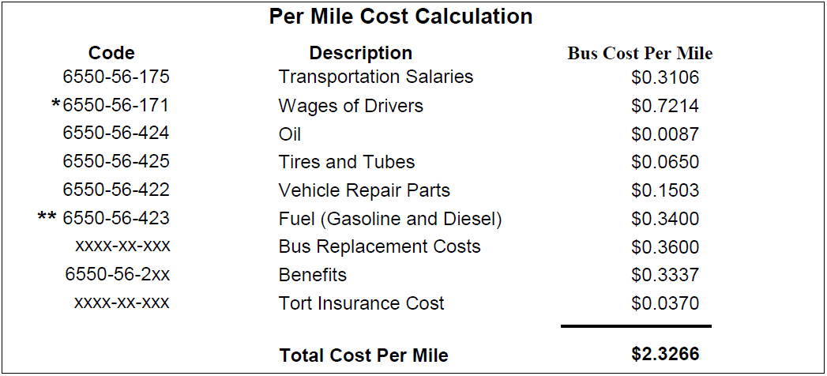
How Much? Per Mile
Refund Rates Based on Actual Expenditures, Students, and Miles Travelled from the Previous Year in each LEA
LEA Encouraged to Update for Major Fuel Price Changes

Slide 11
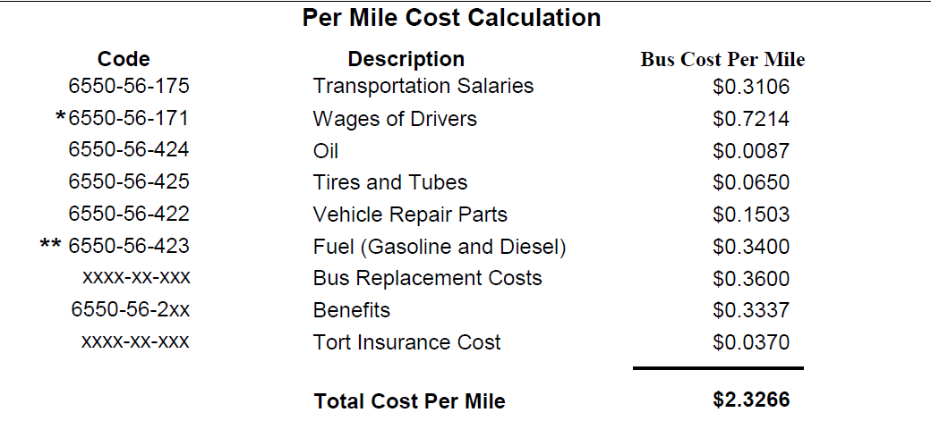
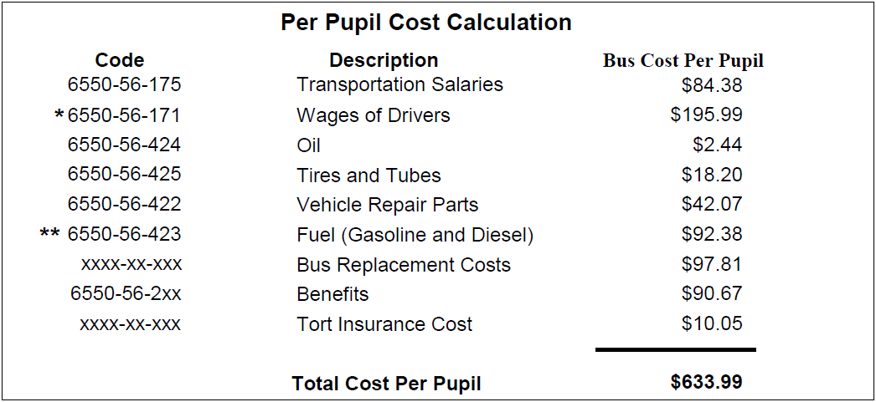
How Much? Per Student
Refund Rates Based on Actual Expenditures, Students, and Miles Travelled from the Previous Year in each LEA
LEA Encouraged to Update for Major Fuel Price Changes

Slide 12
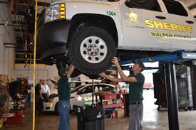
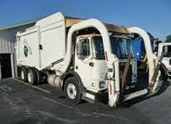
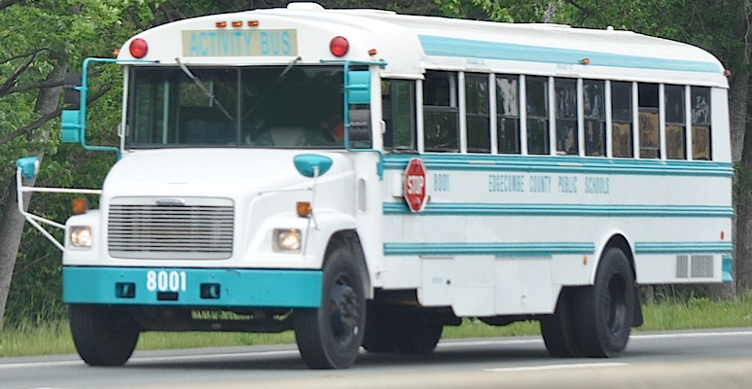
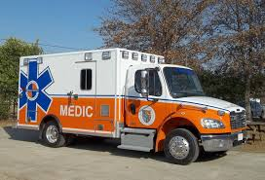
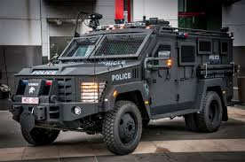
Support of Local Vehicles

Slide 13
Refunding for Local Vehicle Support
MUST refund whenever PRC 056 funded resources are used on local vehicles
Refund only what is spent
  Fuel
  Parts
  Labor (Benefits)
  Towing
  State Inspection
  Etc.
MCIS report in BSIP shows monthly expenses on a per vehicle basis as they are entered into the system

Slide 14
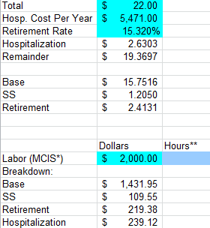
Category Breakdown
MCIS covers all category breakdowns needed except benefits
Employer Benefit Outlays are Included in Labor Rate
Use TD-19 Labor Rate Breakdown

Slide 15
Refunding – Continuity
What is easier to manage?
  All parts are bought using PRC 056 transportation funds
  Some parts are bought using 056 funds and some parts for local vehicles are bought using other funds
What is easier to manage?
  All mechanics are paid for using PRC 056 funds
  Some mechanics are paid from PRC 056 and some are paid from other local sources

Slide 16
WHY is that easier?!
Because all vehicles are treated the same
  Fill out the paperwork as normal for every vehicle.
  Mechanics can work on any vehicles they need
  All parts are fair game
Eliminates confusion
  Does this non-stock part get paid with this card or that one?
  Do I write it down on the work order?
  Do I reimburse for this time on this vehicle?
Do what needs to be done and reimburse at the end of the month based on MCIS

Slide 17

THE MONTHLY TRANSPORTATION REFUND REPORT
TD-19 REPORTING & REIMBURSEMENT

Slide 18
Now What?
Extra Use of Yellow Bus Costs (by Category)
PLUS
Resources (funds) Spent on Local Vehicles (by Category)
EQUALS
Refund to the Category on the TD-19

Slide 19
TD -19 REFUND REPORT
OBJECT CODE DESCRIPTION | OBJECT CODE | AMOUNT
TRANSPORTATION SALARIES | 6550-56-175
DRIVERS SALARIES | 6550-56-171
CONTRACTED REPAIR/MAINT- EQUIPMENT | 6550-56-326
SUPPLIES AND MATERIALS | 6550-56-411
OIL | 6550-56-424
TIRES AND TUBES | 6550-56-425
REPAIR PARTS | 6550-56-422
GASOLINE AND DIESEL FUEL | 6550-56-423
EMPLOYEE'S SOCIAL SECURITY | 6550-56-211
EMPLOYEE'S RETIREMENT | 6550-56-221
EMPLOYEE'S HOSP. INSURANCE | 6550-56-231
TOTAL - STATE PUBLIC SCHOOL FUND.......................................................………………………………………………………
MAJOR REPLACEMENTS - OTHER USE OF BUSES.......................................………………………………………………
TORT INSURANCE COST............................................................................………………………………………………………………..
TOTAL AMOUNT OF REFUND.............................................................…………………………………………………………………….
Insurance Check –
Contracted Fix
Insurance
Check –
Garage Fixed
Prorate Benefits
Insurance Check -
Total Loss

Slide 20
Transportation Reimbursement
QUESTIONS?

Slide 21
Parts issue, Records and inventory

Slide 22
Annual Report TD-1
Inventory Discrepancies Reported Annually
In the past as simple letter of justification was required and accepted
State Auditor’s Study of Pupil Transportation
  Significant focus on LEA Parts Inventory
    Replacement cycles
    Stocking Levels
  Increased focus on accountability for inventory shortages.

Slide 23
Parts Issue Process Overview
From High Above

Slide 24
Purchase
Create County PO and submit to vendor (may just be a phone call)
Wait for arrival of stock and invoice
Receive Parts into BSIP inventory and then place on a shelf (Stocked Parts)
OR
Put the part on a vehicle and charge the cost immediately to the work order in the BSIP system (Non-Stock Parts)

Slide 25
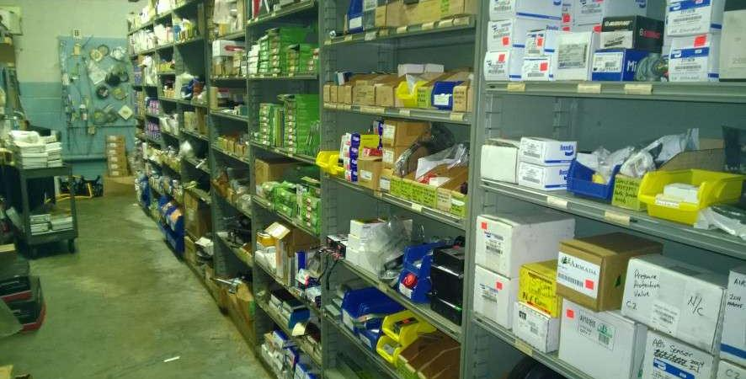
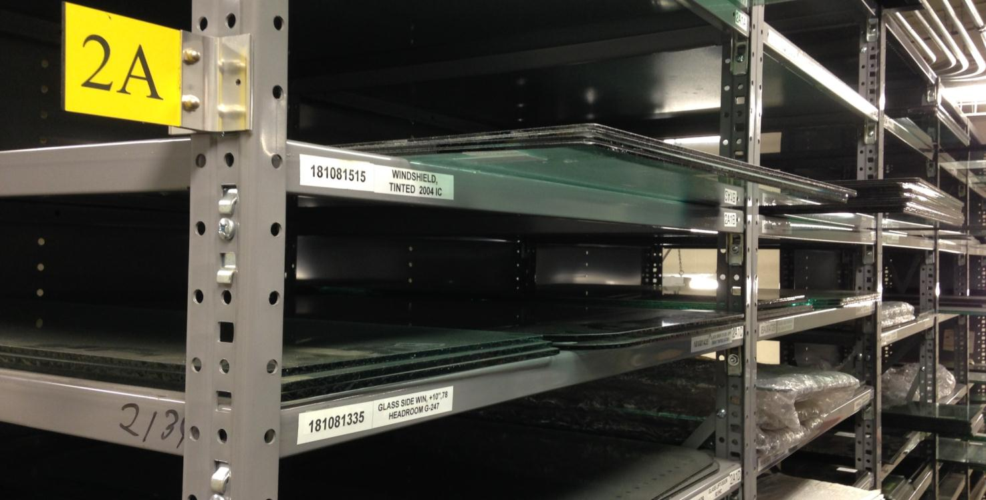

Slide 26
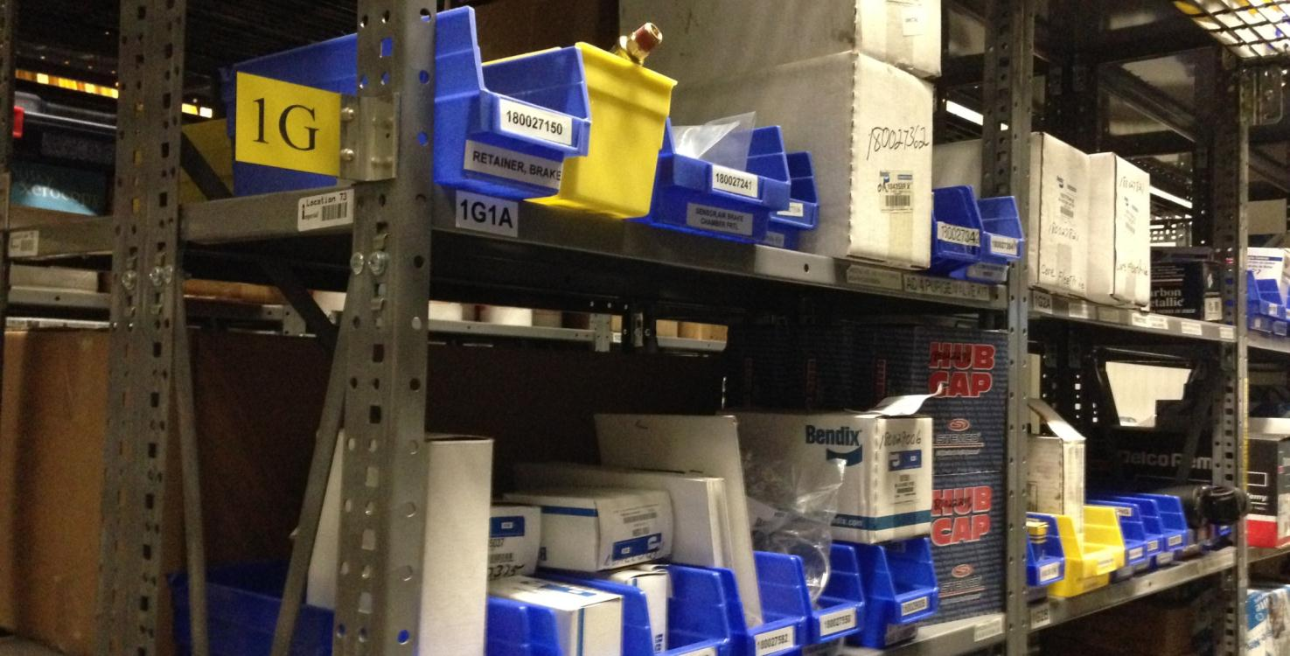
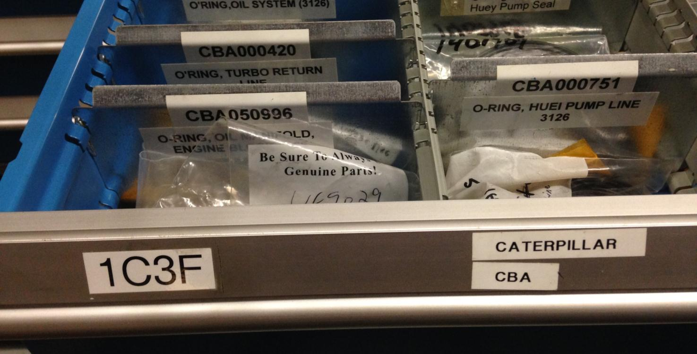

Slide 27
Distribution of Parts
As needed distribute parts to technicians to repair vehicles
Create a work order and issue the part to it
  At time of distribution
  After the job is completed via a paper work order
Non-Stock parts - Invoiced directly to the work order (attach invoice/receipt to order)

Slide 28
The Devil in the Details
Parts on Service Trucks and Field Repairs
Control of the Stock Room not Absolute
  Areas Outside the Parts Room
  Tires, out-buildings, upstairs storage
Perceived Lack of Importance in Paperwork
  Raise the bar on the information collected
  Let personnel see the data be used for something
Notes:
Parts on Service Trucks and Field Repairs
No control over this environment, but you can track your losses to the person if you’re deliberate in what allows restocking
Control of the Stock Room not Absolute
The more hands in the till, the easier it is to say ‘it wasn’t me, it was someone else’
Put someone who stays at the garage in charge of distribution (the gateway) even if they’re not sitting where the parts are
Lack of Importance in Paperwork
As transportation is often undervalued, so is paperwork
Raise the bar on the information collected
Let personnel see the data be used for something

Slide 29
High Level Keys to Success
Personal Responsibility
  However it can be instilled this is worth more than any other thing you can do
Stock Room Parts Distribution Process
  Ultimately it is about parts not leaving without being recorded in whatever form that takes
Cost Clerks and Supervisors careful review of work orders
  If the work order doesn’t make sense it should be questioned immediately
Notes:
Stock Room Parts Distribution Process
Ultimately it is about parts not leaving without being recorded in whatever form that takes
It could be as simple as a notepad cross-check of outgoing parts versus incoming paperwork
It could be as technological as issuing the part to the work order in BSIP before it leaves the room

Slide 30
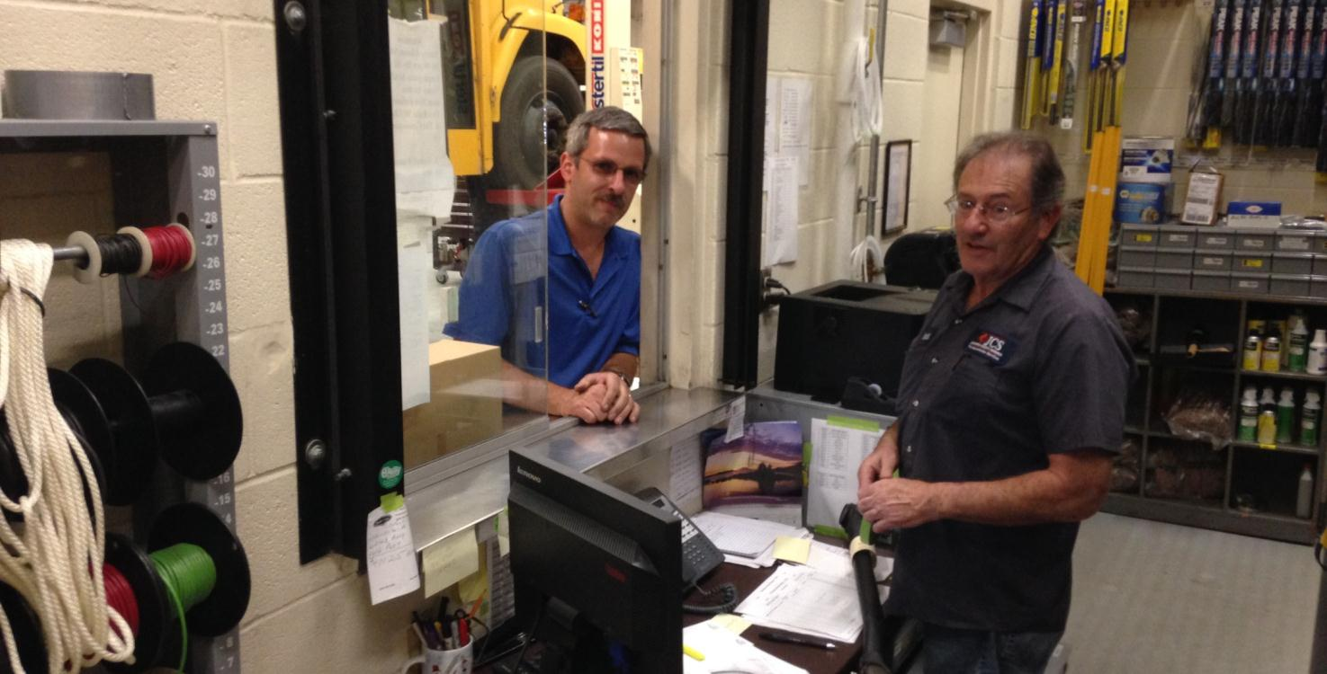
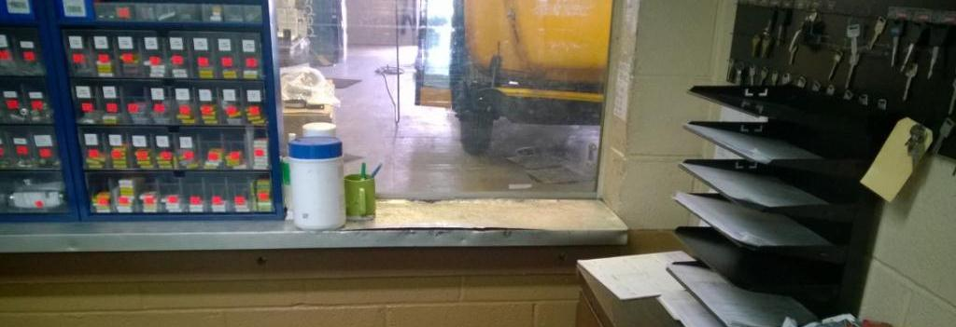

Slide 31
Issue Process Outline
Gateway Personnel (All Parts exiting inventory must go through one of these people)
  No Exceptions
Gateway Personnel record usage
  Include Tech, Bus, and Part Number
  Record Keeping (Any of these Work)
    Google Form
    Spreadsheet
    Notepad
    In BSIP Immediately
https://docs.google.com/forms/d/1EZqAXzR8aay8_aq_2tSDaLHMoa1jVNis4vBIn8729fw/viewform
https://docs.google.com/forms/d/1EZqAXzR8aay8_aq_2tSDaLHMoa1jVNis4vBIn8729fw/edit#

Slide 32
Issue Process Outline
Technician turns in completed paperwork
Supervisor reviews and submits to data entry
Data Entry assures everything looks ok and enters orders into BSIP
  Items used are checked off the outgoing parts list to indicate they were definitely charged
Periodically any outstanding parts not on orders have to be tracked down

Slide 33





Who Cares About Records?

Slide 34
Guiding Principals On Data
It should be truthful and correct
It should reflect things that actually happened
It should be complete and have enough detail to understand what was done

Slide 35
TD-18 Work Order
Expectations
Are Way Higher Than This!

Slide 36
Supervisor Expectations
All TD18s, MIs, and PMs submitted by Technicians should be reviewed
Supervisor should use all information available to determine whether the order makes sense

Slide 37
This is Why Technicians/Supervisors Need to Give VMRS Codes…..
Description Cost Clerk Sees When Searching by Text
Actual Major System Code Corresponds to
063-005-021 - Hardware Kit – Assembly
082-001-007 – Motor – Fan or Blower
065-003-012 – Hose
065-004-020 – Seals
193-002-000 – Belts
094-004-027 - Clamp
063 – Satellite Communications Systems
082 – Mechanical Refrigeration Unit
065 – Hydraulic Systems – Multi-Function
193 – Belt Conveyor System
094 – Bulk Product Transfer Systems

Slide 38
Data Entry Expectations
Regardless of type all orders MUST reflect what the technician and supervisor signed off on
Data entry personnel should make no substantive changes to anything without the people who SIGNED their names to it
If something is wrong or does not make sense it should be questioned

Slide 39



Data Entry Expectations Continued
Everything should be entered in a timely manner
Stage 3:
Stage 2:
Stage 1:

Slide 40

Data to the Legislature
Every fuel and mileage entry for every bus in the state for the whole year
Every 30-day inspection and PM completed including when it was due and when it was done
Every stocked part used, how many were used by each garage, the current stock level at each garage, and the current moving average price
Cost to operate each bus for each of the last 5 years (by county/bus #/year)

Slide 41
Annual physical Inventory

Slide 42
Process
Create Blind Count Documents
Count Parts
Enter Counts
Review Entry for Discrepancies
  Correct typos
  Spend your time figuring out where the big dollars disappeared
  Correct Counts, POs, Work Orders, and do recounts where needed
Post Counts

Slide 43
Purpose
Determine actual stock on-hand
  A return to even ground for the start of the next year
Analysis of the Year
  Identify problem areas for instituting corrective action
  Compare to previous years to determine whether you’re moving in the right direction
Contain the problems to one year so you can get a good read on each year

Slide 44
Last Opportunity
After the fiscal year has closed LEAs will be afforded the opportunity to point to losses which should not have been listed as losses
  Stolen items (with police report)
  Invoice and Work Order errors not know before the final posting of physical inventory (corrected after inventory was complete)
  Failure to transfer parts between the stock room and service trucks
  Incorrect inventory adjustments
In all cases documentation of the error and the corrections will be required

Slide 45
Inventory Shortages
The Problem
(… aside from that losing things is bad….)

Slide 46
Why is it a problem?
PRC 056 could be used to support Local Vehicles which would be an illegal use of state funds
Stock may be being actively stolen during the year
Incorrect reporting alters refund rates, which must reflect the actual cost per mile or student in order to prevent illegal use of state funds
Vehicles will have incorrect maintenance and cost records.
Knowingly falsifying state records is illegal

Slide 47
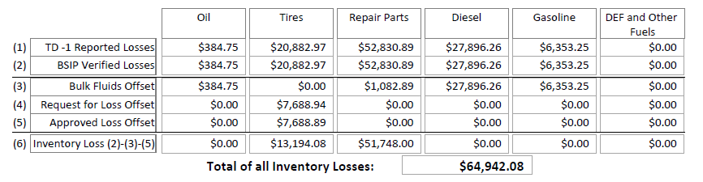
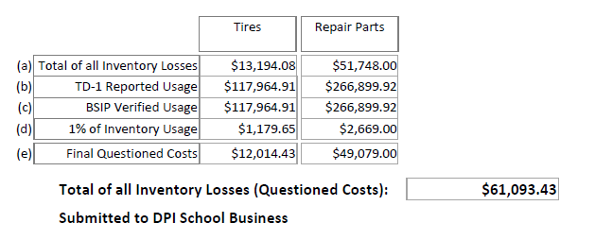
Questioned Costs

Slide 48
How Big Was the Problem?
  ~8-10 Counties appear to have performed no full inventory of stock on hand in 13-14
Reported Stock Losses in 2013-14
  $2,234,144 across ~11 thousand line item losses
  Losses Ranged from $0 - $466k in each County
  36 Counties reported losses greater than $10,000
  16 of those 36 reported losses greater than $30,000
  Half of those 16 reported losses greater than $100k
These are things that SHOULD have been on hand and available to use, were not knowingly stolen or the result of a known data error, and yet could not be found

Slide 49
How Big is the Problem?
UPDATE!
Reported Stock Losses in 2014-15
  $900k across ~8k thousand line item losses
  Losses Ranged from $0 - $164k in each County
  17 Counties reported losses greater than $10,000
  7 of those 17 reported losses greater than $30,000
  Only 3 reported losses greater than $100k (Only one if you take out fuel losses)

Slide 50
Reminder: Guiding Principals On Data Entry
It should be truthful and correct
It should reflect things that actually happened
It should be complete and have enough detail to understand what was done

Slide 51
DPI Audit Findings
“Alternators were issued to multiple vehicles which were then not found upon vehicle inspection.”
“New brake drums were issued in pairs, but with no new brake shoes “
“Multiple items were issued to a vehicle which has only one of that item, such as a roof-mounted strobe light.”
“Items were issued that did not fit the vehicle, specifically (e.g. wrong Amp alternator) or in general (transmission Pall filter on a bus that does not have one.) “
    “We were unable to verify this due to lack of paperwork, whether it be because technicians do not complete it or that the parts manager discards all of that paperwork.”

Slide 52
DPI Audit Findings
“More than four recapped tires at a time (Four is the maximum allowed by law – no recaps can be on the front axle.)”
“More than six tires on one work order (exceeding the total number of tires on the vehicle)”
“Incorrect tire sizes for the vehicles”
“Two different tire sizes to the same vehicle”
“Discrepancies in some items appear to have been eliminated by creating work orders to cover the missing parts”
“Work orders with only a bus number and a list of parts (essentially blank) were created which offset what would have otherwise shown as parts and tire losses.”

Slide 53
DPI Audit Findings
“Given the wrong tire quantities on the work orders reviewed, it seems likely that thousands of dollars in tires cannot be accounted for.”
“Eight tires were reported issued to this bus while the technician reports replacing two. The extra tires listed have a total value of $1,966.33”
“In addition to the specific orders reviewed in this audit, there were several hundred other parts charged [at the same time]… It is uncertain whether this was just an error or whether it was done systematically to eliminate what would have otherwise been inventory losses. “
“The paper copies of the work orders which were reviewed were essentially blank except for bus numbers and part numbers. “
  “Based on the work orders reviewed, it appears that maintenance records for many vehicles do not reflect the parts actually placed on them.”

Slide 54
Resources
Inventory Resources
DPI Resources

Slide 55
Public Schools Transportation: Allotment Overview

Slide 56
Purpose of the Transportation Allotment
“Provides funding for all transportation related expenses for "yellow bus" use for eligible school age (K-12) students for travel to and from school and between schools…”
- DPI Allotment Policy Manual 2013-14

Slide 57
Big Picture
Funding Base * Budget Rating + Legislated Adjustments
Funding Base: Dollars spent by the LEA (state and local) on eligible to-from K-12 school transportation the previous year
Budget Rating: Measure of efficiency of the transportation operation
  Dollars, Buses, and Students Transported in the county
  Modified via linear regression for site characteristics of the county which make transportation more/less costly
  Compared against all other counties
Legislated Adjustments: Retirement, Medical, Salary, Fuel, other
Funding Base * Budget Rating + Legislated Adjustments

Slide 58
County? City? Both?
Funding Base and Legislated Adjustments – Each LEA has their own based on what the LEA spent the previous year
Budget Rating – Combined (Same for City and County)
  County does maintenance, so separating out which costs belong to the city is not very feasible
  Geographical and other site characteristics are county wide and thus cannot be applied fairly to some portion of the county
Notes:
115C-249(e) - Deals with the county board providing maintenance facilities and equipment sufficient to cover all local school administrative units within it

Slide 59
In More Detail

Slide 60
Funding Base
Actual expenditures from previous year – sum of state and local ELIGIBLE expenditures.
Relate directly to the transportation of K-12 students to and from school
Correspond to one of state object codes in PRC 056
  With some exceptions
    Some items you can BUY with PRC 056 but they aren’t included in your funding base
    Some items are allotted separately from the funding process

Slide 61
Deriving the Budget Rating
INPUT DATA
Number of Students Transported Last Year
  TD-2 Student Count (October)
  TD-24 Contract Transportation Supporting Documentation (October)
Number of Buses Operated on Routes Last Year (91+ days)
  TD-10 Bus Inventory (March)
Total ELIGIBLE Expenses Last Year
  Local and State PRC 056 Data
  TD-1 Annual Report (August)
Cost per Student Transported
Buses per 100 Students Transported

Slide 62
Budget Rating - Site Characteristics
Things beyond the control of transportation that impact efficiency
  Distance of Students to School
  Pupil Density (Students per mile of road)
  EC Transportation
Linear Regression allows very different counties to be measured using the same criteria - “levels the playing field”

Slide 63
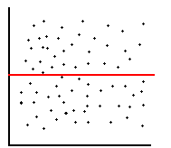
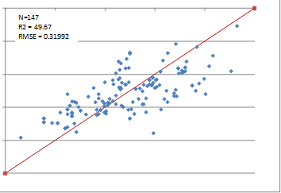
Linear What?
It makes it so that low population density doesn’t mean low budget rating.
Budget Rating
Population Density

Slide 64
Budget Rating Graphically

Slide 65
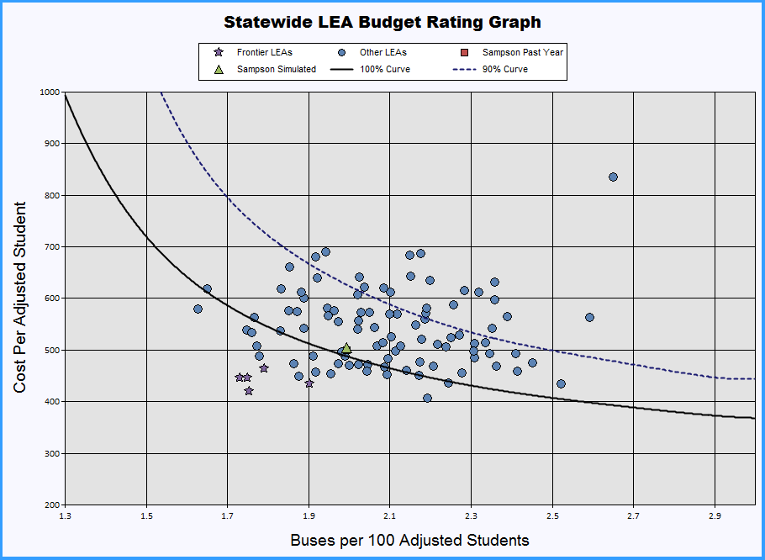

Slide 66
HIGHER LOWER
Bus Ratings Bus Ratings

Slide 67
LOWER Cost Ratings
HIGHER Cost Ratings

Slide 68
Current year allotment = Funding base * Budget Rating + Adjustments
$1,900,000 ELIGIBLE state expenditures
+ 100,000 ELIGIBLE local expenditures
* 98% budget rating
$1,960,000 State allotment before adjustments
+ 10,000 ADM Increase Adjustment
+ 50,000 Salary and Benefit Increases
30,000 Fuel/Legislative Reduction
$1,990,000 Final State Allotment

Slide 69
Budget Rating
Actually…. There are two….

Slide 70
New Run Rating AKA Current Rating
Latest complete year information for everyone.
  2015-16 one slated for mid-late November
Includes all 2014-15 data from all LEAs
Updates site characteristic data and compares all LEAs against each other to create a new efficiency model

Slide 71
The Trouble with the New Run Rating
In 2014-15 when you’re making operational decisions that define the New Run Rating:
  You know your buses, students, and money
  You don’t know everyone else’s
  You don’t know how what everyone else is doing will impact your relative efficiency
It can feel like a moving target
  It is….
  BUT… there’s another rating

Slide 72
Simulator Rating
Data from 2013-14 for everything EXCEPT:
  YOUR 2014-15 Expenditures
  YOUR 2014-15 Students
  YOUR 2014-15 Buses
  Modifications to undo legislative changes in 14-15
It is the New Run Rating Model from the previous year, but modified by what you actually did in 2014-15
Funding is Based on The Highest of the Two Ratings

Slide 73
Questions So Far ??
Ultimately Efficiency is Determined by
  Money Spent
  Buses Used
  Students Transported
  Particular Geographical and Site Characteristics (outside forces)
  Now….. What can you spend money on….. ?

Slide 74
Expenses In Detail
The Foundation of the Funding Base

Slide 75
Funding Base –
Eligible (YES) Expenditures
Relate directly to the transportation of K-12 students to and from school
Correspond to one of state object codes in PRC 056
  With some exceptions
Eligible expenditures form the funding base
Notes:
115C-249(e) - Deals with the county board providing maintenance facilities and equipment sufficient to cover all local school administrative units within it

Slide 76
Ineligible Expenditures (NO)
Expenses that don’t correspond to PRC 056 object codes
  They don’t fit, you can’t spend it
Funds Allotted Separately
  Contingency
  Replacement Buses
  Camera Grants
  License/Title/Use Tax
Since they are handled separately they are not considered

Slide 77
Ineligible Expenditures (NO)
A few PRC 056 object codes contain ineligible expenditures
  You CAN spend state money, but it won’t be included in your base
  Computer Equipment and Software
  Lease/Purchase of Equipment
Things which, by law, have to be paid from elsewhere
  Transportation Director Salary (PRC 002)
  Expenses for Remediation (PRC 069)
  Pre-K EC Expenses (PRC 032)
  State Resources Used on Local Vehicles or for Local Programs
  Use of Yellow Buses not for to-from school transportation

Slide 78
CAN Use PRC 056 Funds “Eligible”
Repair of State Transportation Vehicles
  School Bus Tires
  Labor Charges from Dealership Repairing a School Bus Engine
  Mechanic Salaries
Bus Driver’s
  Bus Driver Salaries
  Bus Driver Hourly Supplement (total wages still within state range)
  Driver Overtime Pay (Driver still under hourly maximum for the year)
  Drug Testing for only Yellow Bus Drivers

Slide 79
CAN Use PRC 056 Funds “Eligible”
Garage Operations
  Generator Fuel for Garage
  Uniform Services for Garage Staff
  Utilities for Bus Garage
  Cellular Service for Garage Staff
  Toll Road Charges

Slide 80
CAN Use PRC 056 Funds “Eligible”
Training
  Travel Expenses to Technician Training
  Hiring a Trainer for an engine diagnostic class
  Staff Development Training on OSHA Regulations
Contract Transportation
  Contract Transportation for a Student
  Contracting with a Parent to Provide Transportation to School

Slide 81
CAN NOT Use PRC 056 Funds
Maintenance of Local Vehicles (Must Be Refunded if PRC 056 Funded Items Used)
  Tires for the Superintendent’s Car
  State Inspection of a Food Services Truck
  Oil Change for a Maintenance Department Truck
  Technician Labor to do Body Repairs on the Transportation Director’s Car
  Replacing Alternator on an Activity Bus
Purchasing an Activity Bus
Garage and Facilities
  Building a new Garage
  Explosion Proofing the Garage
  Replacing an Underground Fuel Tank

Slide 82
CAN NOT Use PRC 056 Funds
Salaries
  Transportation Director Salary
  Salary of the Activity Bus Use and Billing Coordinator
  Driver for Field Trip to the Museum
Other Programs Use
  Busing Costs for Summer Reading Camps (Read to Achieve)
Drug Testing Beyond Necessary for School Bus Drivers
  Drug Testing Program for the whole LEA
  Drug Testing for Coaches who only drive Activity buses
Bus Driver Perfect Attendance Bonuses

Slide 83
CAN Use PRC 056 Funds but NOT part of the Funding Base – Ineligible “No” Expenditures
Lease or Purchase of Equipment
  Purchase of Computers for the Garage
  Bus Radios
  Camera Equipment
  Portable Lift
Engine Diagnostic Software

Slide 84
CAN Use PRC 056 Funds but NOT part of the Funding Base – Ineligible “No” Expenditures
Pay Outside the Allowable Salary Schedule
  Driver Overtime Pay (Places Driver over State range for the year)
Things DPI Allots Money for Separately
  Title Fees and Hwy Use Tax on New School Buses
  Spending Allotted Contingency Funds

Slide 85
Budget Rating Simulator

Slide 86
Allotment Sheet

Slide 87
LEA Funding DATA - (City/County Separated)
Base Data:
(1a) Eligible State Expenditures : | $2,300,000
(1b) Eligible Local Expenditures | $150,000
(1) Total Eligible Expenditures: (1a+1b) | $2,450,000
(2) Total Number of Buses: | 112
(3) September, 2014 Student Count | 5776
(4) Budget Rating 1 (existing formula, simulator) | 97.00%
(5) Transportation Simulator Funding (1) x (4) | $2,376,500
(6) Budget Rating 2 (2015 Model Rating) | 96.00%
(7) 2015 Model Run Funding (1) x (6) | $2,352,000
(8) GREATER OF - BASE FUNDING FOR 2015-2016 | $2,376,000
Funding Formula Inputs
Budget Ratings
Funding Base

Slide 88
(8) GREATER OF - BASE FUNDING FOR 2015-2016 | $2,376,500
(9) Growth Adjustment (Based on ADM growth) ……(Allotted Growth Increase: 0.50%) | $12,000
(10) Legislative Increases Increase – Retirement $ 1,000 Increase – Hospitalization $ 4,000 Salary Increase $ 0 | $5,000
(11) Fuel Reduction – Appropriation for Fuel (($x.xx/gal. for 2014-2015 adjusted down to actual $x.xx) | -$90,000
Total Funding for 2015-16 (8)+(9)+(10)+(11) | $2,303,500
* Funds diverted to Charter Schools | 0
Net Allotment (pending charter school reduction): | $2,303,500
Funding Base
Adjustments
Total State Funding

Slide 89
Estimating Your Allotment
When Fuel Prices are Falling

Slide 90
Agenda
PART 1:
  Using the Budget Rating Simulator
Part 2:
  Estimating Transportation Allotment
  for 2016-2017

Slide 91
Budget Rating Simulator
Developed from prior year data
Must be updated to reflect your current year data
External costs – e.g. fuel, salaries – must be adjusted to be put into “prior year dollars”

Slide 92
THE IMPACT OF FALLING FUEL PRICES
If you spend the same amount this year as last year, to transport the same amount of students, you are being less efficient because fuel costs less.
If you spend more per student, your budget rating will decrease.

Slide 93
Estimating Transportation Allotment for 2016-2017
What you will need:
  2015-2016 transportation funding information sheet dated November 5, 2015
  Number of buses operated 2015-2016
  Student Count, October 2015
  Expenditure Information
  Budget Rating Simulator Software

Slide 94
PRC 56 Allotment
(Transportation)
Funding Base
  State Expenditures 2015-2016
  Local Expenditures 2015-2016
MAXIMUMUM ALLOWABLE FUNDING BASE:
  2014-2015 Funding Base Plus ADM Increase MINUS FUEL COST SAVINGS
Multiply by Budget Rating
Increase for higher ADM

Slide 95
Funding Base = Total Eligible State and Local Expenditures (PRC 56) for 2015-2016
State funds you plan to spend
Local funds you plan to spend
Add additional funds for ADM increase (line 9)
Add additional funds for increases in retirement and hospitalization (line 10)
Deduct savings due to lower fuel costs

Slide 96
CALCULATE SIMULATOR RATING
Update Number of Students Transported from TD-2, October 2015
Update Number of Buses Operated for 91+ Days, 2015 – 2016
Update Funding Base -
Expenditures from 2015 – 2016
  (as explained on previous page)

Slide 97
Estimate Transportation Funding
Funding base for 2015-2016 x Simulator Rating
(+) ADM Increase (if applicable)
  ( )Salary/Benefits Adjustments
= Estimated Transportation Funding for 2016 - 2017

