Slide 1
PowerSchool & TIMS
2014 NCPTA

Slide 2
What Is TIMS?
Transportation Information
Management System
TIMS is essentially the use of School Bus Routing Software to track buses, students, stop locations, driver hours, travel times, and more!
TIMS offers the ability to examine and track current school bus routes and analyze potential efficiency improvements before implementing them on the road.
Policies of the NC State Board of Education Regarding Pupil Transportation
Policy #TCS-H-002, 16 NCAC 6B.004

Slide 3
The TIMS System
Fulfills Legislative Mandate
Promotes Efficiency Improvements
Offers Safety Enhancements
Documents Railroads and other Hazards
Documents Students Ridership Information
Contingency Planning
Can create snow routes
Emergency Evacuation Plans
District Wide Enrollment Analysis
School Boundary Planning
Notes:
Since September 1, 1992 as required by the legislative mandate all LEA’s have implemented the TIMS system.

Slide 4
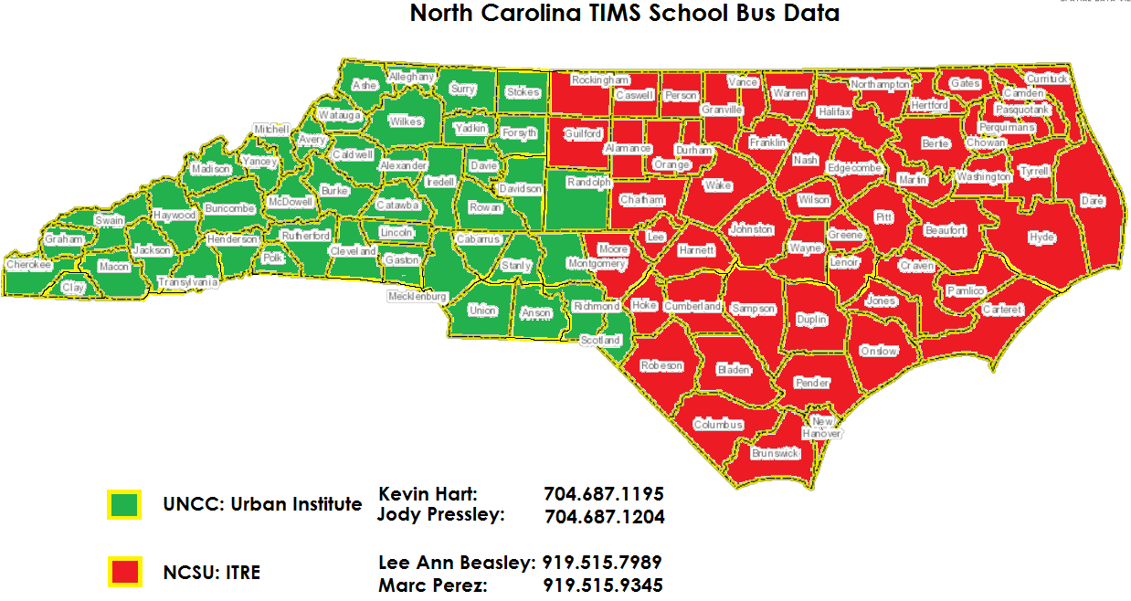

Slide 5
The TIMS System
Geocode
Data
PowerSchool
Data
T
Transportation
Data
S
I
M
Boundary
Planning
Optimization
Reports and
Maps
Service
Indicators

Slide 6
www.ncbussafety.org

Slide 8
Bus Route Creation Using TIMS
TIMS provides the ability to analyze alternate scenarios including multi-school transportation or multi-tier transportation through the use of staggered bell times and the simulation of routing impacts on proposed program placements.
Simulation shows actual student impact
Overall Bus Mileage and Driver Hours
Estimated Student Ride Times
Early Pick Up & Late Drop Off Times

Slide 9
TIMS Overview PowerSchool Data Imports Student Information Address Errors TIMS Demo Importing TIMS Data into PowerSchool

Slide 10
TIMS Data Imports
Student Information is Imported into TIMS from PowerSchool
Assigned School and Grade
Home & Mailing Addresses
Parental and Emergency Contact Information
TIMS uses the Geocode to verify student address information
Maps typically come from County GIS or Tax Department
Contains official street names and addressing information
Allows TIMS to Calculate Time and Distances
Student Distance to School and Distance to Bus Stop
Student Pick-Up and Drop-Off Times
Daily Bus Miles and Path of Travel
Driver Hours
Notes:
This is where having a solid transportation plan comes into play – you need to have a plan with schools to get new bus stops approved and students assigned. Many LEA’s use different types of forms to accomplish this – others also use ridership codes in NCWISE that gets loaded into TIMS. Ridership codes show the TIMS operator who needs to be assigned to a bus stop. You should still have a process in place to get bus stops approved.

Slide 11
Students
TIMS contains a record of all students enrolled in each school district. An extract is obtained by the Transportation Department and the Student Data from PowerSchool is imported into TIMS
The accuracy of student addresses entered into PowerSchool is vital to your Transportation Department
Incorrect Addresses can lead to hours of corrections and edits by the Transportation Department

Slide 12
Common Mistakes
There are a number of common mistakes made by data managers across the state when entering student address information into PowerSchool
Missing or Incorrect Street Information
Street Types
Street Prefixes
Street Suffixes
Simple Misspellings
Apartment and Lot Numbers Entered Incorrectly

Slide 13
Missing or Incomplete Street Information
Another common mistake made my PowerSchool Data Managers deals with missing or incomplete Street Information
An accurate Street Address contains the following
House Number
Street Prefix (North, South, Northwest, Southeast, etc)
Street Name (Elm, Main, Pine)
Street Type (Road, Lane, Avenue)
Street Prefix (North, South, Northwest, Southeast, etc)

Slide 14
Student Addressing
PowerSchool Address
505 S Green Street
TIMS address
Num Pr Street Name Type Suf
505 S Green St
Oak St
Willow St
The system matched the PowerSchool address to an address in the Geocode, therefore this student is ‘located’.
Pine St
S Green St
N Green St
Maple St

Slide 15
Missing or Incomplete Street Information
It is important that student addressing is parsed out correctly in order for the Student Upload to work correctly.
Pay attention not only to Prefix and Suffix information but also to the official spelling and spacing of street names throughout your district.
Example:
Is Pine View one word or two?
Is Maplewood one word or two?

Slide 16
Missing or Incomplete Street Information

Slide 17
Missing or Incomplete Street Information

Slide 18
Missing or Incomplete Street Information
Pay Attention to the correct spelling for street names that contain numbers
Is It…
10th Street or Tenth Street?
1st Avenue or First Avenue?
You May Have Both...
First Street and a
1st Street

Slide 19
Missing or Incomplete Street Information
Other mistakes seen across the state involve student addressing in PowerSchool missing the street type entirely
Examples:
356 Maple Leaf
Maple Leaf what? … Road, Street, Avenue, Boulevard, etc is missing
Parent may have left off the Street Type or PowerSchool Data Entry Error
356 Maplewood Road
Is actually Maplewood Lane as the parent supplied the incorrect information and the data manager was just typing in the information on the student registration form

Slide 20
Missing or Incomplete Street Information
This example shows three different Maple Streets in the School District.
Each of these are their own street with their own addressing
If the student lives at 501 N Maple Street but the “N” Prefix is left off, then TIMS may place the student on the other side of the county, where the address of 501 Maple Street is actually located

Slide 21
Duplicate Street Names
Sometimes there will be two or more streets with the exact same official street name scattered throughout your district.
These are often very common street names like Main Street, Elm Street, Pine Street, etc. that are present in different cities around your county
If this is the case, TIMS will then references the Student’s Zip Code to determine which “Pine Street” is correct.
So make sure their Zip Code is correct too!

Slide 22
Student Addressing
PowerSchool Address
505 S Green Street
TIMS address
Num Pr Street Name Type Suf
505 S Green St
Oak St
Willow St
The system matched the PowerSchool address to an address in the Geocode, therefore this student is ‘located’.
Pine St
S Green St
N Green St
Maple St

Slide 23
Simple Misspellings
PowerSchool Address
505 S Greene Street
TIMS address
Num Pr Street Name Type Suf
505 S Greene St
Oak St
Willow St
Pine St
S Green St
N Green St
The geocode does not have a Greene St.; so it doesn’t know where to ‘locate’ this student.
Maple St

Slide 24
Apartment & Lot Numbers
One of the most common PowerSchool Address Errors made across the state is the entry of Apartment and Lot Numbers into the wrong box on the student address screen
Do not include them in the Street Field
There is a separate box in PowerSchool for entering Apartment and Lot Numbers
House Number & Complete Street Name
Apt or Lot
City
NC
Zip Code

Slide 25
Apartment & Lot Numbers
Examples of Common Errors
Lot #33 entered incorrectly in Street Field, Lot #33 should be moved to correct field
Correct Address Entry is 27 Ridgeway Ave Apt A, with Apt A in correct field

Slide 26
Apartment & Lot Numbers
Examples of Correct Data Entry
Please note how Lot 92 is entered into the correct address field
Please note how Apt 205 is entered into the correct address field

Slide 27
Correcting Address Errors in PowerSchool
As you can see, there are multiple ways for address errors to occur in PowerSchool. As part of the TIMS UpStu Process, your Transportation Department can create a list of students whose address does not match a valid address within your district. These need to be reviewed and corrected as needed to prevent import errors during future UpStu’s.
Many LEAs give TIMS Operators the appropriate permissions and credentials in PowerSchool to login and fix student address errors. Other LEAs ask that TIMS Staff provide a list of address errors back to every data manager so they can correct the error for students within their school.
Procedures vary by LEA.

Slide 28
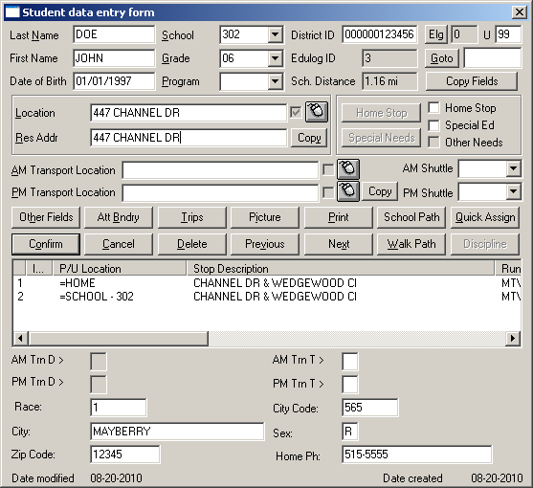
Student Screens in TIMS
Notes:
Point out school distance, grade,school district id, Stop information and emergency info fields.

Slide 29
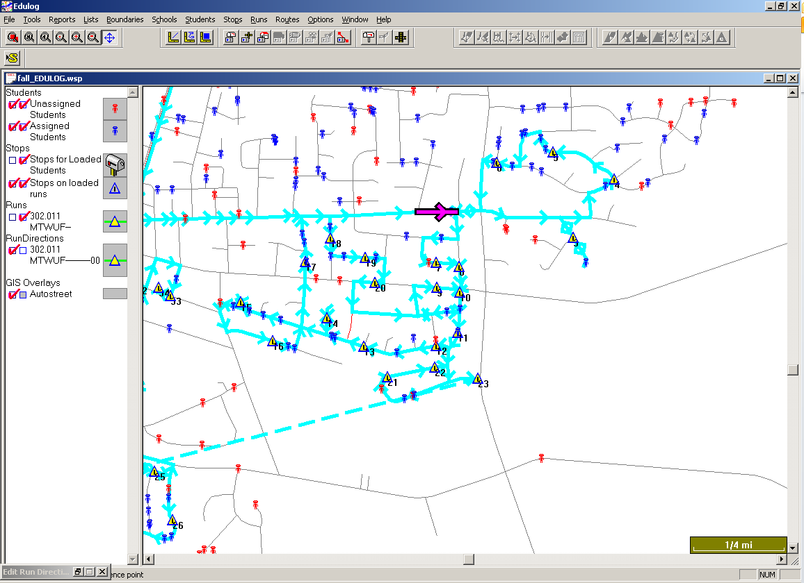
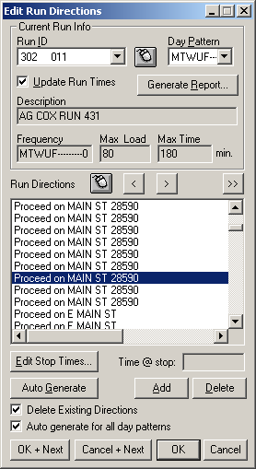
The TIMS Map
TIMS provides graphical views for transportation planning.

Slide 30
Stops
A stop is any location in the geocode where students are picked up or dropped off from school.
Stops can be located at a specific address or at a street corner.
Main St
5th Ave
Address Location
Corner Location

Slide 31
Bus Runs
A run is a sequence of stops that a bus makes when transporting students to or from school.

Slide 32
Bus Run Directions
Once a map is calibrated correctly and all the stop locations entered, TIMS will find the quickest path between each stop in the order they have been placed.
Notes:
Reword??

Slide 33
Routes
A route is the sum of activity for an individual bus during a complete day (AM and PM).
Buses may have multiple AM and PM Runs that make up the their full Route
Notes:
Note: Route ID and Bus # are the same -

Slide 34
Reports
With TIMS we have the ability to customize reports to show exactly the data you need.
Runs with stops and student names
Runs with driver directions
Passenger Lists
Stop Locations
Reports on geographical information (street names and attributes)
Summaries of Route Time and Miles
Notes:
Just to name a few…

Slide 35
Reports

Slide 36
Summary of Route Time and Miles

Slide 37
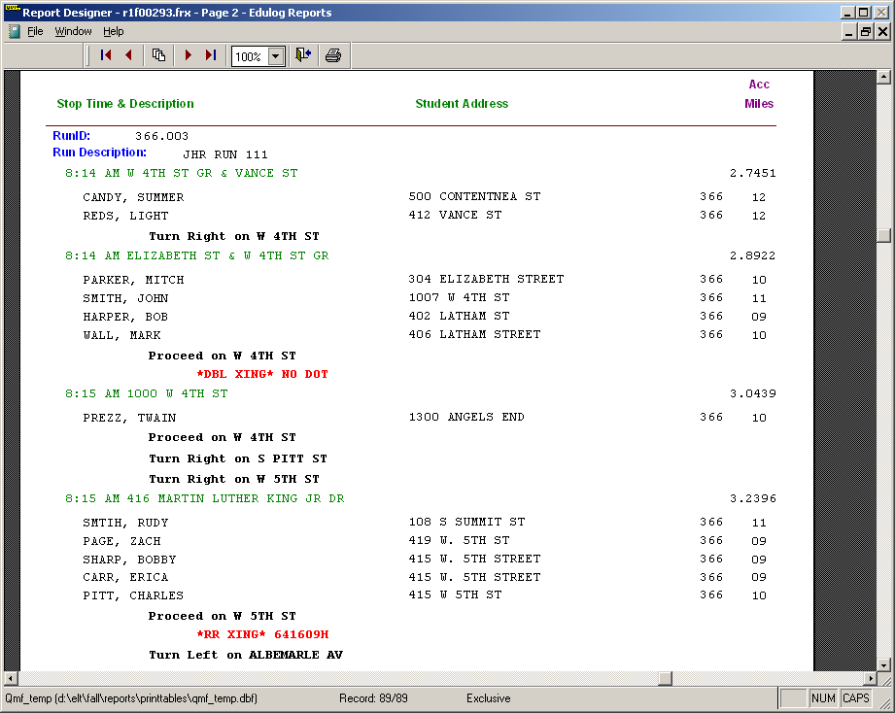
NCDOT Railroad Crossing Report
TIMS Operators have the option of including Railroad Warnings in their printed driving directions.
As part of the TDTIMS Annual Audit, each LEA runs a Railroad Crossing Report that tallies the number of times a bus goes over each crossing and the number of students on the bus.
This data is transmitted to NCDOT who uses the information in prioritizing railroad crossing inspections and upgrades.
Warning of
Double Crossing
RR Crossing
Warning

Slide 38
Passenger Lists
A list of students assigned to a particular stop or all students on a bus.
Useful for updating routes
Keep on buses for emergency information

Slide 39
PowerSchool Transportation Data

Slide 40
PowerSchool Transportation Data
From the student screen in PowerSchool, there is a link to the students transportation information.

Slide 41
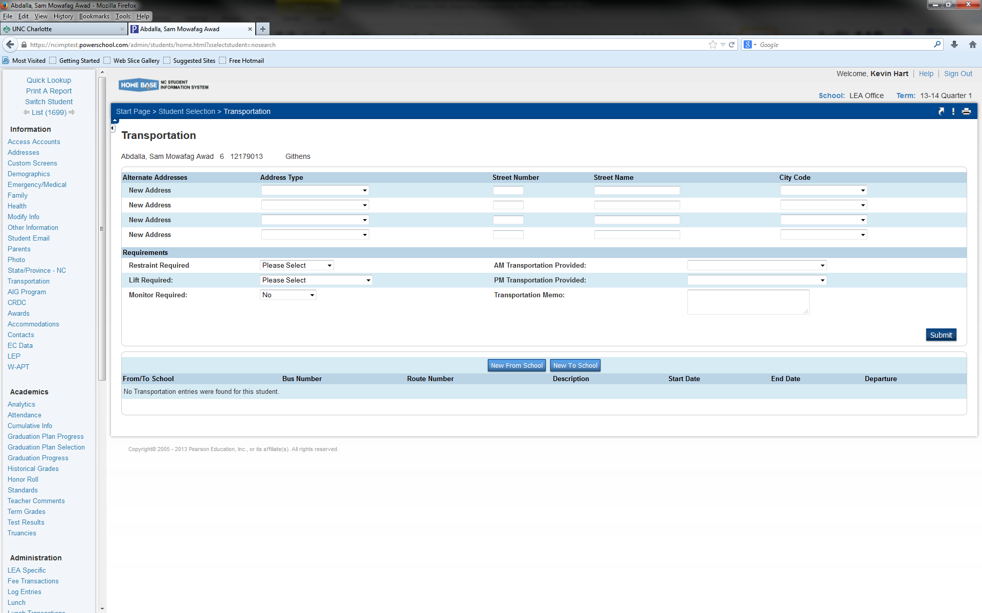
PowerSchool Transportation Data
The entry of transportation data into PowerSchool varies by LEA.

Slide 42
PowerSchool Transportation Data
Some LEAs utilize the variety of options available under the “Requirements” section of the transportation screen

Slide 43
PowerSchool Transportation Data
The choices available under the Requirements sections mostly relate to students with special needs. Each of these pieces of data are imported into TIMS and provide the Transportation Department additional information about student transportation needs.

Slide 44
PowerSchool Transportation Data
In additional to providing information about students with special needs, there is also a place to indicate if students have requested to ride the bus in the AM and/or PM.
The information selected here is also imported into TIMS and your transportation department can create lists of students based on the information entered.

Slide 45
PowerSchool Transportation Data
The use of this information by the transportation department varies by LEA.
Please consult a member of the transportation staff to determine if they are using this information in TIMS and how PowerSchool Data Managers need to enter information on the Student Transportation Screen.

Slide 46
PowerSchool Transportation Data
At the bottom of the transportation screen, there is a section that can display student bus stop and route information.
We are developing a TIMS Report that can be back loaded into PowerSchool.

Slide 47
Uploading TIMS Data Into PowerSchool

Slide 48
We are developing a Bus Route Upload of TIMS Information onto the Transportation Screen in PowerSchool for each Student assigned to a bus…

Slide 49
Your Transportation Department can create a CSV File in TIMS that contains pertinent School Transportation Information for Students

Slide 50
Currently, the Student Transportation Page in PowerSchool displays the following information
PowerSchool ID #
To/From School Trip Type
Stop Time
Stop Description
Bus Number

Slide 51
Student Transportation Information from TIMS is then viewable
on the Student Transportation Screen in PowerSchool

Slide 52
Please Note: The processes for Uploading TIMS Data into PowerSchool is still being developed.
We have encountered problems with duplicate transportation records and the unsuccessful deletion of rider info for students who stop riding the bus. We are working with PowerSchool Administration on resolving some of the hiccups we have encountered.
Stay Tuned…

Slide 53
TIMS Data Analysis

Slide 54
Redistricting – Boundary Planning
Boundary Planning is widely used when LEAs begin the redistricting process because of the ability to create and edit boundaries and tally the students inside those boundaries.
Moving boundary lines and obtaining quick tallies of students is invaluable when examining potential changes.

Slide 55
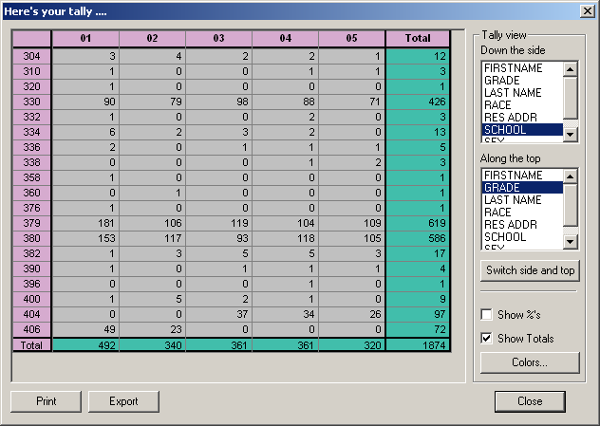
Boundary Planning

Slide 56
Boundary Planning - Tally
View of student locations; the grey icons indicate the students that were included in the tally.

Slide 57
TIMS Boundaries & PowerSchool
We have recently been experimenting with importing TIMS Boundaries into PowerSchool so Data Managers can use the information to help determine enrollment and eligibility
PowerSchool uses Google Maps for Address Verification and Validation. This can cause errors in a lot of places as Google may not have the most current and accurate information and could be missing
New Streets that have been added
Street Names that have changed
Address Ranges that have been extended

Slide 58
TIMS Boundaries & PowerSchool
The process of importing TIMS Boundaries into PowerSchool is detailed and requires several steps.
1) Convert TIMS Boundaries to Shape Files
2) Convert Shape Files to Google Format
3) Export the X,Y Coordinates for each Boundary Point in the Converted Shape File to a CSV File
4) Use the X,Y Coordinates from the CSV File to generate a String of Code that is imported into PowerSchool
5) Import the Boundary Code into PowerSchool
These steps will need to be performed for each boundary you wish to import into PowerSchool

Slide 59
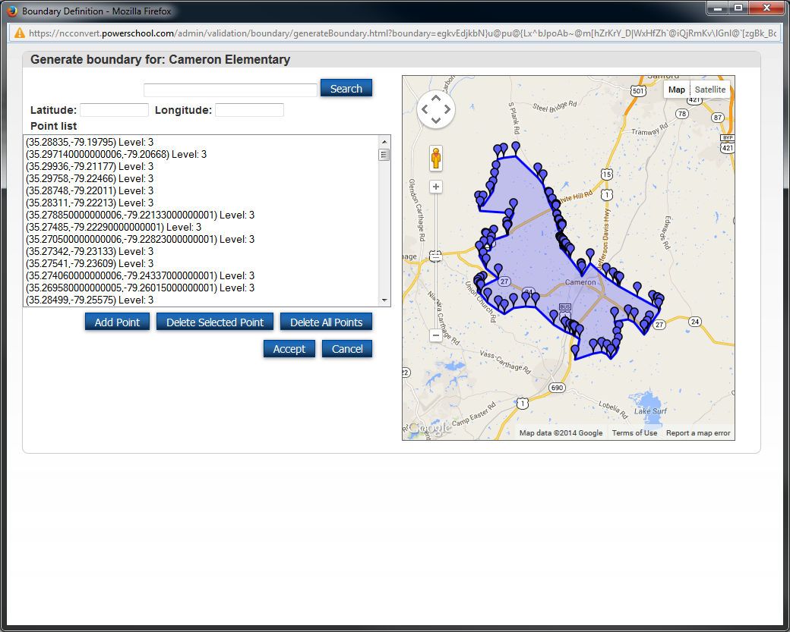
Cameron Elem Boundary Imported from TIMS Boundary Files

Slide 60
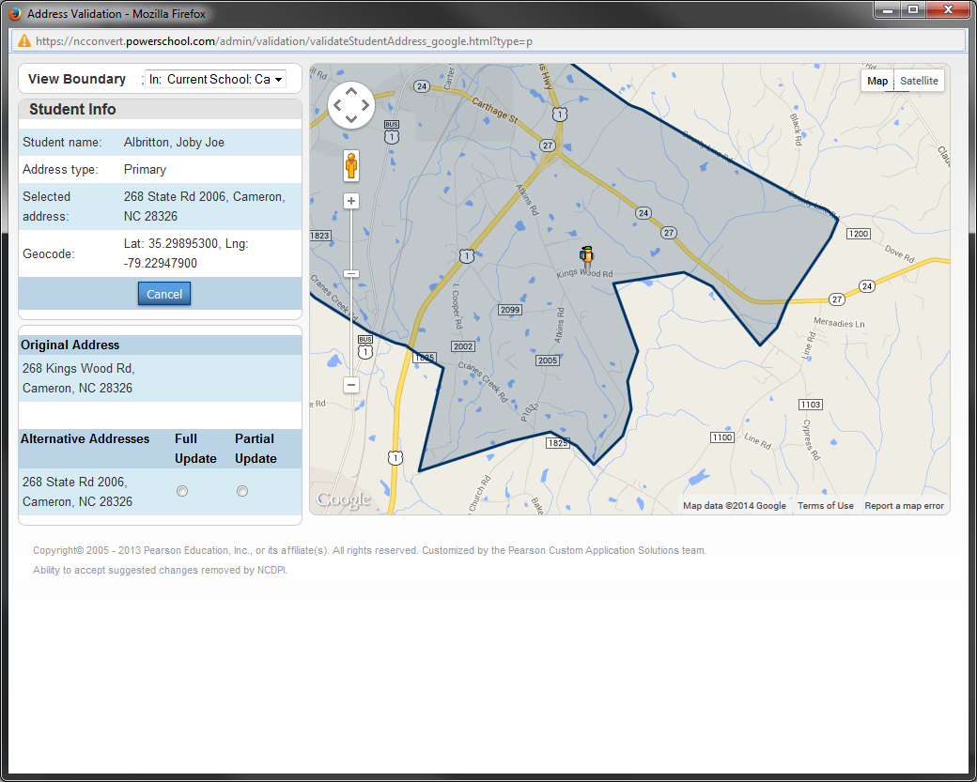
View Student Locations within School Boundaries

Slide 61
Can Zoom In/Out as needed to View Full Boundary or Street Level Data

Slide 62
Dropdown Menu Shows lists all “In Schools” and “Out Schools” for the Student

Slide 63
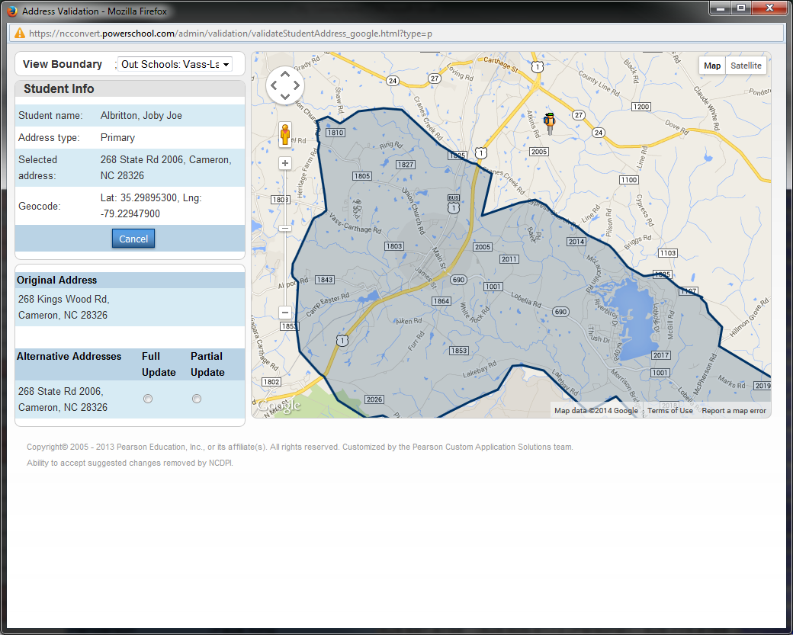
You can choose one of the “Out Schools” from the Drop-Down Menu to view student location in relation to the school boundary

Slide 64
TIMS DATA
TIMS Data are used in a number of statewide reports:
Transportation Service Indicators Report
LEA Funding Formula
NCDOT Railroad Crossing Report
TDTIMS Annual Transportation Audit

Slide 65
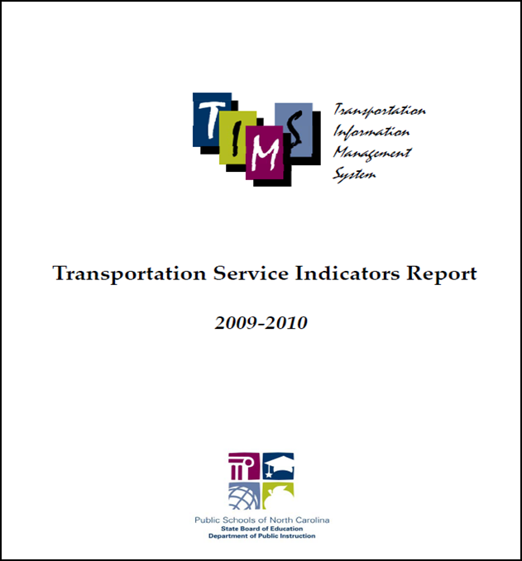
TIMS Data & Service Indicators
www.ncbussafety.org/TIMS.html
TIMS Data are published annually for each district as a means of comparison on a number of key measures:
Student Ride Times
Student Distance to School
Student to Stop Distance
Early Pickup/Late Drop-off Times
School Bell Times
Number of Bus Runs per Route

Slide 66
Service Indicators
The Transportation Service Indicators Report examines state averages for multiple transportation variables to understand the level of service received by the typical school bus rider in North Carolina.

Slide 67
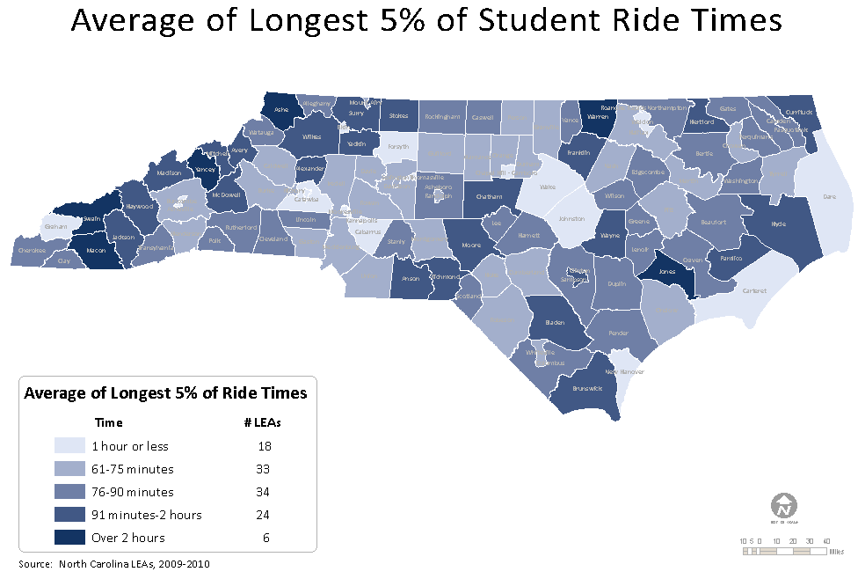
Service Indicators
The data for each district is then displayed in categorical groupings on the state map

Slide 68
Service Indicators
The actual numbers and change from the previous year are also reported for each district and can indicate improved or diminished services for students.

Slide 69
LEA Funding Formula: The Importance of Accurate Student Addresses
In addition to misleading service indicators for your district, inaccurate student assignments in TIMS can impact your annual transportation allotment.
One key statistic from TIMS utilized in the funding formula is the Student to School Distance of your assigned riders.
The formula uses this statistic to determine the distance from home for students who are transported each day and assists in equalizing the allocation process between rural and urban areas.

Slide 70
PowerSchool & TIMS
Any Questions?

Slide 71
For more information about TIMS and all things related to
North Carolina Pupil Transportation, you may contact the following staff members
NCDPI – Transportation Services TIMS Support Staff

