Slide 1
WELCOME BACK!
BUS DRIVER TRAINING
NC Department of Public Instruction
August, 2015
Notes:
This training is offered to all LEA’s to present to their School Bus Drivers prior to the start of the 2015-16 school year. It is recommended that the person that is going to use this look at each video prior to showing the drivers to familiarize themselves with the material.
A projector, internet connection and speakers are needed.
The entire presentation should take between 60 and 70 minutes.
The presentation should take between 30 and 40 minutes without the First Observer portion.

Slide 2
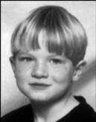





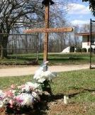

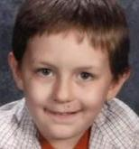




THE NEED FOR SAFE school BUS TRANSPORTATION
Thirteen NC Loading Zone Fatalities since 1998
What adult is in a position to have a direct impact on student safety at every bus stop?
Notes:
We are transporting precious cargo. Not only are we transporting the future, we are transporting somebody else’s baby. When parents put their child on the school bus they are entrusting us with their child’s safety and well being.
We need to learn from the past to insure the safety of our riders in the future
Since 1998 thirteen students have been killed in the loading zone.
In order to protect children in the future, we must acknowledge that the only adults in a position to have a direct impact on student safety at every bus stop are school bus drivers.
Note – of the 7 most recent fatalities, 5 were in middle school or high school

Slide 3
NC School Bus Driver Training
TO PREPARE FOR 2015-16
Cell phones and Texting – Distracted Driving
Security Training – First Observer
New Crossing Procedures – Bus Stop Safety
Notes:
What this presentation will speak to are the three bullets on this slide.

Slide 4
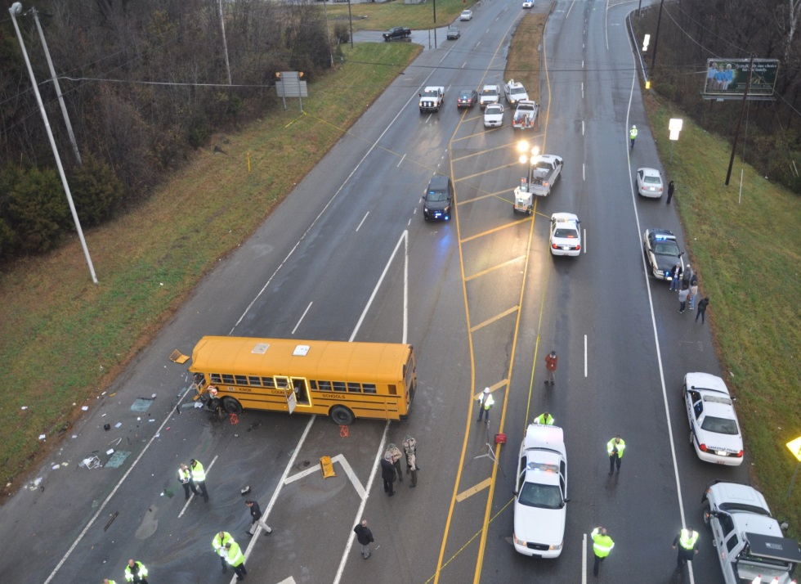
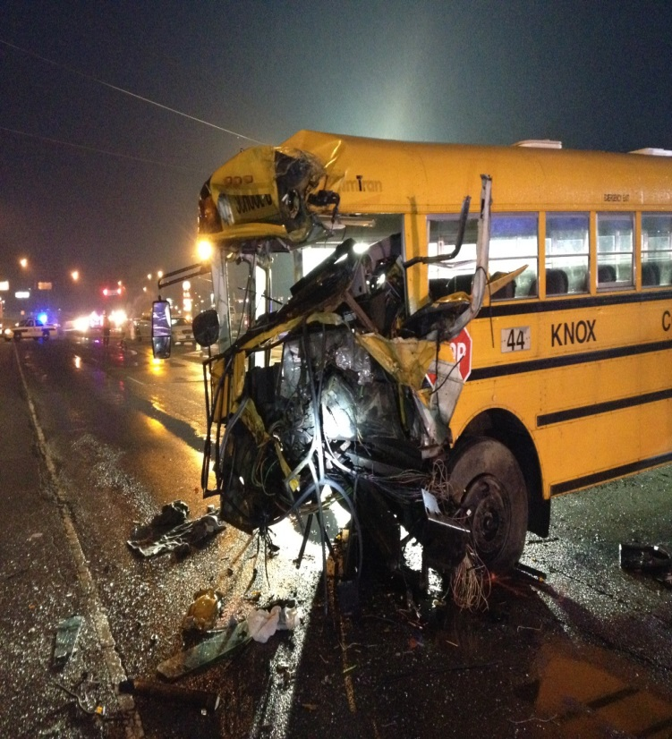
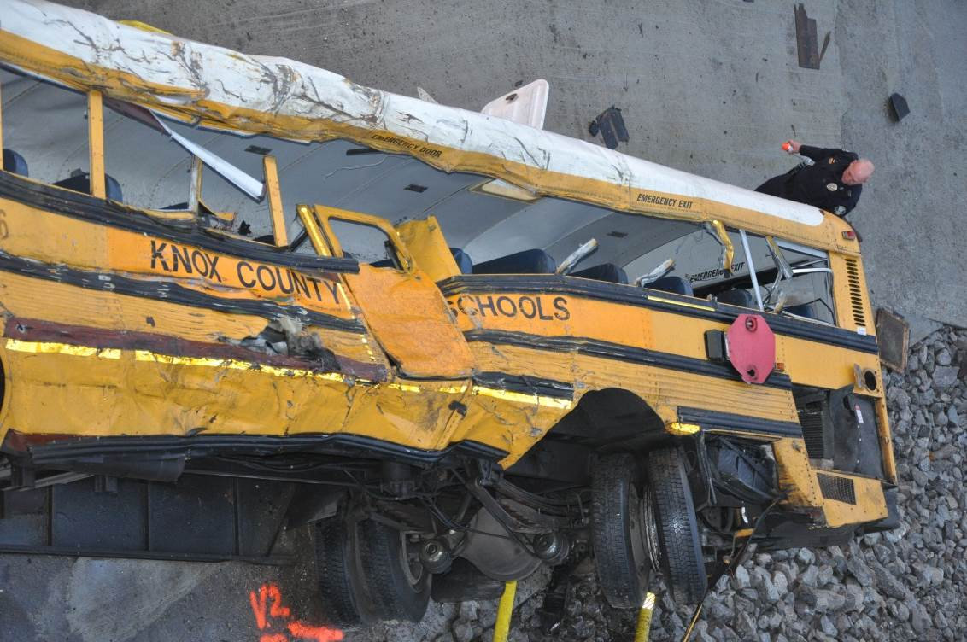
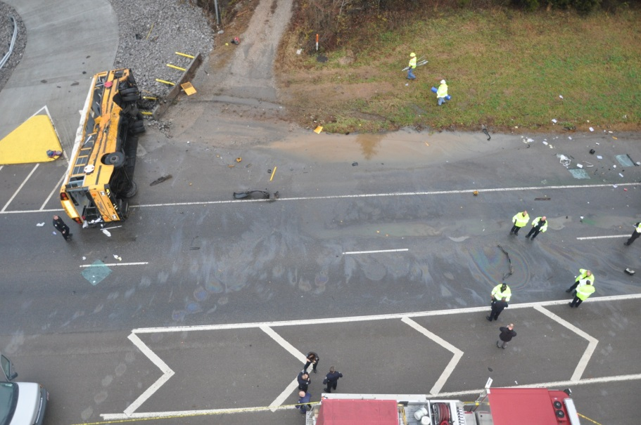
knox county, tenn. December 2, 2014
Notes:
These are pictures of the two buses involved in the Knox County Tennessee accident on 12/2/14.
The Driver of the bus that swerved from on lane (top two pictures) was found to be texting while driving. He looked up after texting to see the traffic in front of him had stopped. He avoid the vehicle in front of him at the same time as he meant to slam on the brakes but hit the accelerator pedal instead.
Students on the bus has stated that he kept on looking down and they thought that maybe he was falling asleep.

Slide 5



December 2, 2014 fatalities
Zykia Burns age 6
Seraya Glasper
Age 7
Kimberly Riddle
Bus Monitor
Notes:
These are the three fatalities due to a distracted driving accident

Slide 6
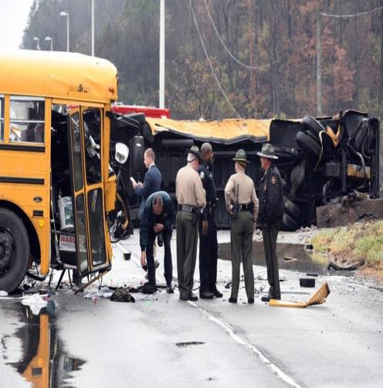
DISTRACTED DRIVING
Three Types
  Manual – Taking your hands off the wheel
  Visual – Taking your eyes off the road
  Cognitive – Taking your mind off driving
Fatal Knox County, Tenn. Crash
  3 Dead
  24 Injured
Notes:
A driver distraction is anything that takes your attention from driving, including activities inside (or even outside) the vehicle. Distracted driving causes slowed perception, delayed decision making, improper actions and accidents. Texting involves all three types of driver distraction. Federal Motor Carrier Safety Regulations restrict the use of hand held phones by commercial drivers and they prohibit texting while driving.
You should give examples of each:
Manual – using a hand held phone, texting, eating, drinking, holding route sheets, etc
Visual – Reading texts, dialing a phone, reading route sheets, looking at students in mirror, watching activities outside the bus.
Cognitive – worrying about a text you got, thinking about what happened at home earlier, worrying about what a co-worker said.
As stated above, texting involves all three types of distractions
The results of the Knox County Accident investigation has shown that the driver of bus #44, Mr. Davenport, was driving while distracted due to sending and receiving text messages. Multiple text messages had been sent and received during the time leading up to the crash. 43 people were on the buses, 3 persons died, 24 were injured. (This video is 3:41 minutes in length, you will need an internet connection and speakers, once video starts you should make it full screen)
It was also learned that the driver was texting and when he looked up traffic had stopped in front of him. He swerved and meant to slam on the brakes but hit the accelerator pedal instead.

Slide 7
FIRST OBSERVER tm
FOR SCHOOL TRANSPORTATION
A video from the Transportation Security Administration (TSA). School Bus Drivers will learn:
  the purpose of the first observer program,
  why they need to be protected as a critical part of the transportation infrastructure and,
  to recognize and report unusual or strange behavior that might be a part of a terrorist operation or rehearsal.
First Observer Video
Notes:
This video could be shown as part of the driver training. There are three videos for a combined 30 minutes and 5 seconds long. You will need speakers for this. The videos will run continuous if you let them.

Slide 8









BUS STOP SAFETY
Since 1998 there have been 13 fatalities at the school bus stop
Press Release
There are many resources available to help LEA’s with bus stop safety
  Safety Video
  Public Awareness Resources
  Close Call with Log Truck
Clearly we must do everything possible, as a state, an LEA and/or a Bus Driver to prevent further fatalities
Notes:
Again mention that there have been thirteen fatalities since 1998. You could add a little information on each child that we lost to personalize the message. Below is basic information on each child
Dalton Folwell – 7 years old – May 17, 1999
Hispanic female motorist driving on an international driver’s license did not know the requirement to stop for the stop arm and red lights. She struck Dalton, traveling in the opposite direction from the school bus
Terrance Howard – 5 years old – February 20, 2002 - Struck and killed by oncoming motorist.
Bus had not come to a complete stop.
Priscilla Norton - 15 years old – April 16, 2003 - Exiting the bus when a motorist (66 year old female) went around the bus on the right side (brake failure)
Ana Maria Sola – 6 years old – November 5, 2003 - Crossing the street to catch the bus. Struck and killed by oncoming motorist. The driver was a student on his way to school.
Sheila Hernandez – 5 years old – January 13, 2004 - Boarding the bus when a truck slammed into the back of the bus. Bus did not have parking brake set, and was literally pushed into another county.
Miguel Posada – 6 years old – October 19, 2004 - Crossing the street to catch the bus. Struck and killed by oncoming
motorist (substitute teacher)
Nicholas Adkins – 16 years old – January 26, 2009 - 63 year old woman reportedly did not see Nick – or the flashing lights - until it was too late.
Ashley Ramos Hernandez – 6 years old - August 19, 2009 - 83 year old woman thought the bus was turning and, when it didn’t, proceeeded through the stop sign, striking and killing Ashley.
Adam Kempf – 12 years old – October 25, 2012 - Adult male driving a van with Mexican driver’s license passed the stopped school bus and swerved in an attempt to avoid hitting Adam. Charged with driving without a license and death by motor vehicle.
Hasani Wesley – 11 years old – December 19, 2012 - 47 year old man was driving in the opposite direction.
Maria Fernandez Jiminez – 14 years old – March 25, 2013 - Crossing before bus was stopped. Amber lights activated. No stop sign or red lights.
Alyiah McKenzie Morgan – 7 years old – April 23, 2013 - Afternoon stop. Log truck passed the bus from the rear on 2-lane US 421.
Motorist Johnny Allen Spell charged with Felony Passing a Stopped School Bus, Felony Hit & Run, Involuntary Manslaughter and DWI While Operating a Commercial Motor Vehicle
Makinsy Jordan Smith – 17 years old – October 17, 2013 - Morning stop, 6:30 AM. Motorist 57 year old Barbara Smith passed the extended stop arm and flashing lights, striking Makinzy. There were no skid marks.
Included as a link is the press release regarding the new crossing signal. You may want to print this out instead of reading it from screen.
The “Safety Video” is a 30 second Public Service Announcement from 1997. This PSA is still pertinent today. The first link will bring you to another link that you will need to press to get the video.
The “Public Awareness Resources” link brings you to http://www.ncbussafety.org/StopArmViolationAwareness.html that has the resources for the awareness campaigns.
The “Close call with Log Truck takes you to a page on NCBUSSAFETY. You have to scroll to the bottom of the page and click on the “View the Log Truck Video” button (45 seconds)
It is not that these campaigns have not been effective, as they do reach people, but they have not been effective enough. We need to do more.

Slide 9
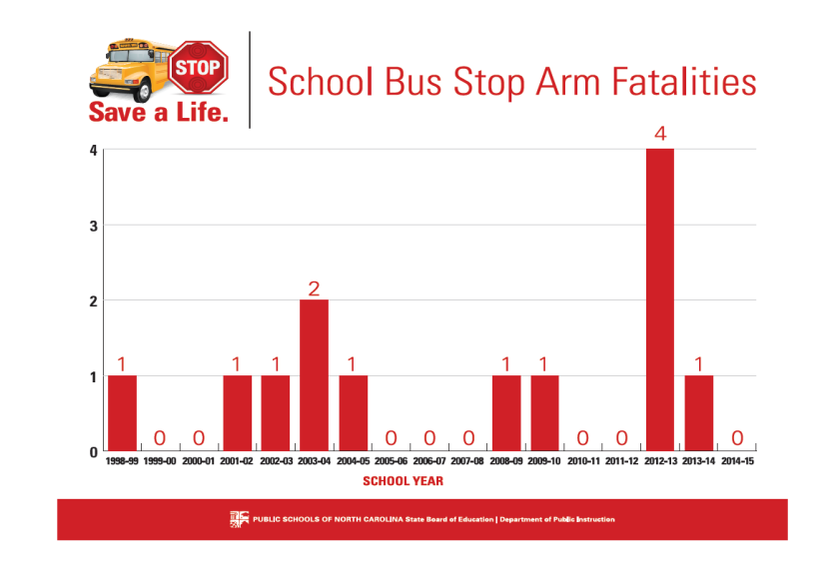
2014-15 zero fatalities – 8 students injured by passing motorists
Notes:
Another example of why we need to do something different. Although we did not have any fatalities in 2014-15 , we had 5 different incidents involving the injury of 8 students due to passing motorists:
9/30/14 One student injured - 11 years old – hit by passing motorist – 16 year old student driver (AM)
10/2/14 Two students injured – 5 and 10 years old – hit by passing motorist – 27 year old unlicensed driver (AM)
12/12/14 One student injured , airlifted to hospital in Charlotte– 17 years old – hit by passing motorist – 72 year old driver (AM)
12/19/14 Three students injured, two airlifted to hospital– 9, 10 and 15 years old – hit by passing motorist – 85 year old driver (AM)
3/25/15 One student injured, airlifted to Duke University Medical Center– 14 years old – hit by passing motorist – 33 year old unlicensed driver (AM)

Slide 10
NORTH CAROLINA CROSSING SIGNAL
Effective January 1, 2016 North Carolina school districts will be using a standard crossing signal to help protect students when they need to cross the street to board the bus or after exiting the bus.
A driver signal is recommended in the National School Transportation Specifications & Procedures Book
The Federal Commercial Driver’s License Manual includes in their procedures a drivers signal
Notes:
At the national level, and in most states, there is a signal that drivers must use, and students must follow, that tells students when it is safe to cross.
Vehicles passing stopped school buses while their red warning lights are on is an epidemic across the United States. There are success stories, all of which include getting the students attention prior to crossing the street. They include a drivers signal and instructing the students daily about the dangers of even stepping off the bus.

Slide 11
Liability concerns
Everyone has potential liabilty – mainly if they do not do their jobs right. We have it now and this process does not change it.
When a driver is negligent in their duties, they become liable
Because it is recommended nationally, we’re liable if we don’t have a crossing signal
Notes:
Drivers must follow required procedures. As long as they do, they will not be liable for something that happens. If a student is crossing the road, and the driver has followed all the procedures, and a car comes flying around the bus and the driver would not have been able to see it, they would not be liable…the did everything they were required.
If the driver did not follow procedures and a child was struck, they may be liable because they did not do everything possible to prevent the accident.
Because it is a national recommendation, both in the National School Transportation Specifications & Procedures Book and the Federal CDL manual, we all would be liable if we did not follow those recommendations.

Slide 12
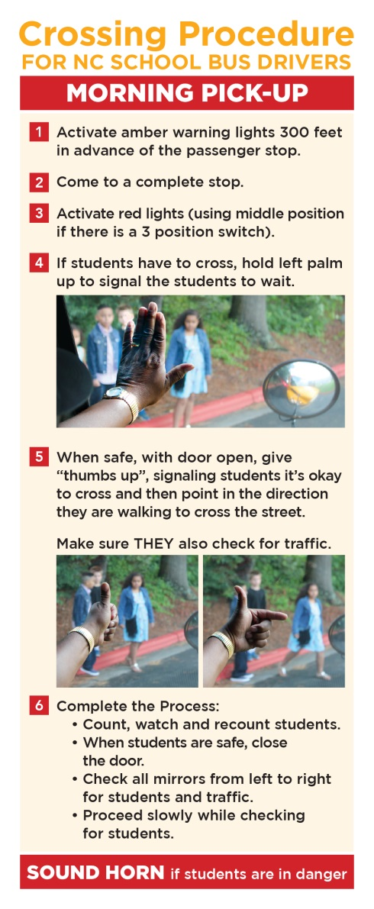
Drivers Morning instructions Card
Activate amber warning lights 300 feet in advance of the passenger stop.
Come to a complete stop.
If students have to cross, hold left palm up to signal the students to wait.
Activate red lights (using middle position if there is a 3 position switch).
When safe, open door, give “thumbs up”, signaling students it’s okay to cross and then point in the direction they are walking to cross the street. Make sure they also check for traffic.
Count, watch and recount students.
When students are safe, close the door.
Check all mirrors from left to right for students and traffic.
Proceed slowly while checking for students.
IF IT IS DARK, TURN ON INTERIOR LIGHT SO STUDENTS CAN SEE YOUR SIGNAL
Notes:
Expanded instructions for Drivers. Crossing Procedure for North Carolina School Bus Drivers
Morning pick-up
• Activate amber warning lights 300 feet in advance of the passenger stop.
• Come to a complete stop.
If students have to cross, hold left palm up to signal the students to wait.
Activate red lights (using middle position if there is a 3 position switch).
• When safe, open door, give “thumbs up”, signaling students it’s okay to cross and then point in the direction they are walking to cross the street. Make sure they also check for traffic.
• Count, watch and recount students.
• When students are safe, close the door.
• Check all mirrors from left to right for students and traffic.
• Proceed slowly while checking for students.
This slide should be discussed step by step

Slide 13
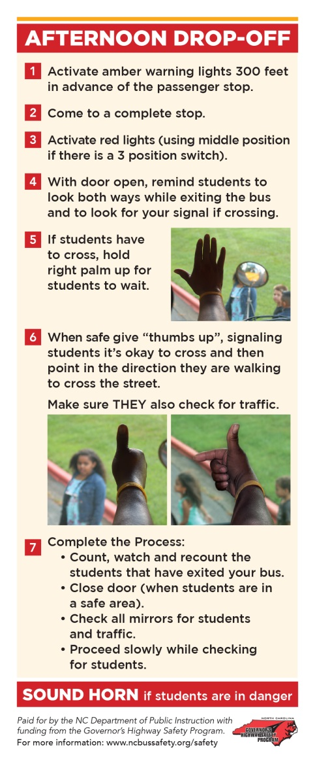
Drivers afternoon instructions card
Activate amber warning lights 300 feet in advance of the passenger stop.
Come to a complete stop.
Activate red lights (using middle position if there is a 3 position switch).
If students have to cross, remind them to walk away from the right front of the bus in full view of the driver, going past the extended bus crossing arm and wait for the drivers signal
When safe open door.
Remind students to look both ways while exiting the bus.
Hold right palm up for students to wait.
When safe, open door, give “thumbs up”, signaling students it’s okay to cross and then point in the direction they are walking to cross the street. Make sure they also check for traffic. Students should stop before stepping away from lane the bus is in.
Count, watch and recount the students that have exited your bus.
Close door (when students are in a safe area).
• Check all mirrors for students and traffic.
• Proceed slowly while checking for students.
IF IT IS DARK, TURN ON INTERIOR LIGHT SO STUDENTS CAN SEE YOUR SIGNAL
Notes:
Expanded instructions for Drivers. Crossing Procedure for North Carolina School Bus Drivers
Afternoon drop off
Activate amber warning lights 300 feet in advance of the passenger stop.
Come to a complete stop.
Activate red lights (using middle position if there is a 3 position switch).
If students have to cross, remind them to walk away from the right front of the bus in full view of the driver, going past the extended bus crossing arm and wait for the drivers signal
When safe open door.
Remind students to look both ways while exiting the bus.
Hold right palm up for students to wait.
When safe, open door, give “thumbs up”, signaling students it’s okay to cross and then point in the direction they are walking to cross the street. Make sure they also check for traffic. Students should stop before stepping away fro lane that the bus is in.
Count, watch and recount the students that have exited your bus.
Close door (when students are in a safe area).
• Check all mirrors for students and traffic.
• Proceed slowly while checking for students.
This slide should be discussed step by step

Slide 14
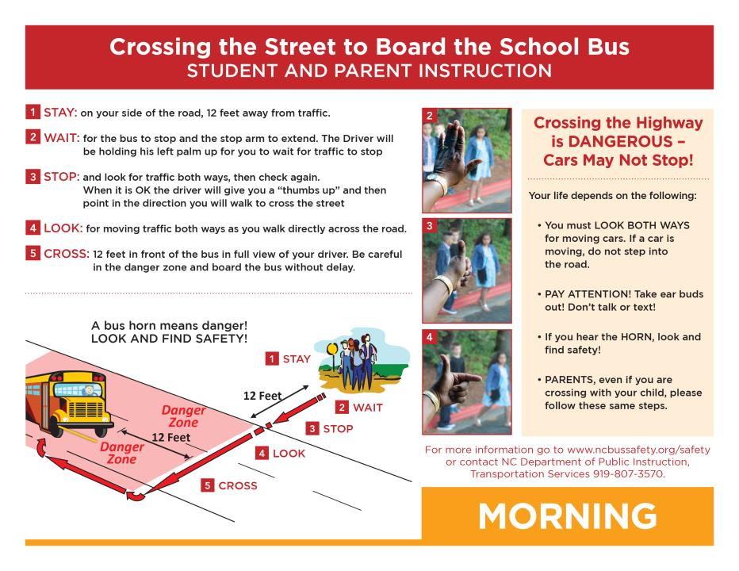
What the students will be taught - am
Notes:
It is important to let the drivers know that if the students do not follow the procedure, the should speak to their supervisor or the principal of the school, or report them as instructed by your LEA.
This slide should be discussed step by step

Slide 15
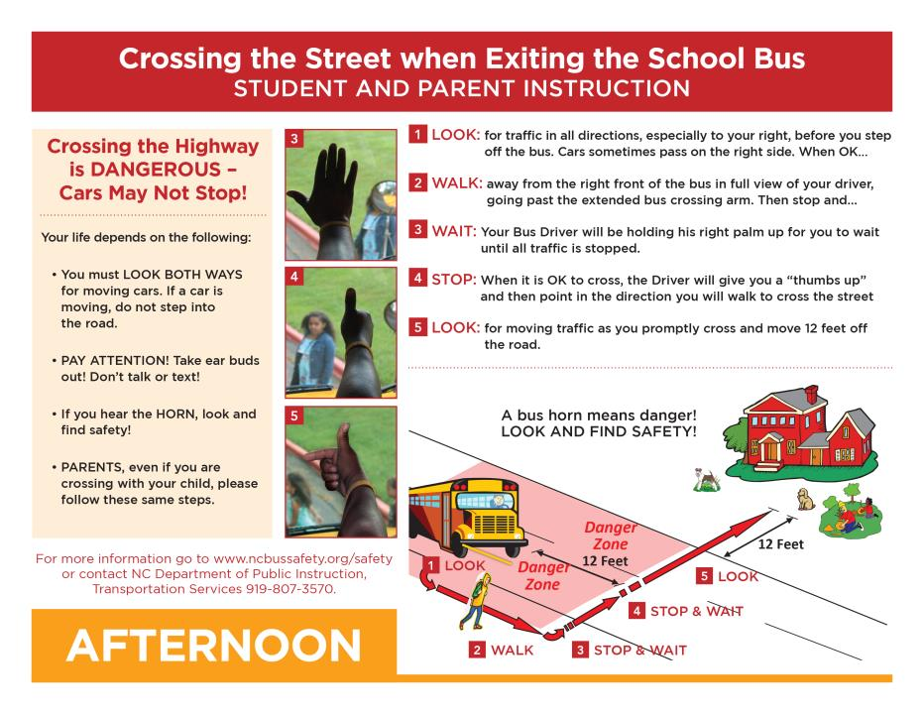
What the students will be taught - PM
Notes:
It is important to let the drivers know that if the students do not follow the procedure, the should speak to their supervisor or the principal of the school, or report them as instructed by your LEA.
This slide should be discussed step by step

Slide 16
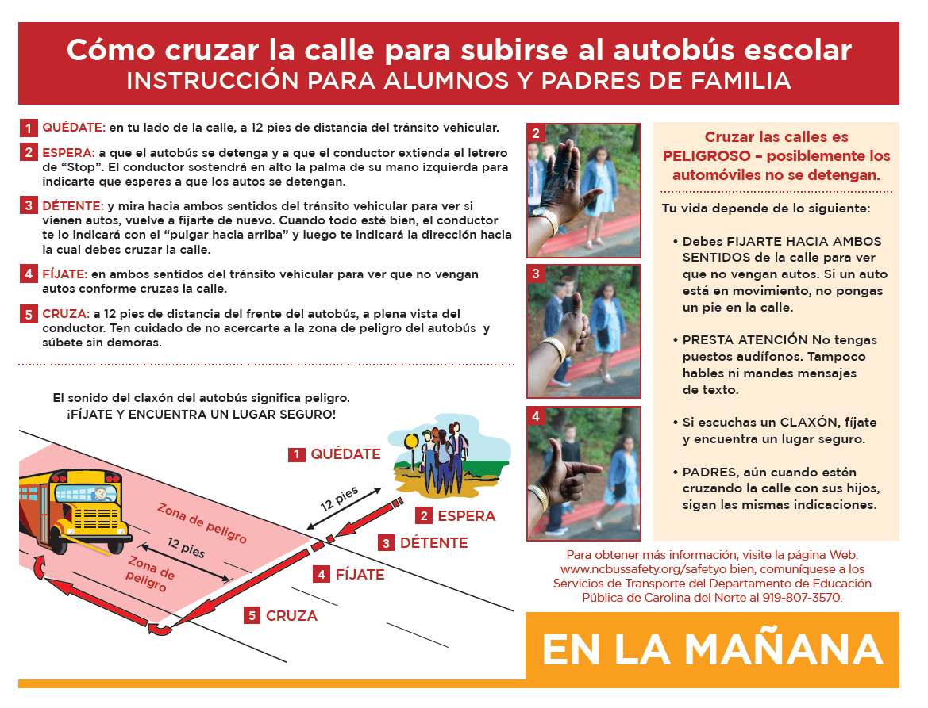
en español

Slide 17
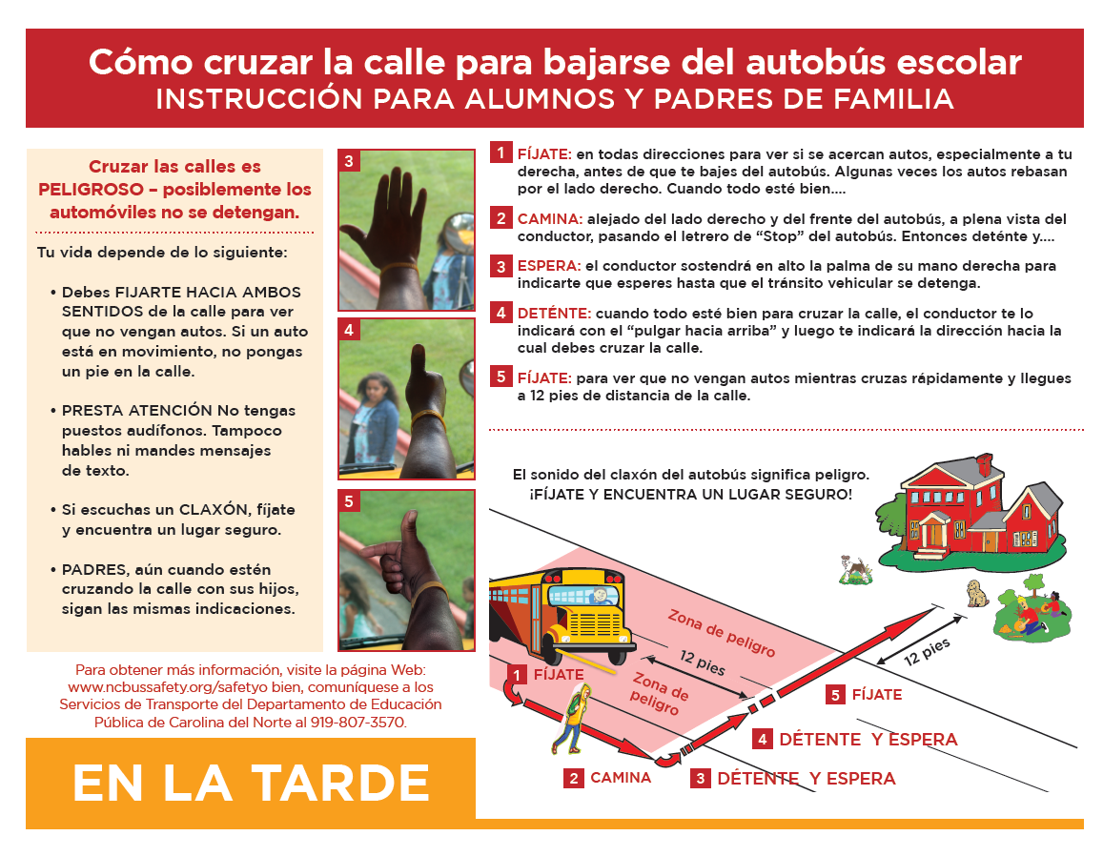
en español

Slide 18
Getting the students attention
A key to the crossing signal is the fact that you are getting the students attention.
If students are wearing earbuds/headphones, or are talking on the phone, or are texting, the Driver does not have their attention.
#BRAKE4BUSES
Notes:
The “#BRAKE4BUSES” video is another 30 second PSA that supports the notion of the student must pay attention, as well as the motorists must stop.

Slide 19
Getting the students attention
We must take every step to protect the students we transport
We cannot control the other motorists, we can do everything we can to make them aware of the dangers of passing a stopped school bus
We can emphasize, day after day, at each bus stop that the student must look both ways exiting the bus, then continually when crossing the road and that they look at the driver to get the signal to cross.
WE NEED THEIR ATTENTION TO MAKE SURE THEY PAY ATTENTION!

Slide 20
Thank you please continue to do all you can this year to protect our precious cargo
BUS DRIVER TRAINING
NC Department of Public Instruction
August, 2015

